Slide 1



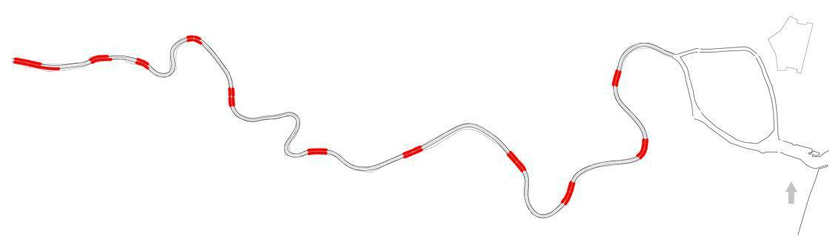
Master Thesis 2018
Research Master Planning and Sustainability: Urban and Regional Planning
URBANIZATION AND ITS INFLUENCES ALONG WITH COOUM RIVER:
For the situation of Chennai Flood
BY DIVYA DHANDAPANI
Supervisor: Professor José Serrano

Slide 2
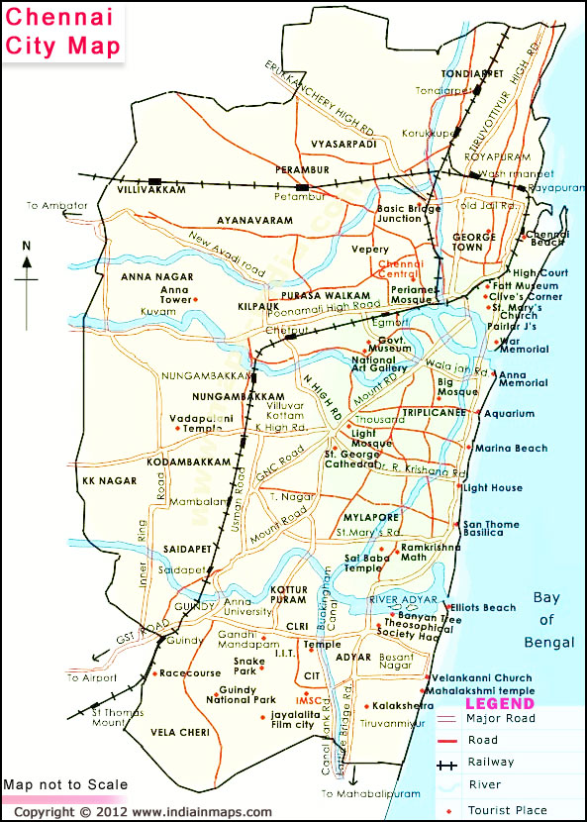
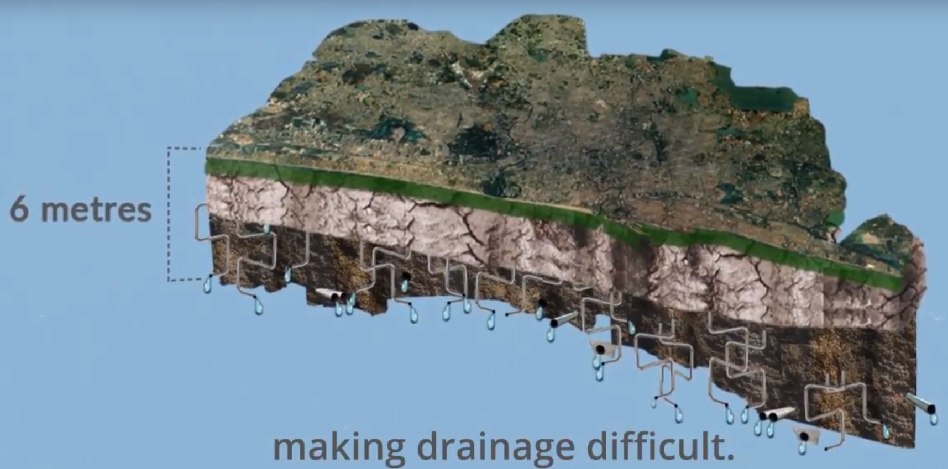
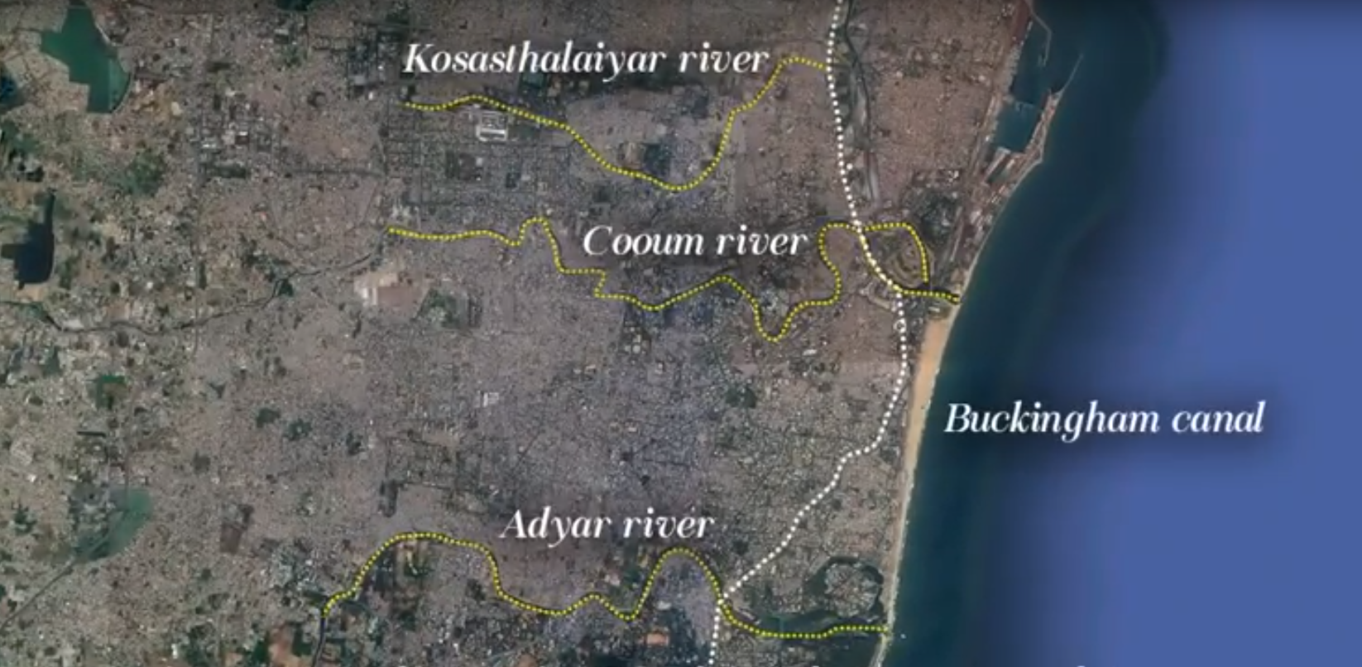
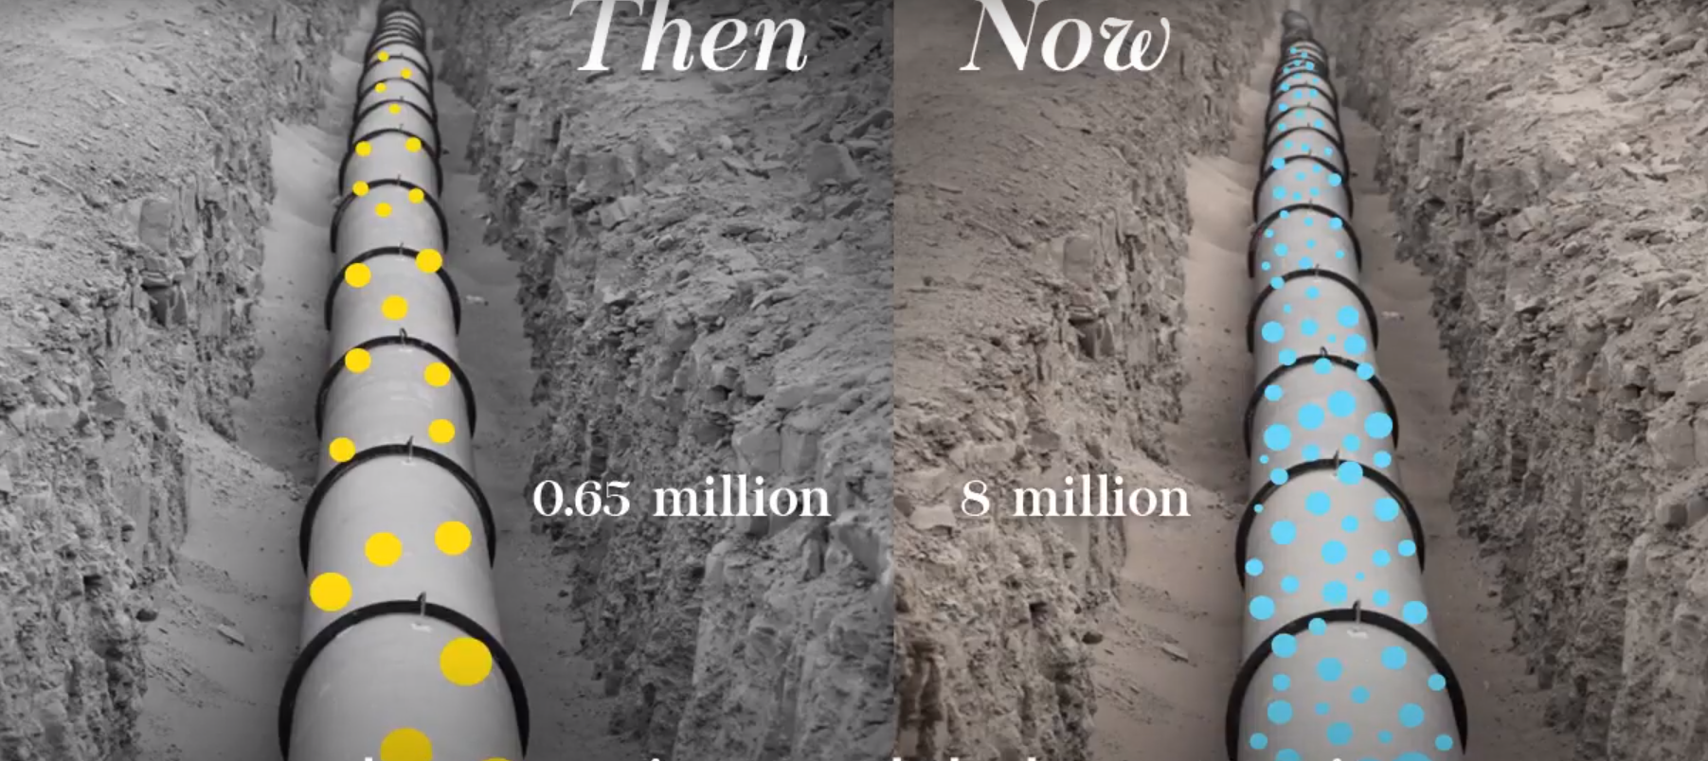
Chennai is the 4th largest city with population around 4.7 millions situated along the bay of Bengal sea.
Chennai is a low-lying area and the land surface is almost like a pancake. The elevation variation within Chennai district varies between 0 to 11m, with mean elevation being about 6m.
Most of the localities are just at sea-level and drainage in such areas remains a serious problem. Chennai City has experienced major flooding during 1943, 1976, 1985, 1996, 2005 and 2015.
The rapidly growing population and urban growth of Chennai today causes several pollution in the city.
The sewage system in Chennai was originally designed
for a population of just over half a million at 114 litres per capita per day of water supply .Today, the population of Chennai is pushing 8 million, that stated poor carrying capacity of water.
The sewage system is upgraded in early 1990s but remains much below capacity

Slide 3
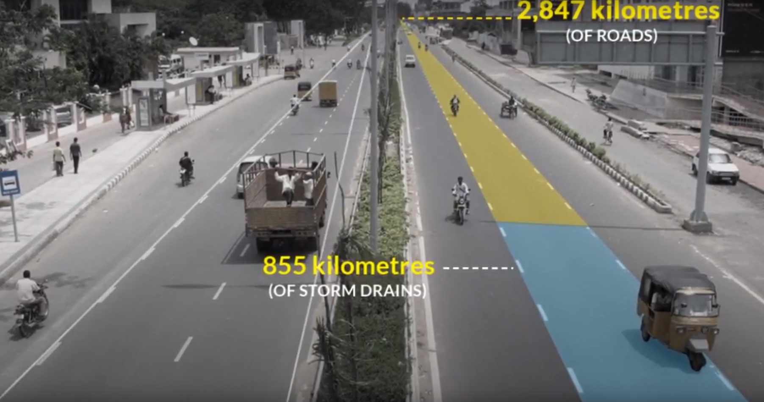
The city has only 855 k.m storm drains again 2,847 K.m of roads
The level of congestion on major arterial roads has increased eightfold in less than 20 years.
Waste disposal along public area ,dumped openly without preventive measure ,near water bodies of water like river and wetland, due to demographic explosion there is poor sanitation network for the treatment of wastewater.
All that shouldn’t have mattered as much because Chennai is blessed uniquely with an excellent natural drainage system with Kosasthailaiyar river in the north ,Cooum river flowing through the centre and Adyar river in the south and 24 macro drains Chennai was well sorted.
There is Buckingham canal too once a crown jewel but I’ll come to that in a moment.
The Cooum River is about 65 km long, including 18 km in Chennai which divides the city horizontally into two parts, and the Adyar River is 42 km long and 15 km in the city before flowing into the bay of Bengal which divides the southern part., these three rivers are extremely polluted mainly because of the wastewater discharged there from industries, formal and informal residential areas, commercial spaces and storm water.

Slide 4
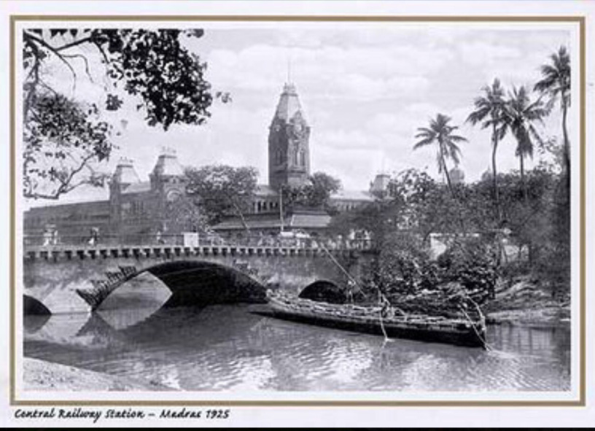
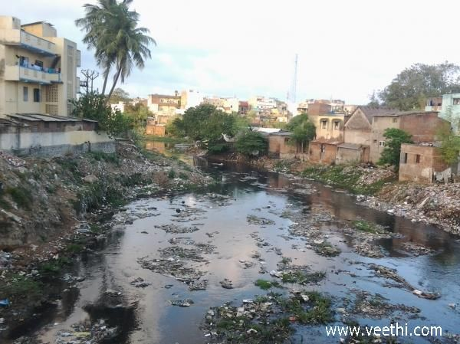
Cooum river origin from Kesavaram dam(kallur river),thiruvallur District and ends under Napier bridge towards to sea.
Cooum river runs 64 km totally from thiruvallur District which splits 32km under urban area rest towards villages, In Chennai district, the river flows through three corporation zones—Kilpauk, Nungambakkam and Triplicane—for a total length of 16 kilometres .
Historically, it was clear water which is also used for drinking, fishing and trading etc., and also named as Thames river by British people .
Unpolluted :It is still using for drinking ,fishing, farming from kesavaram to thiruverkadu (Paruthipattu Anaikat).
Polluted :Paruthipattu Anaikat to the River Mouth in Bay of Bengal.
The total catchment area of the river is about 400 square kilometres (150 sq mi), and the bed width ranges from 40 to 120 metres (130 to 390 ft).

Slide 5
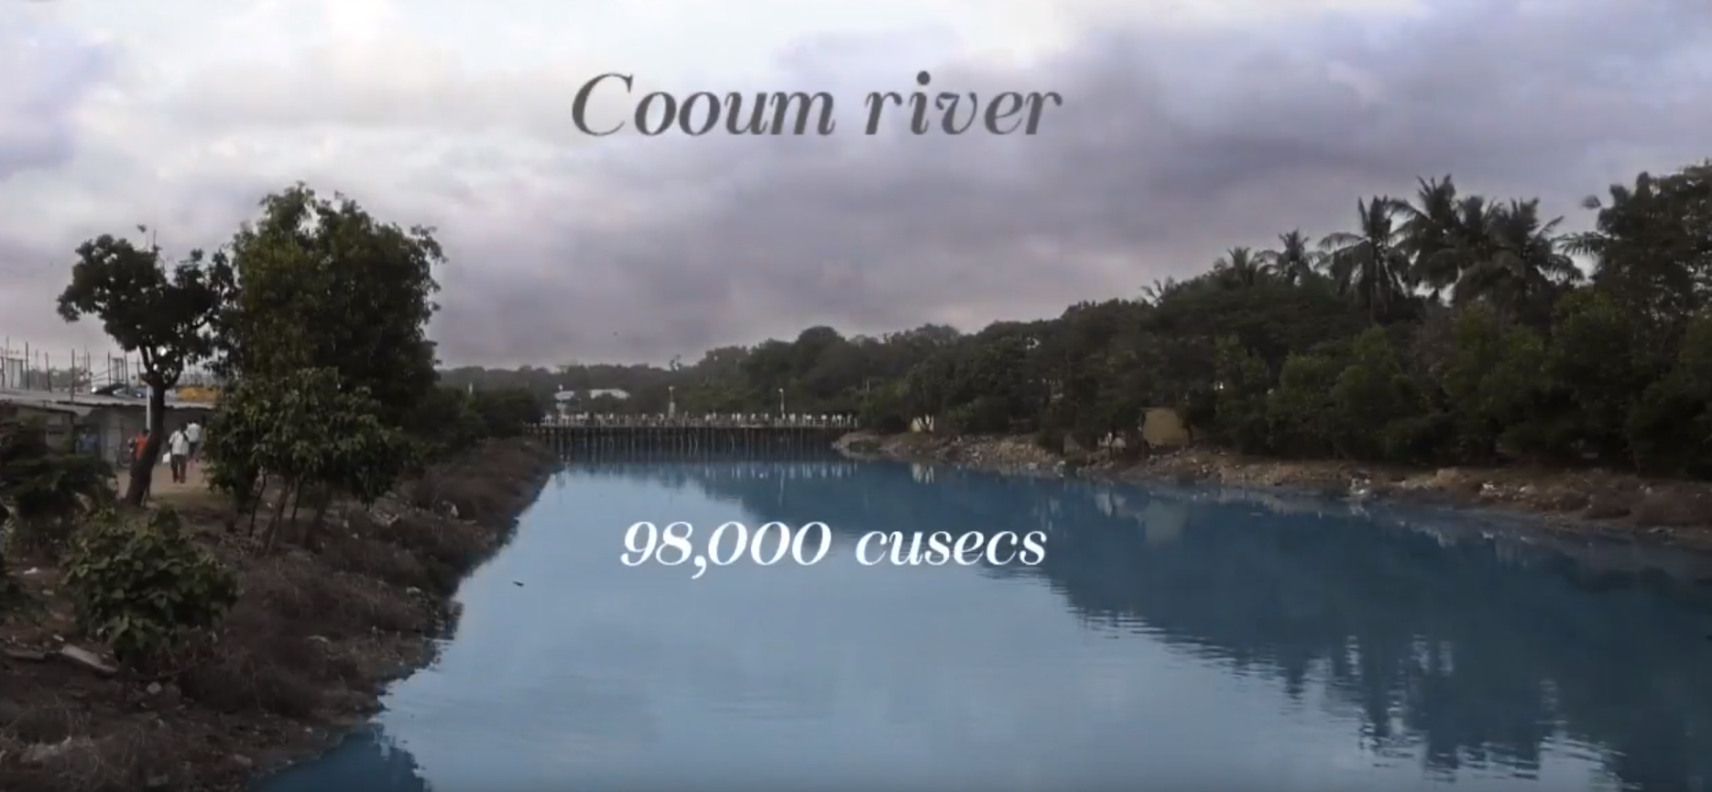
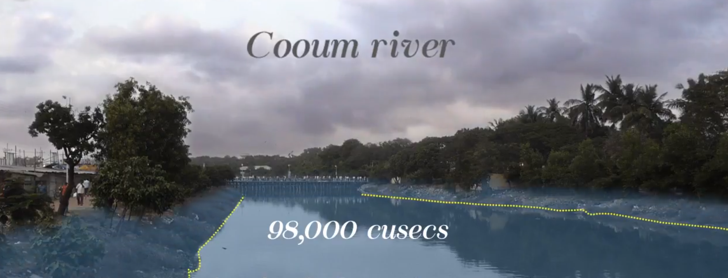
Cooum river carried 98,000 cusecs of water and the coovum river does not have that kind of carrying capacity .
So suddenly all the entire adjacent area, the neighbourhood of these rivers are flooded.
Number of capacity treatment plants exists lower compared to amount of wastewater generates.
Cooum River in Chennai the natural spine of the city has got contaminated due to rapid urbanization and industrial edge. I hereby argue that this river has to be restored with its real charm and convert it into an urban public space, which is important because Cooum River acts as a flood carrier for the city and a water source for the surrounding area. This can also be a mode of transportation connecting important areas in Chennai city.
The River Cooum, once a freshwater source is today a drainage course collecting surpluses of 75 small tanks of a minor basin. The length of the river is about 65 km, of which 18 km, fall within the Chennai city limits. This once fishing river & boat racing ground has borne the brunt of the city's population explosion.
The water quality as we are all aware is bound to degrade progressively as the river takes the untreated sewage but unable to flush it into the sea.
Even if the planners succeed in limiting the disposal of untreated sewage at some point in future, the water discharge in the river is insufficient to improve the water quality
The purpose of this study is to explore means of enhancing the flushing capability through appropriate engineering intervention as there is little scope for natural flushing.
Unpolluted: It is still using for drinking, fishing, farming from kesavaram to thiruverkadu (Paruthipattu Anaikat). Polluted: Paruthipattu Anaikat to the River Mouth in the Bay of Bengal.

Slide 6
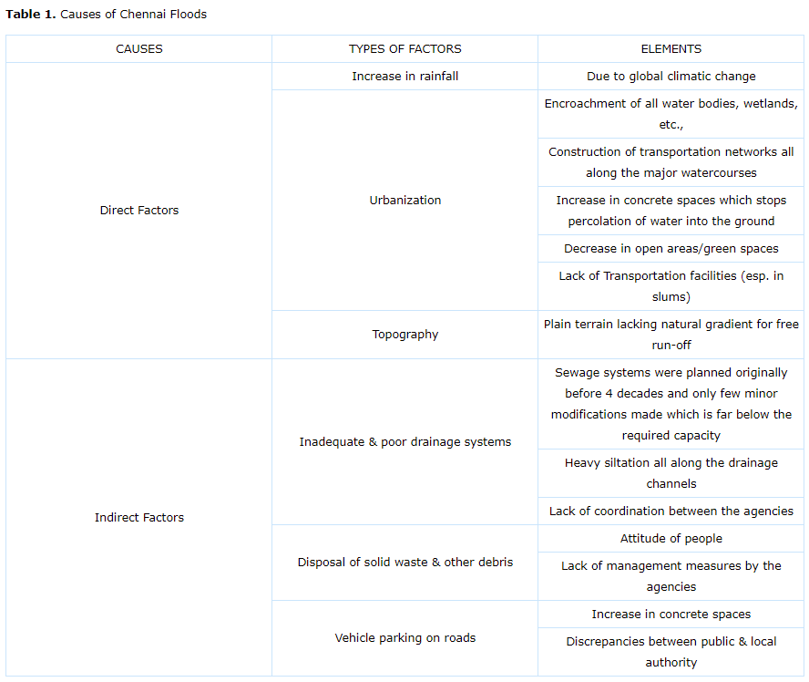
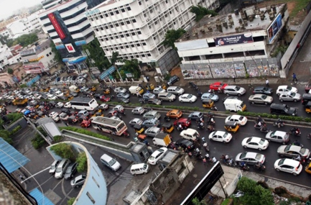
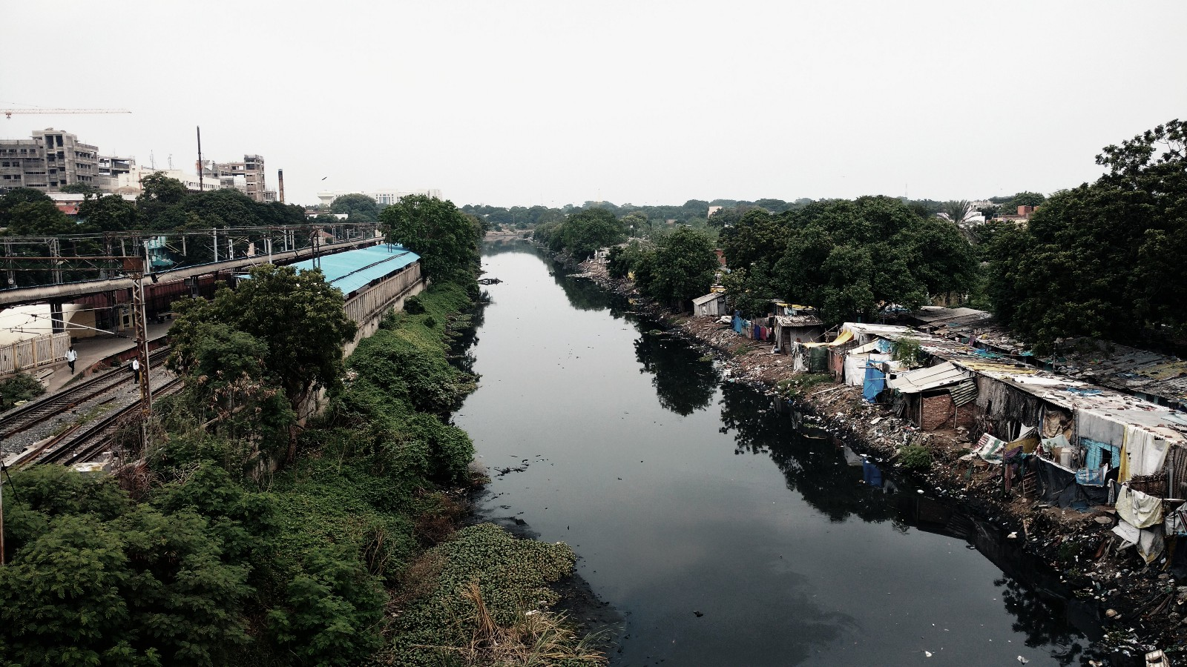
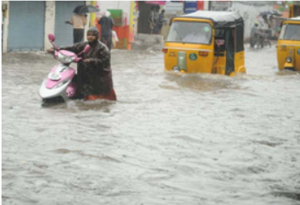

Slide 7
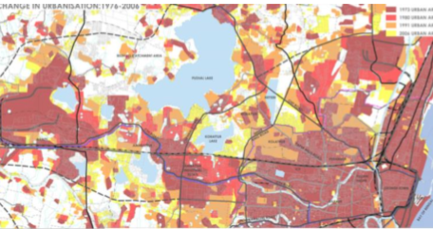
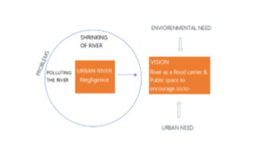
MASTER PLAN & FLOOD MITIGATION IN CHENNAI
The development of Chennai did not happen in a managed way nor did it relate to the accessible framework offices. Chennai needs regular slope with the expectation of complimentary spill over which shows the need of a successful storm water waste framework. The sewage framework in Chennai was initially intended for the number of inhabitants in 0.65 million at 114 l for each capita every day of water supply (additionally altered amid 1989 – 1991) which is presently wasteful as it is underneath the required limit. The two Rivers Chennai, Cooum, and Adyar are relatively stable and don't convey enough water with the exception of amid downpours when they assume a noteworthy part gathering surplus water from around 75 and 450 tanks, in their individual catchments amid surges. Buckingham Canal, worked by the British, initially a route channel and conduit, now serves just as a seepage channel. Chennai being a seafront city is immersed with low-lying zones which have an eco-delicate association with the water driven arrangement of the city.
URBAN ISSUES TOWARDS AN ACKNOWLEDGEMENT OF THE STREAM

Slide 8
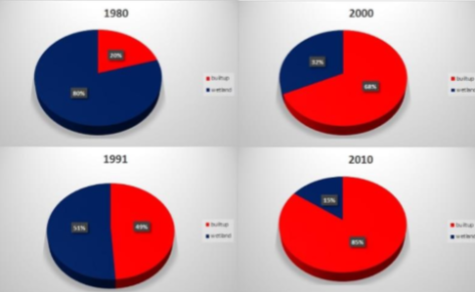
Urban Issues
SHRINKING OF RIVER: ENCROACHMENTS
River edges are encroached by slums and squatters, which are washed away by the past flood and knowing the risk people still settles down along the edges. River edges are also occupied for small scale industrial use and activities such as car parking, motor vehicle workshops, car wash and etc.
WETLAND AND BUILT-UP LAND OF CHENNAI METROPOLITAN AREAS
80% of Chennai was wetland in 1980s, now 15%

Slide 9
METHODOLOGY OF THE RESEARCH THESIS
The rapid industrialization and urbanization of Chennai city and the River banks have led to severe contamination of the Rivers. They are mostly polluted due to disposal of sewage and solid wastes. However the two natural Rivers Cooum and Adyar are not at the same stage of pollution. The Cooum River is much more polluted than the Adyar River (The Hindu, September 2011). Moreover the Cooum River surroundings are denser and urbanized areas, with less free spaces along the Riverbanks compared to the Adyar River. Also the Adyar River was for a long time a barren land, then become the southern limit of the city, and now the urbanization has even expanded further south.
Finally the beginning of the research was also focused on a project of integrated Cooum ecorestoration at Cooum River, The project has been launched by the government and implemented by external consultants (Still under process).
PROBLEM STATEMENT AND HYPOTHESIS
Based from a theoretical corpus (interviews, thesis, books, articles, documents available online), my statement is that most parts of the population of Chennai are taking into consideration the pollution on water bodies. Again the Government has taken measures and implemented projects to address the issues on the Cooum River’s pollution. To me, it demonstrates a situation in Chennai and reason behind the flood. Also if the restoration of the Cooum River is pursued on the whole stretch, a movement of Riverfront development in Chennai might happen later. I assume that there is no awareness among the general public and governing body of the column as well as the Chennai development authority regarding the importance of the control of various factors affecting the colour River as one among illegal settlements along the column River and importance of recycling the routing of the sewage generated in the city on day to day basis. And increasing the carrying capacity of the Cooum River which is in the hands of the PWD and CMDA as well as the PCB who are all the most important governing bodies of the Cooum River.
The hypothesis will be verified by looking at the governmental measures, the Riverfront projects, and the ecological restoration projects, by exploring the discourse of newspaper, analysing the discussions with the different parts of the society of Chennai, investigating on the direct site the happenings, and examining theses about the Cooum River in various fields (chemistry, biology, planning, and architecture).

Slide 10
RESEARCH QUESTION
The study is also to answer the research question,
● Does urbanization along the Cooum River reduce carrying capacity of water which leads to the impact of flood and does poor governance forgot to maintenance the urban River and thus results in less carrying capacity of the Cooum River?
‘We have forgotten the art of drainage. We only see land for buildings, not for water’. Chennai is perhaps experiencing the worst impact of freak weather, but the city could have fared better had it protected and preserved its natural water bodies and drainage channels, experts at the Centre for Science and Environment (CSE) said. The unprecedented deluge that Chennai has been subjected to is a reminder of increasing frequency of such freak weather events across the Indian subcontinent, they said.
Talking regarding the matter, CSE chief General Sunita Narain stated: "We have more than once attracted consideration regarding the way that our urban sprawls, for example, Delhi, Kolkata, Mumbai, Chennai, Srinagar and so forth have not given careful consideration to the regular water bodies that exist in them. In Chennai, every one of its lakes has a characteristic surge release channel which depletes the overflow. In any case, we have worked over huge numbers of these water bodies, hindering the smooth stream of water. We have overlooked the craft of waste. We just observe arrive for structures, not for water."

Slide 11
JUSTIFICATION OF THESIS
Loss of Water Bodies
Lack of Storm water Drains
Absence of wetlands
Poor administration of Cooum River
C. N. Annadurai propelled a Cooum Improvement Scheme at a cost of ₹ 19 million in September 1967 ₹ 12,000-million Chennai City River Conservation Project (CCRCP) in January 2001.
In 2010, the Tamil Nadu government marked a MoU with Singapore Cooperation Enterprise (SEC), a Singapore office for the reclamation venture. In 2011 The World Bank has endorsed Rs 22.41 crore for the Cooum reclamation venture towards the advancement of its water system potential. In 2012, the administration distributed ₹ 3,000 million towards the development of 337 sewage cleaning frameworks in the conduits in the city, incorporating 105 areas in the Cooum River. So Politicians are attempting over and over, yet till date, Cooum reclamation venture isn't done because of the poor support of the administration.

Slide 12
STUDY AREA AND SITUATION OF COOUM RIVER
The River depletes a catchment of around 290 km2, including around 140 tanks or stores (Gowri, 1997:43). Inside the city, the River's channel ranges from around 170-180 meters wide close to the mouth with the River itself representing 140-150 meters of this, to a channel width extending between around 45 and 100 meters and the River itself changing in the vicinity of 25 and 60 meters (Mott MacDonald, 1994, Table 5.12:49). This River has been depicted as a "sluggish stream" which is relatively dormant and which conveys little water aside from amid the rainstorm. It has additionally been noticed that the Cooum "gets a sizeable amount of sewage from its neighbourhood for transfer" (Government of Tamil Nadu, 1981:10).
Recently the state of conduits in Chennai has turned into an issue at the more elevated amounts of the State and Central governments. In mid 1999 the Government of Tamil Nadu declared 3 "Thousand years Projects" went for rebuilding and change of the conduits in Chennai, and financed by Rs. 300 crore (roughly USD 71 million) in credits from HUDCO. These will include (1) The improvement of a Master Plan and the arrangement of offer reports for the advancement of Chennai conduits for route, entertainment and abuse of land potential; (2) The evacuation of sand bars hindering the outlets of the Cooum and Adyar Rivers; and (3) Sediment and slime expulsion and the resettlement of ghetto tenants. By February 1999, 37 organizations had reacted to offer on the first of these undertakings, and 7 organizations had reacted to the second, while the third had not yet opened for offering (Hindu, 1.2.1999:3). Also, the Ministry of Environment and Forests, Government of India, is attempted an assessment of "logical and building" parts of tasks related with a proposition, declared in January of 2000, of a 800 crore (USD ~184 million) push to clean Chennai conduits (Hindu, 1.10.2000). Hence, not exclusively is the circumstance of the Cooum River and environs a basic natural issue, however it is additionally an auspicious one for this program of research. There exists a chance to add to endeavours to address the issues of the Cooum and different conduits in the city. It is in light of this that the accompanying areas of this part present the approach attempted in this examination and the objectives of the Cooum River.

Slide 13
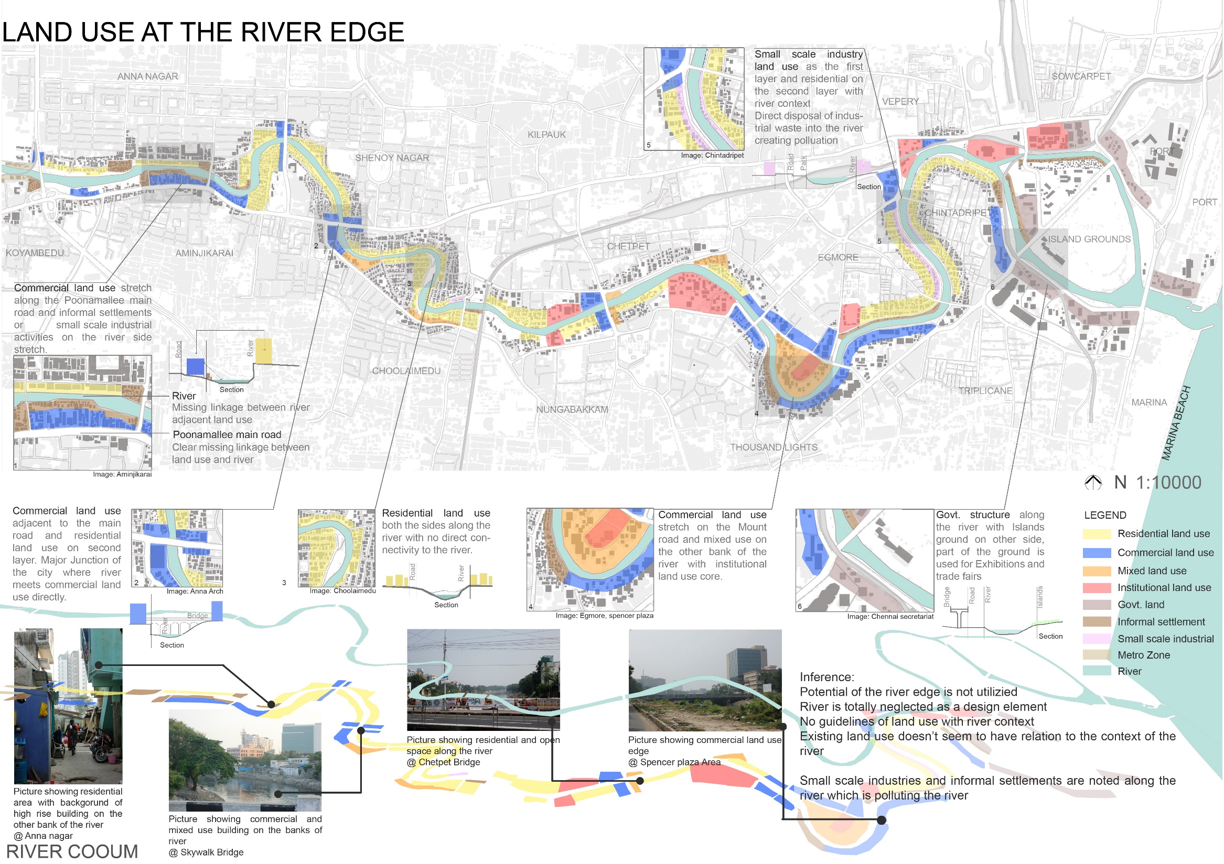

Slide 14
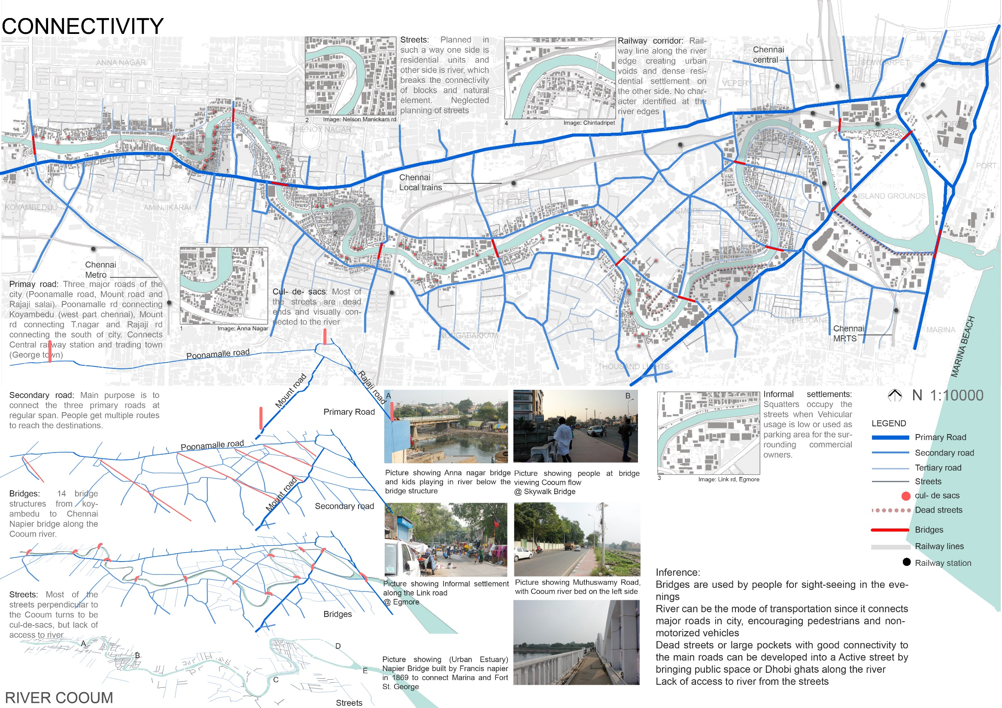

Slide 15
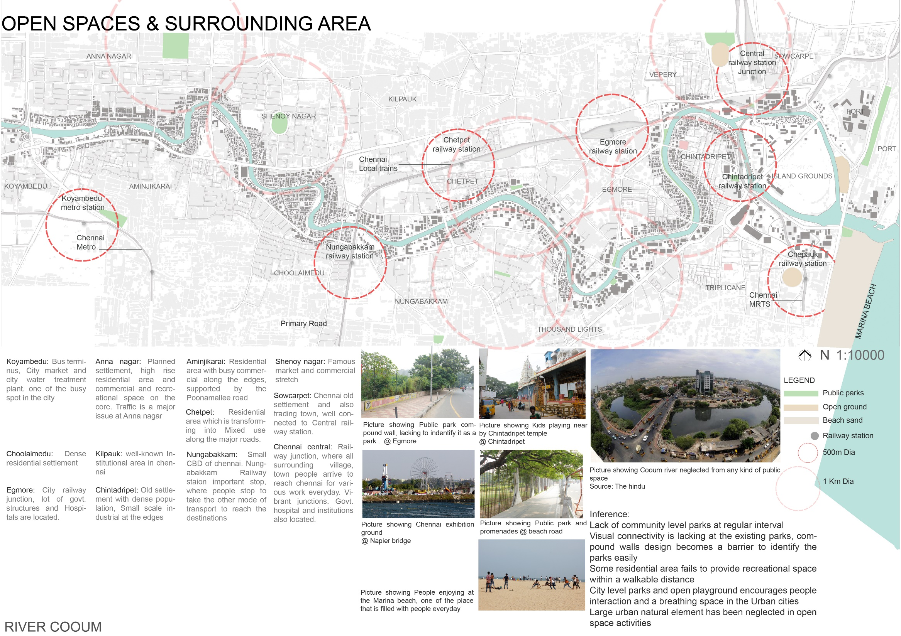

Slide 16
SLUMS IN CHENNAI
Chennai is evaluated at the fourth position as far as ghetto populace of India. The city is home to 820,000 ghetto individuals (Census 2001) living in ghetto conditions. A large portion of the ghetto homes are along the water bodies, for example, Adyar River, Cooum River, Buckingham Canal and other open spaces.
A ghetto, as characterized by the United Nation office UN-HABITAT, is a run-down territory of the city described by substandard lodging and griminess and ailing in residency security. As per the United Nations, the level of urban occupants living in ghettos diminished from a monstrous 47 percent to 37 percent in the creating scene in the vicinity of 1990 and 2005. Be that as it may, because of rising populace, and the ascent particularly in urban populaces, the quantity of ghetto occupants is rising. One billion individuals overall live in ghettos and the figure is anticipated to develop to 2 billion by 2030.
The term has customarily alluded to lodging territories that were once moderately prosperous yet which disintegrated as the first occupants proceeded onward to more up to date and better parts of the city, yet has come to incorporate the immense casual settlements found in urban areas in the creating scene. In spite of the fact that their attributes differ between geographic districts, they are generally occupied by the plain poor or socially impeded. Ghetto structures change from straightforward shacks to perpetual and very much looked after structures. Most ghetto needs clean water, power, sanitation and other essential administrations.
Slum Formation
• Slum idea framed amid industrialization. There is no ghetto at first be the fore development of industrialization in light of the fact that there was no urban or country contrast be the fore mechanical transformation. • The whole world was total them to approach of modern upset and revelation of different missions ventures began going. • The mechanical preliminary upset changed families and way of life of urban needy individuals.

Slide 17
Slum Control Board (TNSCB)
Tamil Nadu Slum Clearance Board was set up in September 1970 and has been actualizing different Housing, Slum Development and Rehabilitation and Resettlement projects to improve the living states of the ghetto families in Tamil Nadu. The Board at first began its exercises in Chennai and its exercises were bit by bit reached out to other urban territories of Tamil Nadu from 1984 onwards in a staged way.
DEVELOPMENT CONTROL BOARD (CMDA) (Chennai Metropolitan Development Authority)
Unlawful Construction, Encroachments Make Chennai Vulnerable To Heavy Rain
Multi year after gigantic surges destroyed Chennai and remaining 17 lakh individuals without homes, a board of trustees of MPs has faulted infringements of lakes and River quaint little inns town arranging. In its report, the parliamentary advisory group has suggested activity against the "land mafia and infringements". In any case, the express government's drive against unlawful developments, propelled a year ago while the city was endeavouring to recuperate from the surge, appears to have come up short on steam.
SEWAGE AND WATER SUPPLY BOARD (CMWSSB)
The city, much to its disgrace, has three dead and contaminated Rivers – the Cooum, Adyar, and Kosathalaiyar, which navigate it to stream into the Bay of Bengal. Be that as it may, this isn't all the water abundance of the city. Chennai is befuddled with trenches and spotted with lakes and other water bodies. As indicated by the City Development Plan, arranged for the halfway supported Jawaharlal Nehru National Urban Renewal Mission (JNNURM), there are upwards of 320 tanks and lakes inside the city's limit

Slide 18
WHY CHENNAI’S WATER BODIES POLLUTED?
The unavoidable issue is, the reason do these Rivers and waterways remain so contaminated when the city has a close impeccable reputation in water and sewerage provisioning? Additionally critical to note here is that Chennai has gotten the single greatest piece of the cash under the National River Conservation Program – exactly 11 percent of the authorized expenses till 2005 – for cleaning of its Rivers. The Adyar and Cooum together were authorized 15 percent of the River cleaning spending plan of the whole nation.
The key issue in Chennai is that the city is arranging with the supposition that its close immaculate sewerage scope, pumping and funnelling plan will effectively catch all its wastewater. In this manner, its whole program for River cleaning is centred on putting resources into building and enlarging sewage treatment limit; expanding the length of the underground sewage system, and adding to pumping and funnelling limit.
GOVERNMENT PROJECTS AND BUDGET ALLOCATION
The Tamil Nadu government would spend Rs 3,833.62 crore for its goal-oriented program of re-establishing the Cooum River, which has turned into a sewage transporter in the course of the most recent four decades, to its unique magnificence. The monstrous task, with a course of events of five years, would be embraced by the Cooum River Restoration Trust (CRRT). The CRRT will keep on being the nodal office for the program.
The rising populace and quick extending framework apply a gigantic weight on the city condition. The task includes Rs 2,077.29 crore for alleviation and restoration of influenced families. In any case, an entirety of Rs 500 crore will be distributed for the monetary year 201415, the fund serve.
Chennai has three noteworthy conduits, including the Adyar, the Cooum, and the maninfluenced Buckingham to channel. The legislature, as a major aspect of the rebuilding, has initiated stopping of 179 sewage outfalls out of the distinguished 337 outfalls which contaminate the conduits at Rs 150 crore. The works will be finished by 2015 was said by the Chief Minister of that tim

Slide 19
FLOOD DECEMBER 2015 | FUND LOSS
The misfortune to the state and the general population from the rain and glimmer surges this upper east storm season may have crossed an amazing Rs 50,000 crore as of now. Furthermore, if the circumstance endures for the following couple of days, the aggregate money related misfortune could raise to an incredible Rs 1 lakh crore, a senior income official said. The authority went ahead to expand that the state's legitimate gauge of the rain harm crossed Rs 9,800 crore in the November downpours itself notwithstanding when such harm was limited for the most part to the state's framework with streets and boulevards broken while the harm to nationals' lives came generally in the cottages along the Cooum and Adyar Rivers being washed away. According to the TOI, (Times of India) Flood has influenced heaps of government properties and open lives and additionally the properties.
December 2015 Flood has achieved around misfortune 1 lakh crore which 4 times more noteworthy than the financial backing allotted for the Cooum rebuilding.
The administration of Cooum for cases the bodies sitting above the Cooum River isn't working legitimately is additionally one of the significant explanation for the Cooum venture on hold.
A ton of times reserves has been permitted and later the undertaking was not ready to execute because of different political and different reasons.

Slide 20
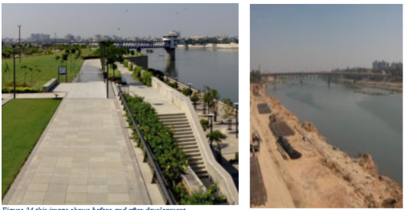
CASE1 : SABARMATHI RIVER FRONT
In spite of the water thought of the channels, India is in like way exhibiting vitality to the urban surges of the urban systems. The nation has taken endeavours for the patching up of water bodies, the CRZ headings keep the difference in exercises harming nature on the coastline and the inhabitants wish to esteem the Riverside with perspectives, gets to, and works out. Several urban systems in India in like way began to make waterfront of channels, for adding to the individual satisfaction in the majority of its perspectives like money related, social and social. It gives a separating contrasting option to the urban thickness that the prevailing piece of them are facing, by giving open and tremendous zones, and it permits another dynamism inside the city, a rebuilding system which can be gotten a kick out of by everybody
Recuperation of Slum Dwellers
Partner River to Community
An inspiration in light of different setting and condition1
So also, it is essential to assess cash related, social and typical upgrades, along these lines engaging the undertaking to advance from the start with the demand indeed years and decades. For this just participatory is required amidst every time of the fundamental expert process. Not just the high genuine assistants should pick what they need to execute, something else, the undertaking will be at the cost of desperate people, the earth, and who and what is to come. At the at the present time, the Riverfront updates in India ideal position to arrive organizers and a section of the urban administrative class. The undertakings, isolated from the stream, go for commodifying the conductor and accomplish practical therapeutic changes of urban space

Slide 21
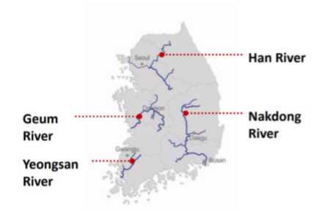
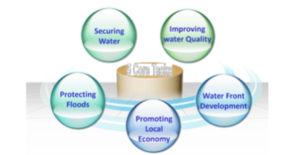
CASE 2 KOREA - THE FOUR RIVERS RESTORATION PROJECT
The undertaking is intended to address the huge natural difficulties looked by the Han, Nakdong, Geum and Yeongsan Rivers in Korea. Continued flooding and dry spells have caused human setbacks, biological system misfortune, and environment corruption, property harm and constrained relocation of Riverine inhabitants. Outrageous climate occasions that prompt flooding and dry spells are required to decline in recurrence and force because of environmental change impacts. On account of the Yeongsan River, harmful sullying from residential and mechanical waste transfer has brought about water quality levels unfit notwithstanding for agribusiness and modern utilize. These natural difficulties have emotional financial results. In Korea, instances of heavy precipitation more than 100 mm in multi day have expanded by 1.7 times amid the most recent 10 years. In 2002, Typhoon Rusa brought record-breaking precipitation of 870 mm daily in Korea. Also, exuberant precipitation is relied upon to increment by 2.7 times and dry seasons are required to wind up 3.4 times more successive sooner rather than later. The yearly normal precipitation of Korea is 40% more prominent than the world normal. Be that as it may, the measure of water accessible per capita in multi year is just around 12% more noteworthy, in light of the fact that 66% of the yearly precipitation happens amid the stormy season from June to September, and no rain happens in the dry season.

Slide 22
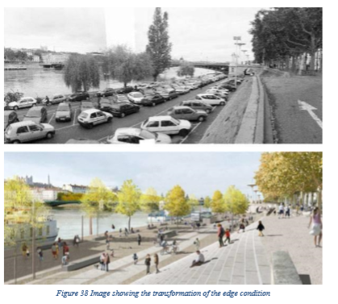
CASE 3
THE LYON RIVER BANK, FRANCE
Length: 5 km
Site area: 10ha
Project: Local authority
Study Synthesis:
• Design proposal to improve the connectivity and linkages to the river and change to an active spot.
• Removing parking and visual barrier along the river edge and provide a design to improve the access to the river edge
• Provided with Non- motorized pathway such as bicycle lane, pedestrian pathway and Public Square along the river.
• Encouraging the recreational activity for the surrounding area and develop the ownership sense for the users

Slide 23
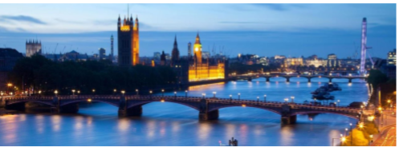
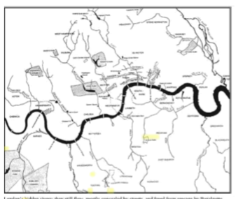
CASE 4 THE THAMES RIVER, LONDON
River Length: 346 km
River Width 252mts
Chief Engineer: Sir Joseph Bazalgette
The waterway Thames was proclaimed as the Dead River and the 'Incomparable Stink' loaded with smudged and causing Cholera due to stagnated waste water. Joseph Bazalgette was the central architect to handle the issue and give an answer for chance foul stream into a solid waterway. His outline set the benchmark in the History for River Restoration ventures with a delicate plan approach. The undertaking set up approach for development of waste framework, storm water framework, and railroad arrange along the enormous bank to stop the sewer joining the waterway straightforwardly. The bank surface was utilized for the parks and open spaces, associating points of interest of the city, today the waterway fills in as a water sourc

Slide 24
Awareness lacking among public and Chennai government about the importance of Cooum prevention.
The State of Tamil Nadu is made plans to improve the regular conditions of conduits and water bodies and have made Chennai Rivers Restoration Trust (CRRT) to make a basic advance toward this way. The Government of Tamil Nadu has guided Chennai Rivers Restoration Trust to pass on the limit of orchestrating, arranging and watching practices for the revamping of various streams and water bodies. As modifying of Cooum River has been at the most noteworthy purpose of the inspiration for the Government of Tamil Nadu, an examination was supplied to a Consultant to set up an intensive course of action for recovery. The endeavor utilization recommendation was set up in the meeting with the Line Departments and point by point discoursed was done at each stage. The suggestion has a game plan of 60 subprojects to be done in three years.

Slide 25
INTEGRATED COOUM RIVER ECO-RESTORATION PLAN
Goals: The objective of Integrated Eco-Restoration of Cooum River Master Plan is according to the accompanying:
• To ensure convincing decline of sullying and confirmation of conduit by grasping a plausible approach progressing between sectorial co-arrangement through entire facilitated orchestrating and organization.
• To upgrade and keep up the surge passing on utmost of the stream
• To ensure great diminishment of defilement.
Focal points of Project Ecological revamping, brisk and whole deal practicality are the key focuses of the Integrated Cooum River Eco-Restoration wander. All aspects of the Cooum conduit reconstructing displays a strong vow to the earth. The upsides of the proposed wander are according to the accompanying:
1. Confirmation, assurance, reclamation, and overhaul of biodiversity of Cooum Riverine system earth.
2. Upgrading and keeping up water quality that backings wide collections of land and water proficient biota and safe house nearby and transient avifauna
4. It will give nourishment significant data and perception of the typical Riverine organic network and will make an area to support a relationship of shared exchange between Cooum River Eco-Restoration and open, understudies, experts, hipsters, and NGOs through the course of action of biological preparing programs.
Brief on the "Official Summary of the Integrated Cooum River Eco-Restoration Plan (November 2014)"

Slide 26
Comparison between Chennai and Ahmedabad / Inference from Case study
Ahmedabad has framed lot of development control regulations along the Sabarmati River to control the new development which should not impact the river in negative ways. And also it has designed the river stretch in such a way that no encroachments can happen along its periphery and it has lot of tourism proposal which will earn to funds for maintenance and take out the investment for river development
Along with the problems findings following are the design recommendations which has derived from the above study, which will help for the betterment of the public as well the river development.
Following are the key difference between Ahmedabad and Chennai
Governance
2. Fund Management
3. Planning and utilization of the river front development
4. Resource optimization to execute the projects

Slide 27
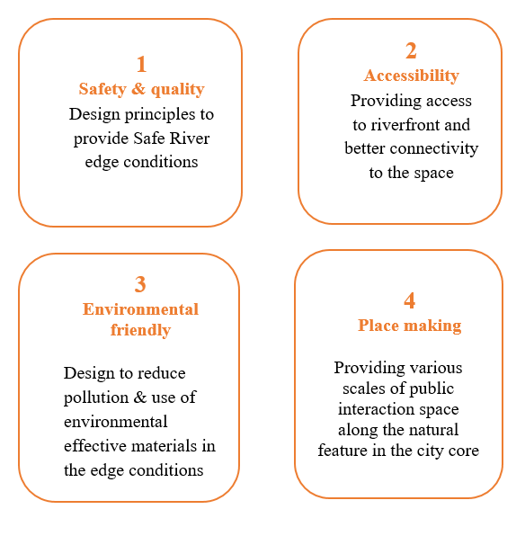
Recommendation and its Principles
Vision Statement
To bring back the river’s multi-functional quality as flood carrier and provide a secondary source of water to city and to create a vibrant public space to encourage city and river relationship improving socio- cultural, economic value of the city.
4.1.2. Goals and objectives
To activate city scale public space – Primary Goal
Bringing back river as the city’s flood carrier – Primary Goal
Reclaiming the river edge
To stop the drain line connecting the river
To activate the river multi-functional quality
Model that impacts the city development
Strategies and Recommendation

Slide 28
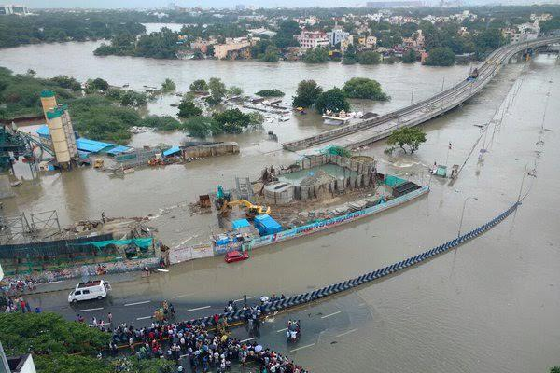
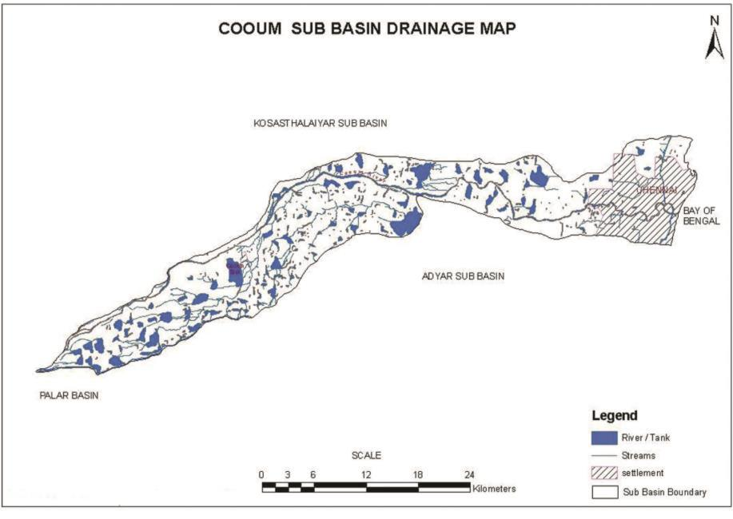
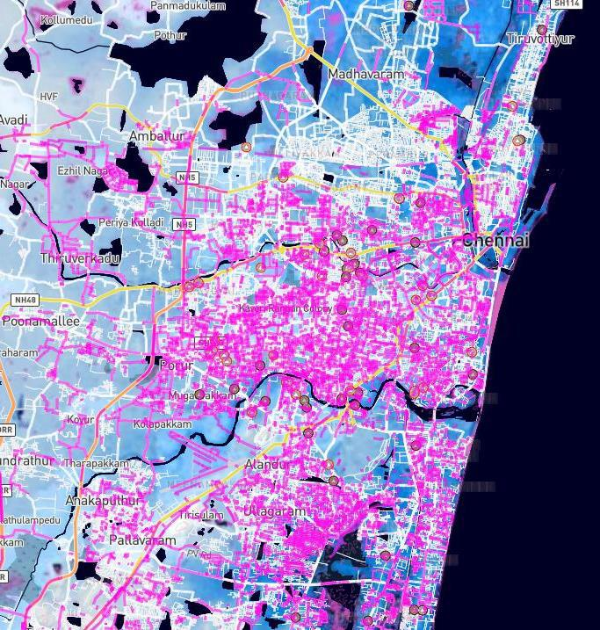
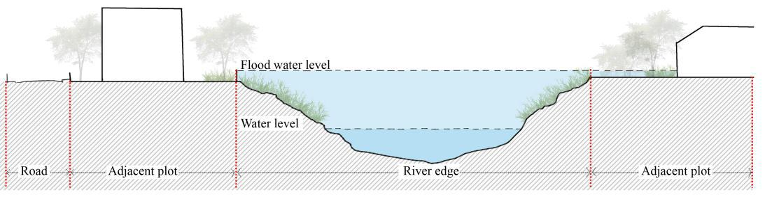
Strategy -1 Safety and quality
1-Past flood in the city
2-Cooum river catchment area
3.Flood level
Figure : Image showing past flood in Chennai, 2015
Figure : Map showing the flooded area
Figure : Image showing the Cooum river basin
Existing section
The river embankments are dumped with garbage and the edges are undefined, lacking maintenance. The drainage is discharged directly into the river polluting it making the environment unhealthy. Surrounding land use is washed away due to the flood and people have moved back to their huts recently. The water level fluctuates extremely to the edge of river during monsoon season and discharge storm water into the sea. The importance of river is reducing and turning into a grey water layer, the river edges has to be reclaimed and provided with netter drainage system and storm water system .
Figure : Section showing the existing condition in the river banks

Slide 29
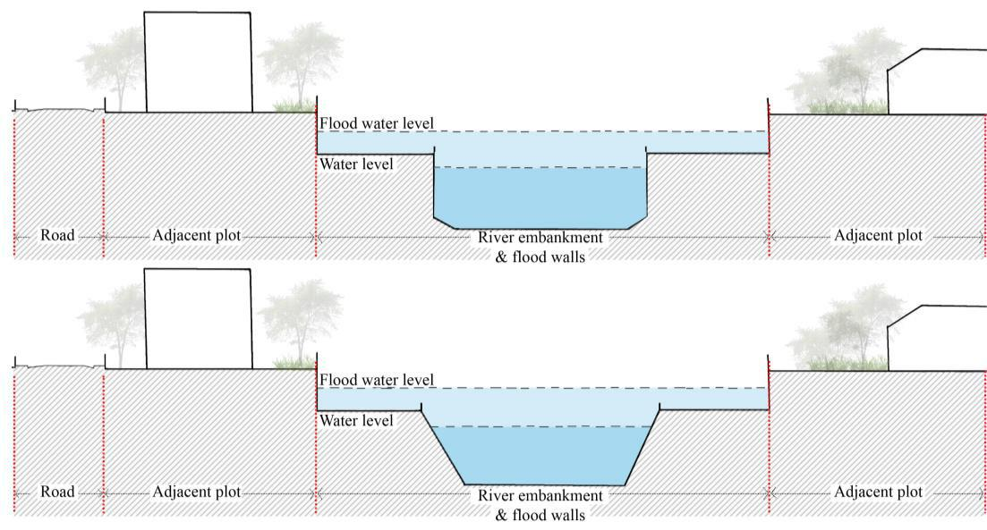
Design principles and recommendation
River embankment design:
The river edge profile design with maximum carrying capacity, the section shows the fluctuating level of water during summer and monsoon. River profile shape that is effective to hold maximum flow and guide the water flow to the discharge points. The Flood walls safeguards the surrounding areas during flood and reduce damage to the city.
Figure : Section showing embankment design

Slide 30
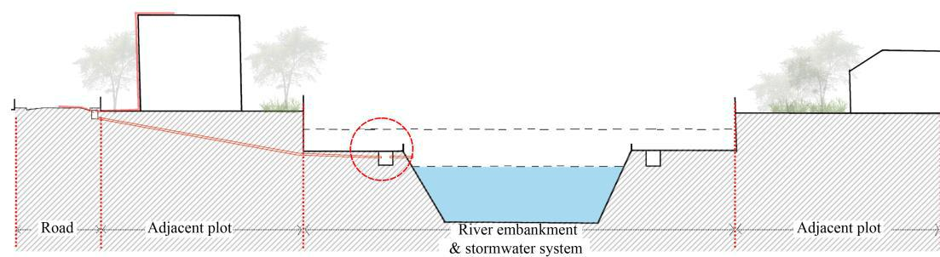
Storm water collection:
Figure : Section showing embankment wall
The River Embankment that supports the city system such as drainage, storm water and infrastructure along the natural topography. This method can control the drainage discharging into the river directly, introducing treatment plants at regular intervals and discharging the treated water into the river. The storm water from open space such as roads, public parks, terraces can be connected to the river edge, treated and used as a secondary source of water.

Slide 31
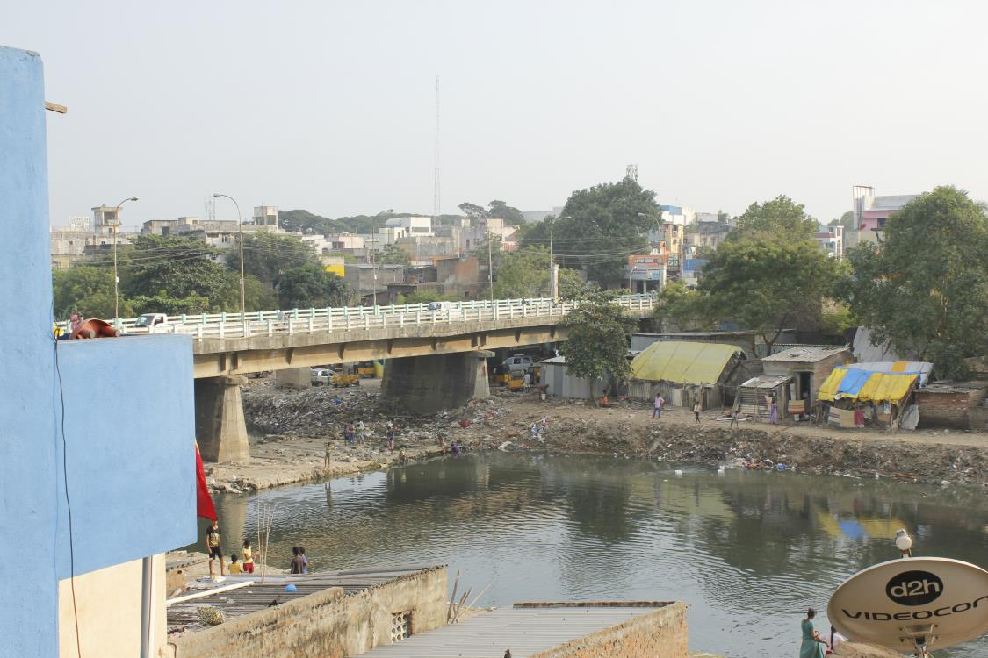
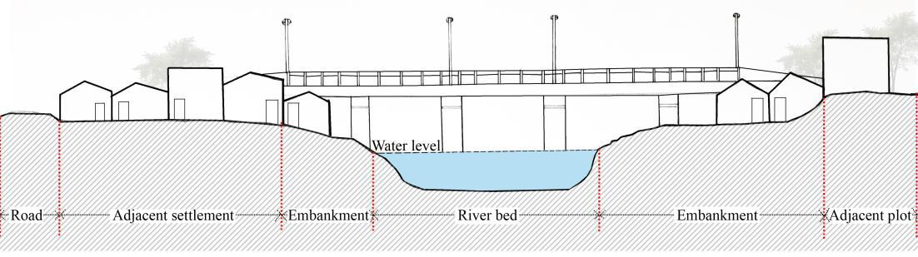
Strategy -2 Accessibility
Existing connection to the river
Improving local network
This documentation is an evidence for showing the lack of direct access to the river and river edge, due to encroachment. The possible access to river edge is the bridge points where the river is visually well connected and will help to navigate you. The parallel streets to the river can provide direct access to the river and act as an interaction space. The reclaimed edges can be used for providing continuous corridors for walking and cycling to encourage healthy lifestyle in city.
Bridges
Bridge structure along the river is the active spots in the evening. People get a clear view of river at these structures, providing access from the bridge structure can make it easier for people to reach the riverfront and to reach their destinations. Bridges are the trace to know the level of water flow during the floods. The past flood water level was till the bridge parapet wall creating damage to the bridge structures. Design providing sight-seeing deck along the pedestrian pathway in bridge.
The existing section shows disconnect between the access to the river and the visual connection of the same. The edges are encroached by settlement, the left side settlement with access to river edge from the road and the other has missing linkage. The existing condition lacks need of attraction to the river for any kind of public activities, a good opportunity to develop the edge for various activities and retain the space utilized.

Slide 32
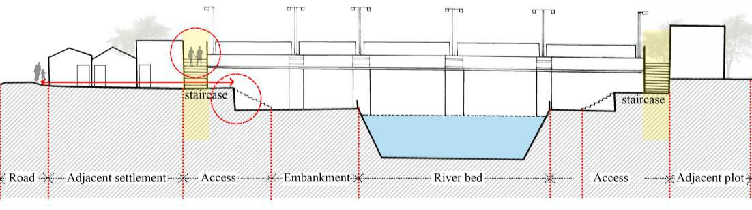
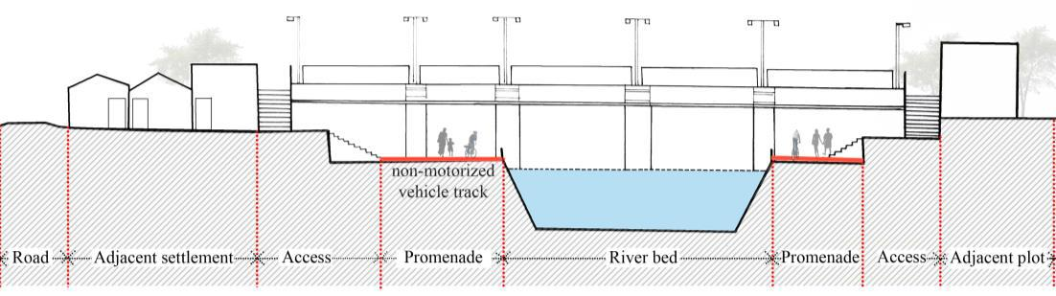
principles and recommendation Access to the river edge
Providing staircase in the bridge edges to reach the different levels of riverfront development. Development of direct access from the parallel roads and destination points at the perpendicular streets junctions. Different levels of promenades for user.
Non-motorized vehicle area
Non- motorized continuous corridors connecting different landmarks and destinations and to encourage healthy lifestyle in urban area

Slide 33
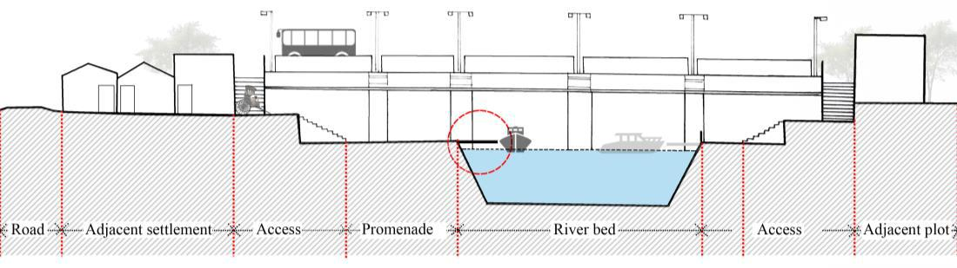
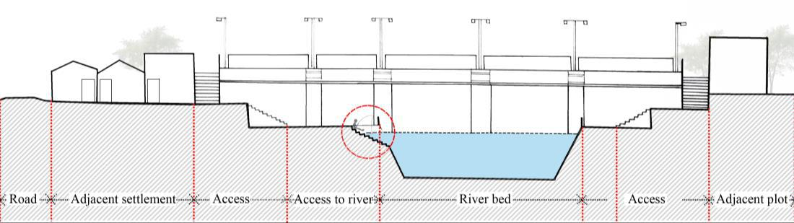
Mode of transportation
The river connects major three roads in the city and busy places which attracts commuters every day. Ferry system can be a mode of transportation to reach the destinations faster in heavy traffic and also a new experience for the urban people. This can reduce the traffic during peak hours. This system brings back the sense of river in past decade - how people used water as a mode of transportation.
Access to river
The river was used for bathing and fishing activities before 20 years, today every few are using the river water for their domestic activities. Bringing back the clean river can boost people to access the river for activities like fishing, sightseeing, swimming, bathing and etc… introducing Ghats for people to enjoy the river.

Slide 34
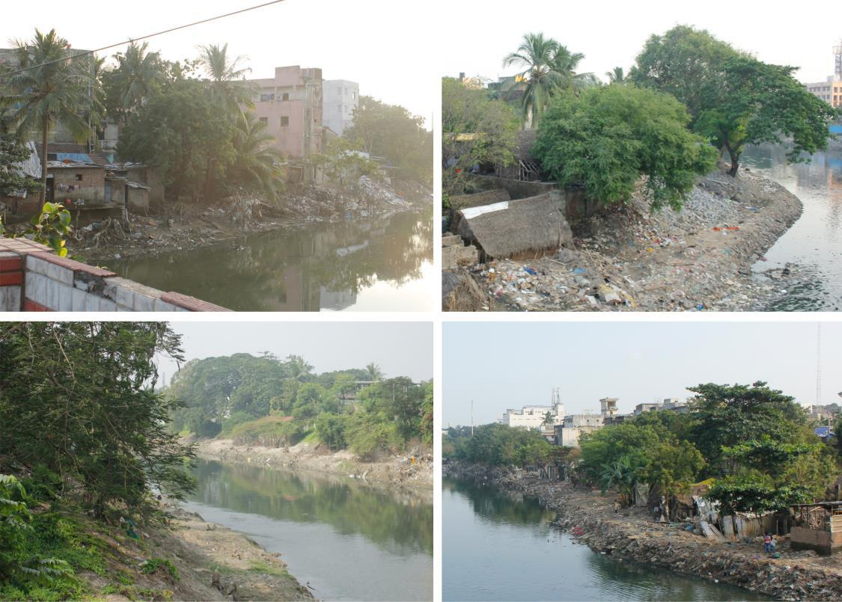
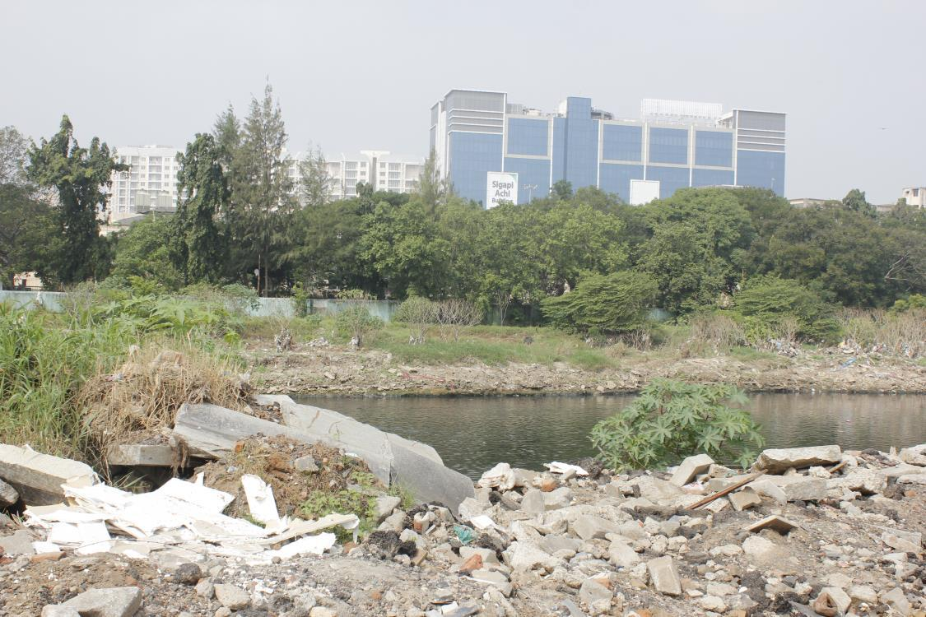
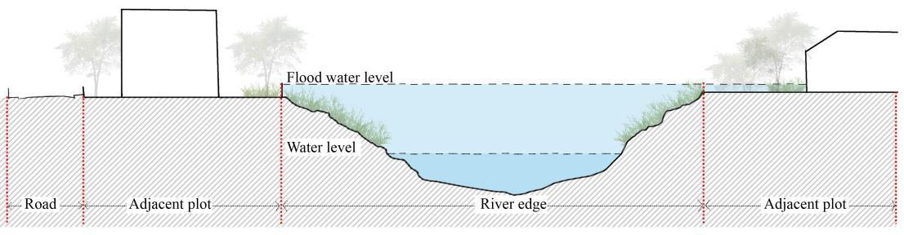
Strategy -3 Environmental friendly
Natural vegetation
Current condition of the river
Figure : Image showing the river edge dumped with waste in embankments
Figure : Image section showing river edge vegetation
The edges are covered with unplanned vegetation, dumped with construction waste and sand bars under the bridges. This debris pollutes the river and reduces the groundcover of the river bed which reduces the ground water recharge. Reclaiming the edges for landscape can improve water purification and percolate water into the ground.
Existing section

Slide 35
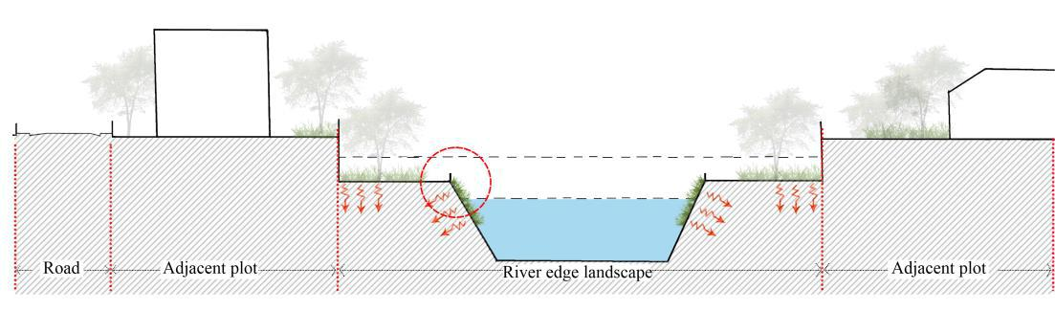
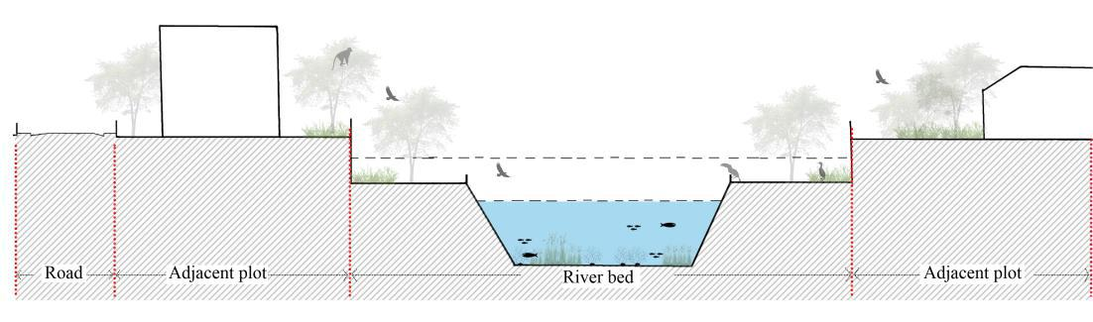
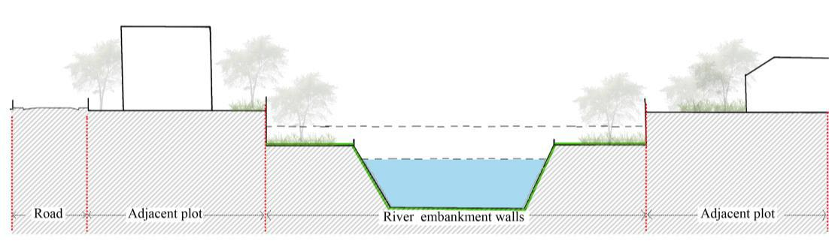
Design principles and recommendation
River edge landscape
The landscaping of edges will act as the aquifer and reduce pollution. Vegetation has the capacity to hold the water run-off and recharge into the ground. Landscape with biphasic shift concept can utilize
the river edge effectively for the multipurpose situation
Encouraging bio diversity
The clean river supports the bio-diversity and natural systems, benefit the city and enhance the people attitude on natural waterbodies.
Percolating material
Today’s technology allows choice of material for sustainable development of edge conditions. Perforated materials allow the water to percolate in, so that before the river reaches the sea it will recharge maximum to the ground. Use of these materials also can act sensitive during the floods.

Slide 36
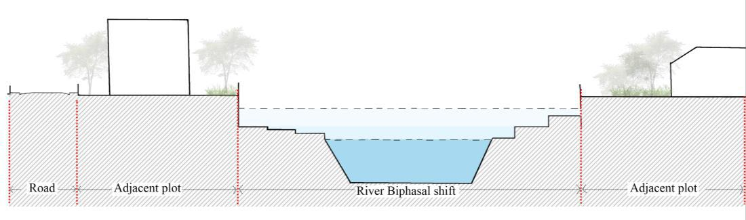
Biphasal shift
River edge profile that act as a flood carrier during the heavy flood and work as a public space and promenades during the off seasons. River edge design that respond to the water fluctuations and functions according to the necessity.

Slide 37
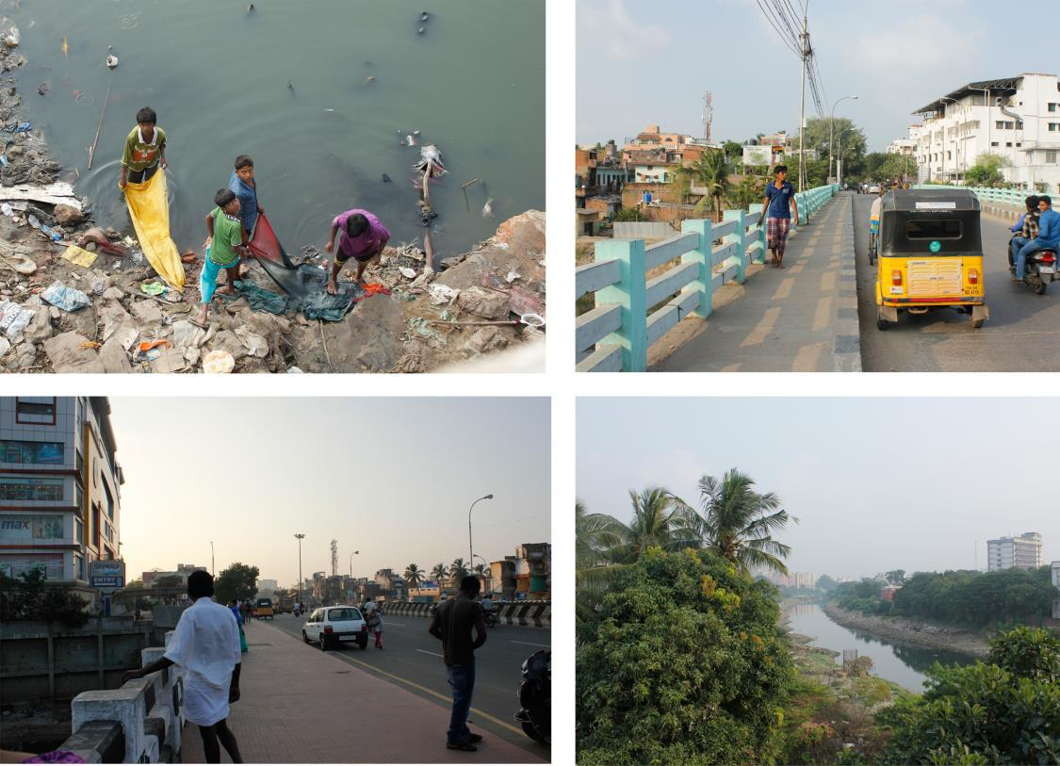

Strategy -4
Place making
Urban need
Figure : Image showing Activities along the river

Slide 38
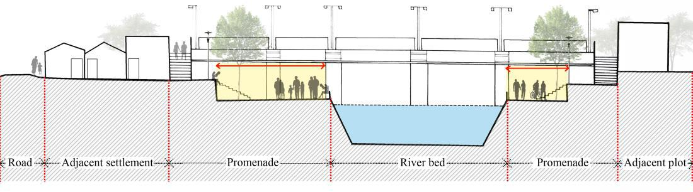
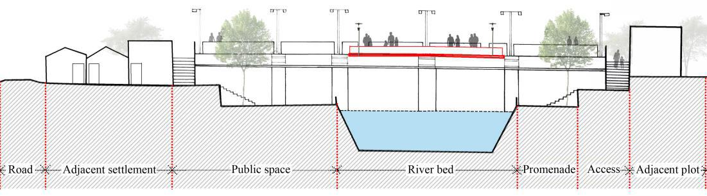
principles and recommendation
Promenade design
River edge promenade to encourage people interaction. Access provided from adjacent road and bridge to the promenade. Promenade to accommodate various public activities and place for people to relaxation.
Bridge structures
Bridges are the space from where the river is viewed clearly and people stop their vehicle to experience the riverfront. Providing view decks at the bridge platform to watch the river and sightseeing.

Slide 39
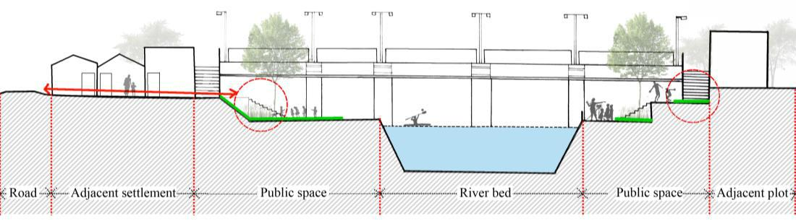

Public space and parks
The documentation concludes the lack of community open parks and Public Square, providing public parks in different scale. These large pocket in the city core can be the breathe in space and landmark for the urban settlement.
Intermediate levels
Providing Ghats and decks in river edge for people to access the water for domestic activity and water sport. To incorporate various scale of activities, different levels of space to be provided.

Slide 40



Key plan -Typical edge condition
Typical section kit for the River Restoration
Typical River edge condition near bridge structures
Typical River edge condition near bridge structures: During flood

Slide 41



Key plan- Typical River edge condition
Typical River edge condition along private lands: During flood
Typical River edge condition along private lands

Slide 42



Typical River edge condition in direct access area
Typical River edge condition in direct access area: During flood
Key plan- Typical River edge condition

Slide 43



Typical River edge condition along the settlements
Typical River edge condition in direct access area: During flood
Key plan- Typical River edge condition

Slide 44
BIBLIOGRAPHY
2011, Finndian. Finndian. 2011. <http://www.finndian.com/wp-content/uploads/2011/03/Chennai-City-Map-1909.jpg>.
"Bishan Park, Singapore." n.d. <http://blogs.gsd.harvard.edu/loeb-fellows/files/2012/11/AD-Ref_Singapore_Bishan-Park.pdf>.
CDIA and COC. Chennai City Development Plan Volume 1. Chennai, 2009.
"Cheonggyecheon Resstoration Project." n.d. Ecrr.org. <http://www.ecrr.org/Portals/27/Cheonggyecheon%20case%20study.pdf>.
Flooded streets. 2015. <https://osm-in.github.io/flood-map/chennai.html#11/13.0000/80.2000>.
Janakarajan S, Rman, Sundar, Jothi, Prabahar. Impacts of increased urban demand for water on livelihood resilience in Chennai's peri-urban areas. Chennai, 2006.
Kanthimathinathan, Thiru T. River and drainage system in CMA. Chennai: CMDA, n.d.
Landscape Architecture Works. n.d. <http://www.landezine.com/index.php/2011/06/rhone-river-banks-by-in-situ-architectes-paysagistes/>.
Lavanya, Ar.K. Urban Flood management- A Case study of Chennai City. Chennai, 2012.
Nadu, Govt. of Tamil. Chennai River Restoration Trust. 2006. <http://www.chennairivers.gov.in/>.
Nair, Anil K. Gupta and Sreeja S. "Flood risk and context of Land uses: Chennai city case." (2010).
"NAtional parks." n.d. <https://www.nparks.gov.sg/gardens-parks-and-nature/parks-and-nature-reserves/bishan---ang-mo-kio-park>.
Oates, Robert. "Thames River Trust." (2012).

