Slide 1
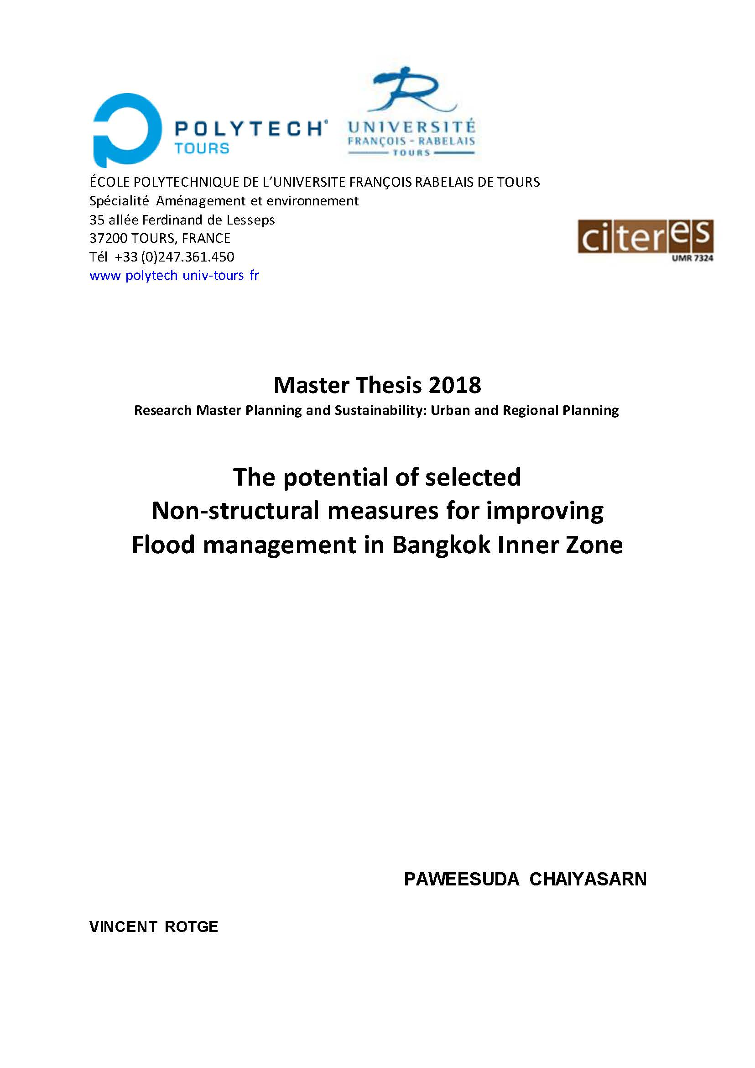
PAWEESUDA CHAIYASARN
Paweesuda.chaiyasarn@etu.univ-tours.fr
Supervisor: Prof. : VINCENT ROTGE

Slide 2
The potential of selected
Non-structural measures for improving Flood management in
Bangkok Inner Zone
Abstract :
Bangkok is a complex system in term of physical, institutional, and scale dimensions. consist of many factors which vulnerability to flooding is attributable to the ineffectiveness of the flood drainage systems and prevention measures. The implementation plan of Bangkok Metropolitan Administration clearly indicates its emphasis on structural measures and not seriously taken for non-structural measures, Flood still chronic problem in the city in case of heavy rainfall, structural measures cannot cope with flood totally, pointed out that It is important to acknowledge that protecting urban areas from floods is impossible even with massive structural measures and that implementation of non-structural measures also have a great potential to reduce damage and losses with the same level of floods.
This Research finds empirical data include clarification of the causal factors or causes of continued floods in the capital and the implementation of flood-related policies and imbalances between Structural and non-structural measures and showing that non-structural aspect is very important but have been overlooked for some reasons by a focus on resolving floods due to heavy rainfall. In the inner city, Which an important economic, transportation, business, industrial centers and tourist centers, Then proposes some non-structural measure which had potential properly with flood condition problem in Bangkok. This research had shown some examples of technical modifications include in the scale of Bulk control and Land Use Control / Activities Control. However, the most important non-structural measures which are The key to approach all solution of technical problems is public awareness.
In summary, found that measures are applied is of primary importance. First, The best order is to develop public awareness, which will lead to the creation of the political will, followed by drafting and passing laws and regulations, and secondly, proposing measures to reduce risk and to offer education and Training. Approach to prepare plans for effectively managing requires a combination of technical, participation planning, Community, and stakeholder consultation should be an integral aspect of the flood management framework for Bangkok
Keywords :
Floodplain inner zone in Bangkok
Analysis problem and symptom flood of Bangkok
The Weakness of the Master Plan and flood management measures
Efficiency of Non-structural measures
Non-structural measure solution
Improvement priority of Non-structural measures

Slide 3
TABLE OF CONTENTS
I. INTRODUCTION
A. Background and Situation
B. Bangkok and The flood 0f 2011
C. Problem statement and Cause of flood in Bangkok inner zone
D. Key words concept and Scope of Research
E. Aim and Objectives of Research
F. Literature Review
"Guidelines on Non-structural measures in urban flood management"
"Cities and Flooding A Guide to Integrated Urban Flood Risk Management for the 21st Century"
"Challenges for adapting Bangkok’s flood management systems to climate change"
"A theory on urban resilience to floods—a basis for alternative planning practices«
G. Research questions and Hypotheses
H. Research Method
II. DEFINITION MEASURE TO COPE WITH FLOODS
Unified urban flood management
III. CASE STUDY
Some policy aspects of flood management in The Netherlands
Waste charging system in Taipei, Taiwan
IV. DATA ANALYSIS
PART 1 : Reviewing plans, policies and urban management with structure and non-structure measures
1.1 Collect land use and building use data, including plan, policy and ordinance regulations for analyzing and estimating.
1.2 Collect water management data and guidelines, including plan, policy and ordinance regulations for analyzing and estimating.
1.3 Analysis of potential and limitations of each plan and/or policy
PART 2 : Assessing non-structural measure
2.1 Assessing the relative importance of structural & non-structural causes
2.2 Assessing the potential for removing or at least alleviating these causes for adaptive actions with a focus on non-structural aspects
2.2.1. Cause specific problems. The flooding in the inner city of Bangkok.
2.2.2. Review all non-structural measures used in flood management in Bangkok.
2.2.3. Analyze / assess potential to find solutions. The focus is on the use of non-structural measures Comply with Structural elements are available in Bangkok.
PART 3 : Propose which non-structural measures improvements should be achieved to enforce an efficient flood prevention policy in BMA.
3.1 The first scenario: Develop Zoning and Building code in risk area zones
3.2 The second scenario: Defined catchment and drainage and add more permeability surface
3.3 The third scenario: Propose develop some of nonstructural measures.
V. SUMMARY AND CONCLUSION
VI. REFERENCES

Slide 4
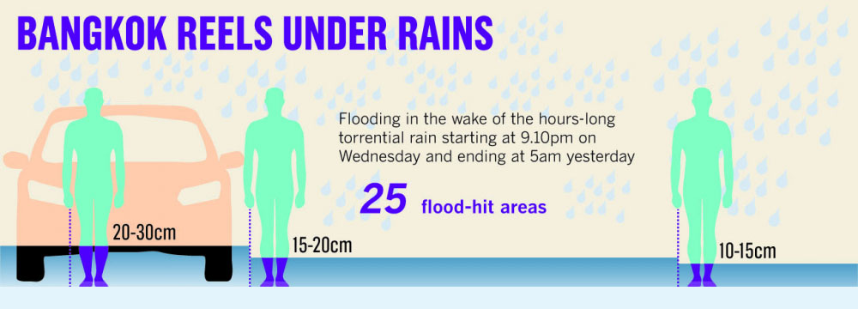
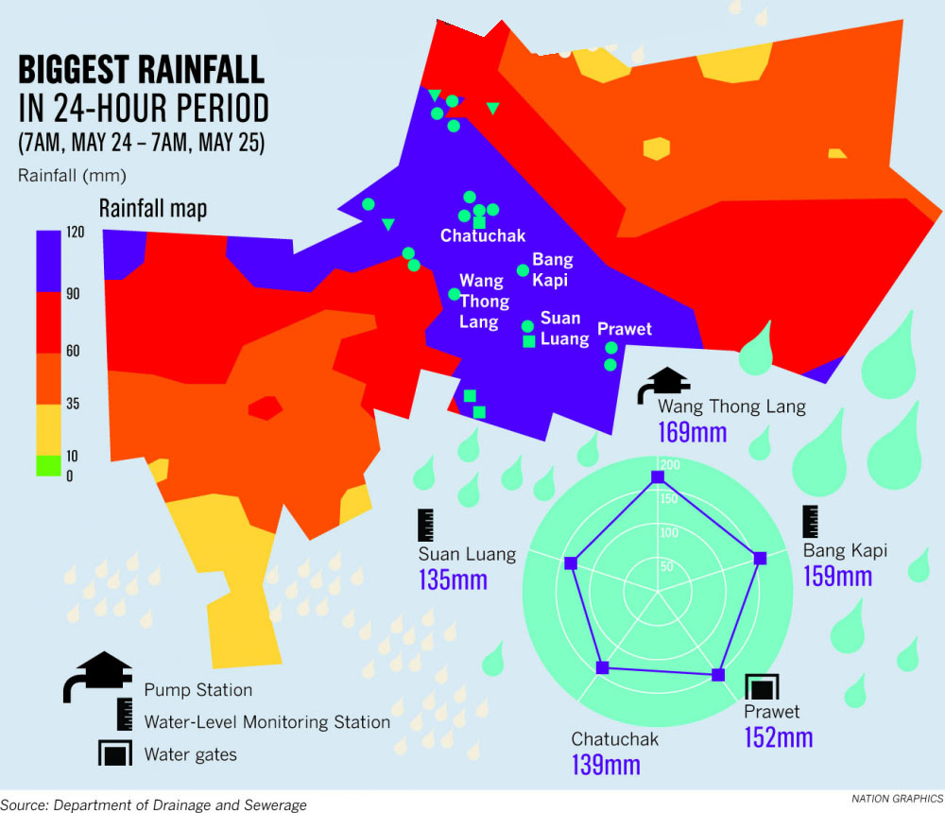
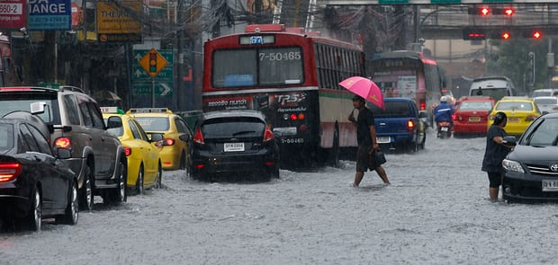
A. Background and Situation
An interesting question is why floodway movement in Thailand is not successful compared with the costly structural measure such as concrete walls that are becoming higher and longer everywhere on the floodplains.
It is worth noting that every legal procedure in Thailand takes time, maybe years for passing flood regulations. That is another reason why the government gives more importance to structural measure such concrete walls that can be built immediately and fulfill political commitment within the shorter time.
Certainly, numerous costly concrete structures have been approved shortly focusing on industrial estates on floodplains. This proves that industrial sector is the primary concern in the view of the government. Their vision is lack of urban resilience to floods just for against flood rather than working with the river. And They are still lack of awareness about an optimal engineering solution may not be the best because of social and institutional constraints.
Pedestrians brave torrential rain in Bangkok. Photograph: Narong Sangnak/EPA
Source: Floods bring rush hour chaos to Bangkok
https://www.theguardian.com/environment/2017/may/28/floods-bring-rush-hour-chaos-bangkok-thailand
Reference : Bangkok flooding is chronic problem, national May 26, 2017 http://www.nationmultimedia.com/news/national/30316334

Slide 5
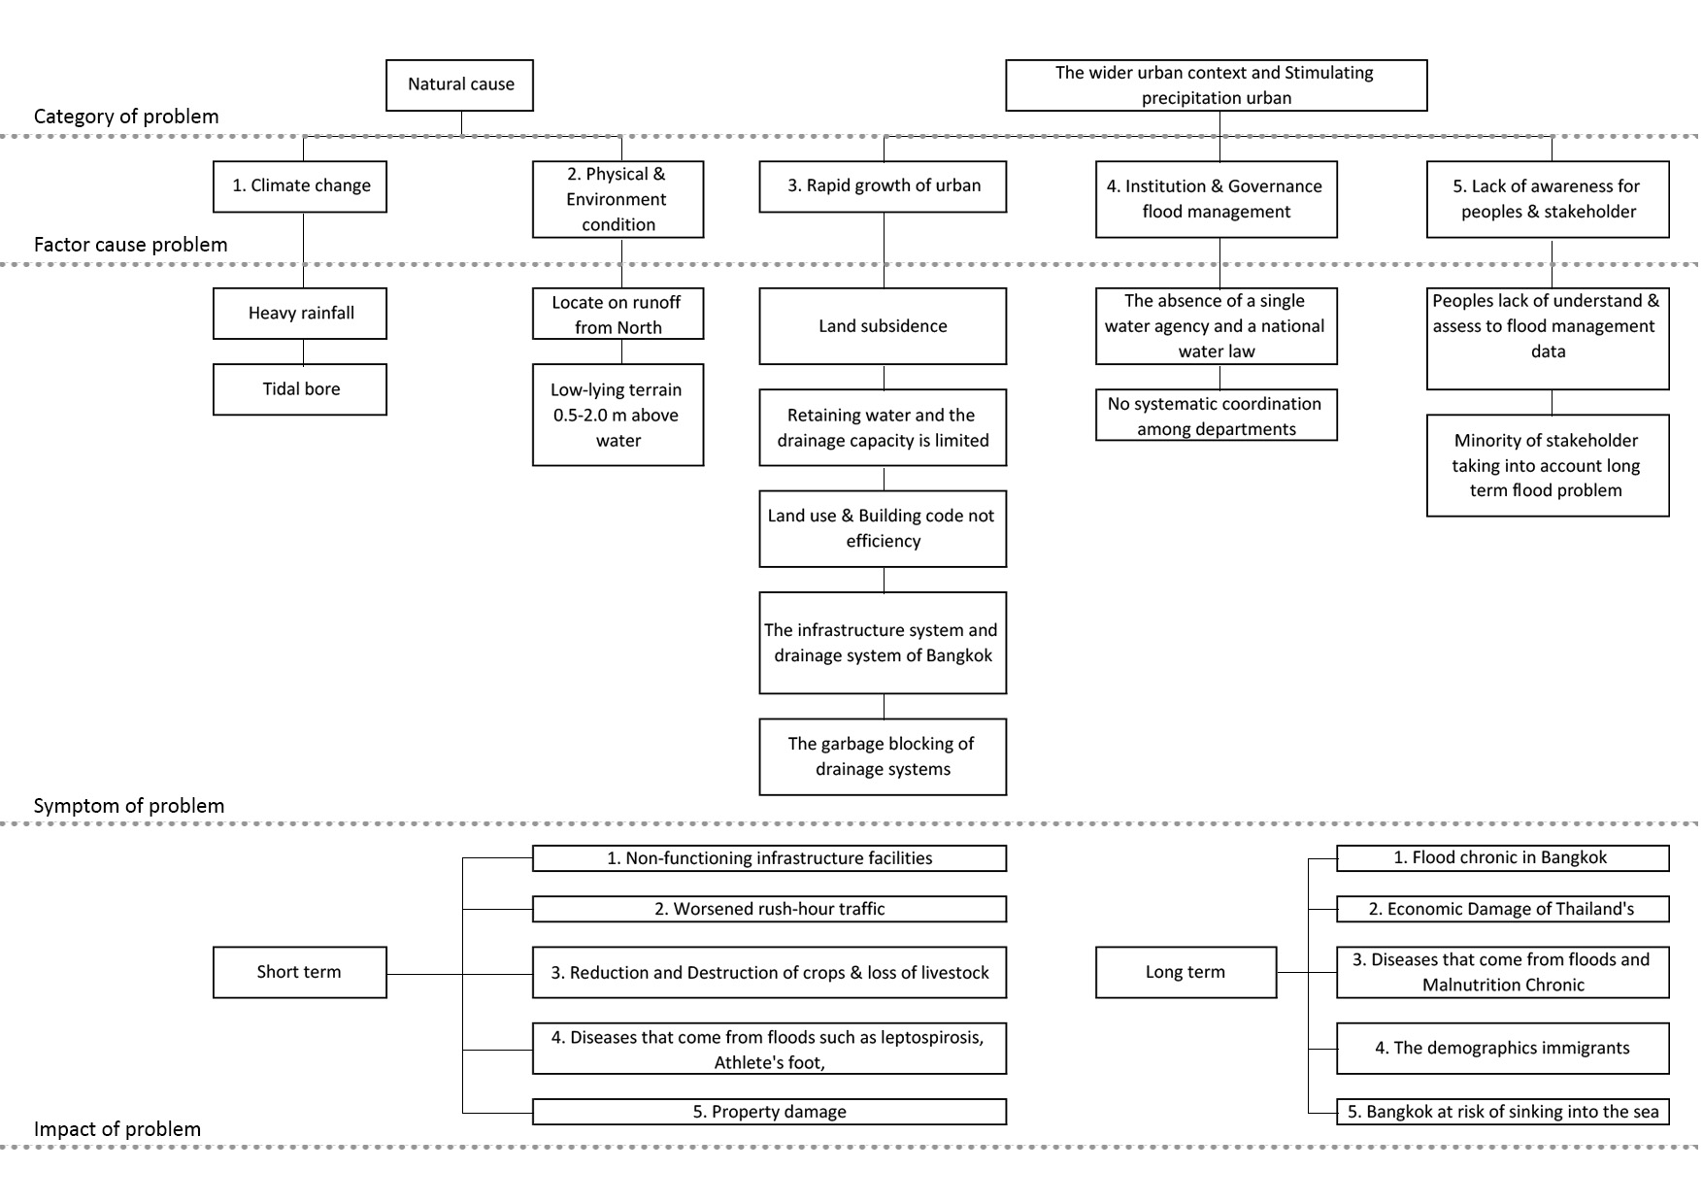
C. Problem statement and Cause of flood in Bangkok inner zone
Factors affecting Bangkok's drainage are from the location of Bangkok as a water source. Climate change combined with rapid urban growth, resulting in ineffective flood control and preventive measures not successful due to poor flood management performance and non-building activities. Planned risk of flooding in the city. And lack of awareness and stakeholders. All factors are bound to become a problem that is very difficult to resolve. This can be explained by the following main factors.

Slide 6
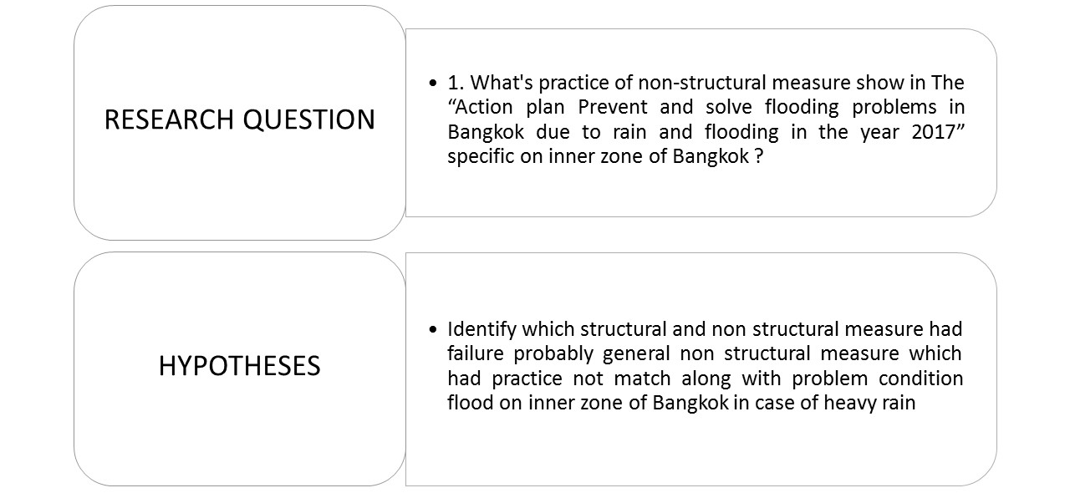
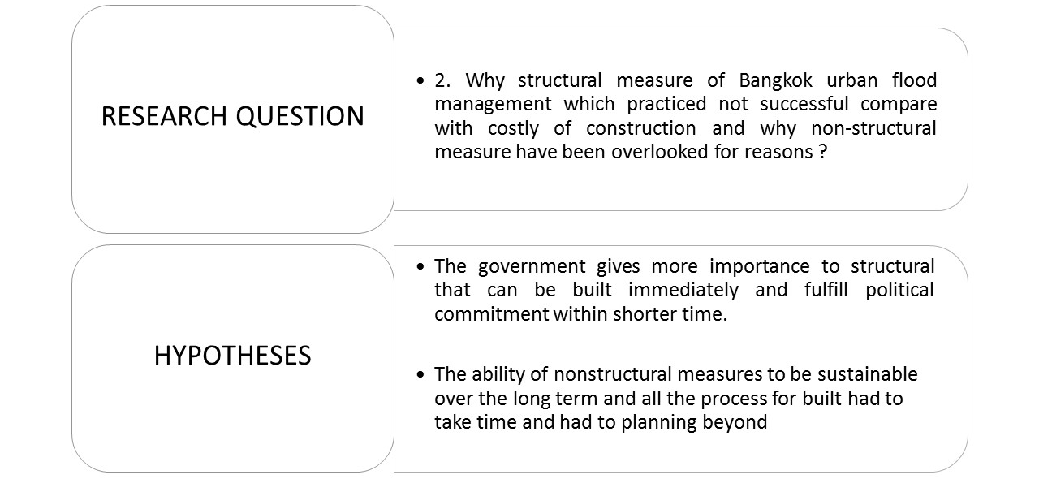
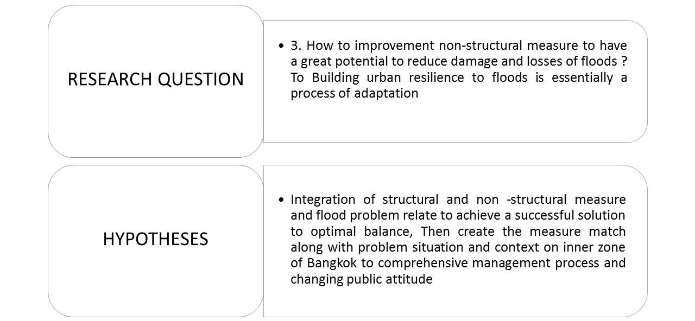
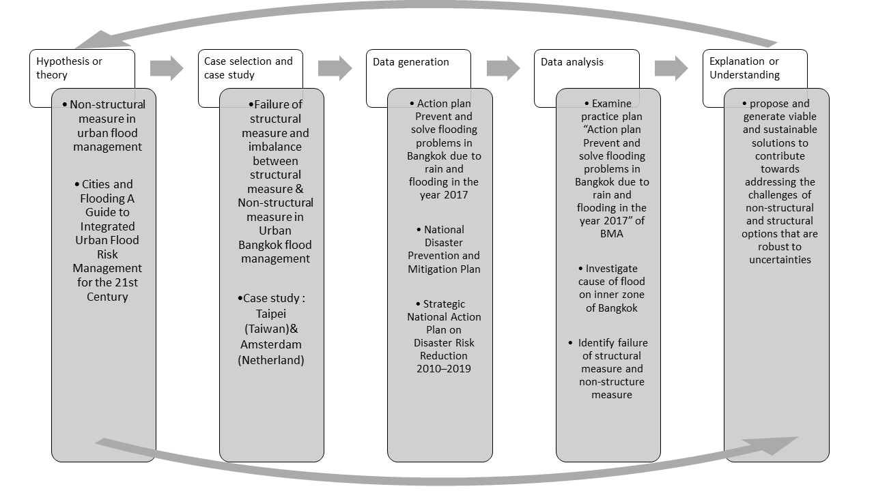
G. Research questions and Hypotheses
The paper aims to address three core questions to answer and solve problem by analyzing which non-structural improvements should be achieved to enforce an efficient flood prevention policy in BMA:
H. Research Method
(1) Review of the available literature, including documents made available by various departments of BMA (2) Examining and surveys with a group of experts (3) Fact-finding collect information and identify issues (4) extension of the results of other research

Slide 7
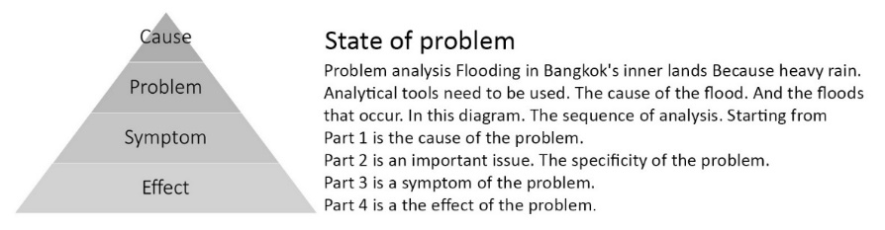
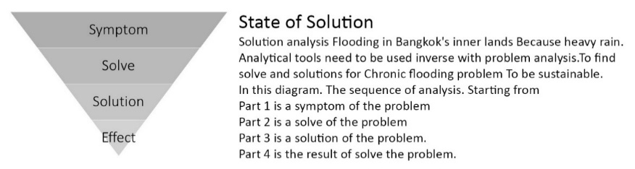
V. DATA ANALYSIS
Today, both structural and non-structural measures, adequately related in time and space, represent the cornerstones of a unified contemporary urban flood management concept
PROBLEM PART
PART 1: Reviewing plans, policies and urban management with structure ad non-structure measures
1.1 Collect land use and building use data, including plan, policy and ordinance regulations for analyzing and estimating.
1.2 Collect water management data and guidelines, including plan, policy and ordinance regulations for analyzing and estimating.
1.3 Analysis of potential and limitations of each plan and/or policy
SOLUTION PART
PART 2: Assessing non-structural measure
2.1 Assessing the relative importance of structural & non-structural causes
2.2 Assessing the potential for removing or at least alleviating these causes for adaptive actions with a focus on non-structural aspects
2.2.1. Cause-specific problems. The flooding in the inner city of Bangkok.
2.2.2. Review all non-structural measures used in flood management in Bangkok.
2.2.3. Analyze/assess the potential to find solutions. The focus is on the use of non-structural measures Comply with Structural elements are available in Bangkok.
PART 3: Propose which non-structural measures improvements should be achieved to enforce an efficient flood prevention policy in BMA.
3.1 The first scenario: Develop Zoning and Building code in risk area zones
3.2 The second scenario: Defined catchment and drainage and add more permeability surface
3.3 The third scenario: Propose develop some of nonstructural measures

Slide 8
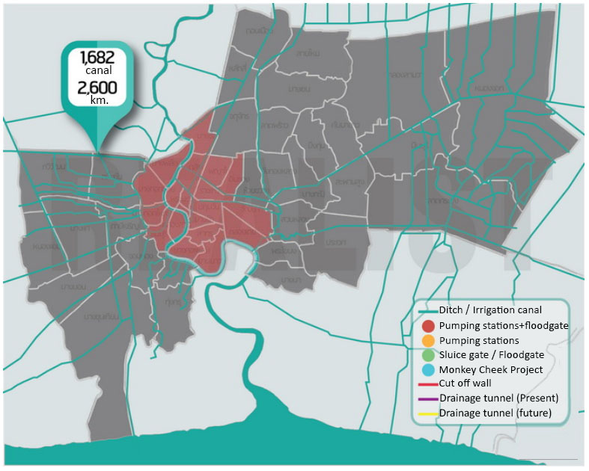
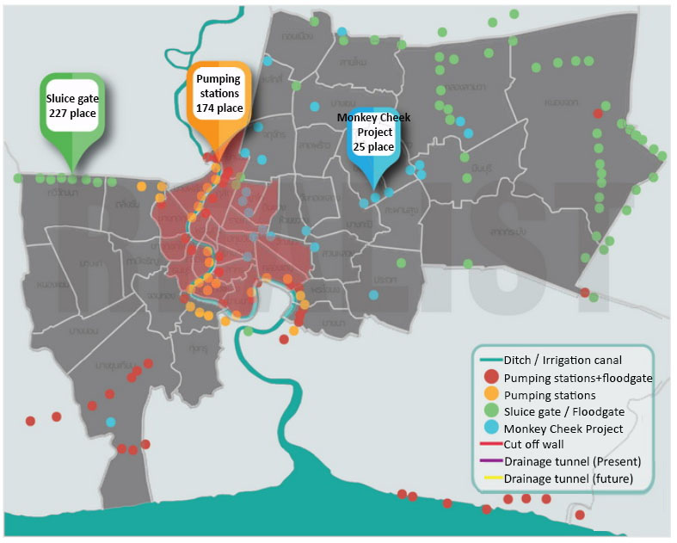
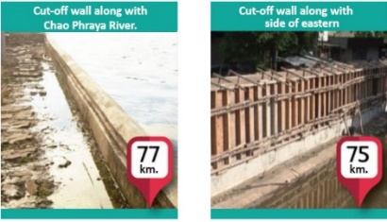
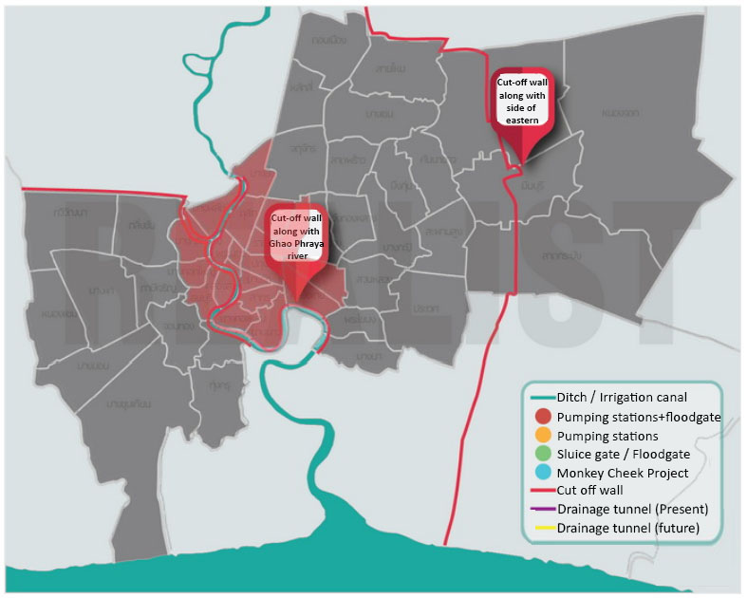
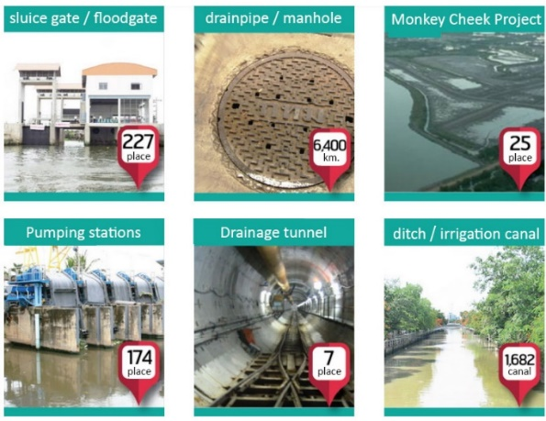
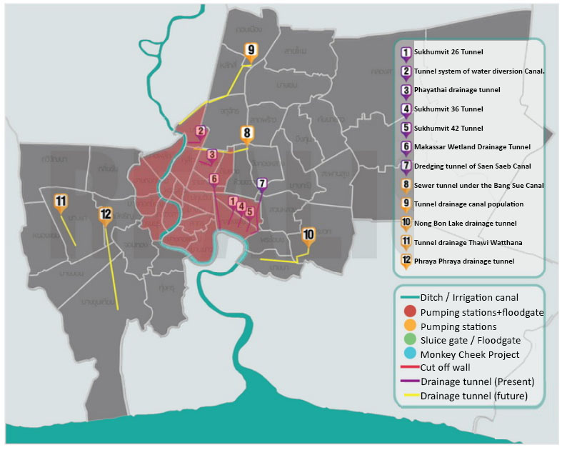
V. DATA ANALYSIS
PART 1: Reviewing plans, policies and urban management with structure ad non-structure measures
1.2 Collect water management data and guidelines, including plan, policy and ordinance regulations for analyzing and estimating.
Bangkok has 2 type is structure measure and non-structure follow as 1. Flood management and drainage infrastructure improvement / 2. Natural buffers (e.g., wetlands, retention ponds) / 3. Groundwater management and rainwater harvesting / 4. Reducing social vulnerability / 5. Land use planning and zoning / 6. Building codes for flood proofing / 7. Early warning systems / 8. Emergency planning and rescue / 9. Awareness campaigns
1. Flood Protection System By barrier due to high tide
2. The drainage system to solve flooding due to rainwater.
Ditch / Irrigation canal
Pumping station + floodgate + Monkey Cheek Project
Flood protection (Cut-off wall)
Drainage tunnel
Source: Infographic http://www.realist.co.th/blog/ and Information “Action plan Prevent and solve flooding problems in Bangkok due to rain and flooding in the year 2017”, Department of Drainage and Sewerage under BMA http://dds.bangkok.go.th/

Slide 9
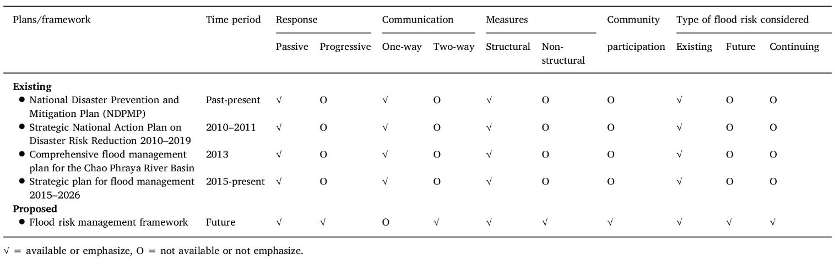
V. DATA ANALYSIS
PART 1: Reviewing plans, policies and urban management with structure ad non-structure measures
1.3 Analysis of potential and limitations of each plan and/or policy
Table .1 Existing plans and proposed framework and their characteristics relevant to flood risk management for the Chao Phraya River Basin.
Source : Nuanchan S., (2017), International Journal of Disaster Risk Reduction : Flood risk management in Thailand: Shifting from a passive to a progressive paradigm, Volume 25, 92p.-100p., http://dx.doi.org/10.1016/j.ijdrr.2017.08.003
Master plan flood management in Bangkok
(a) There are no concrete proposals on how to compensate farmers in floodplain areas
(b) Inadequate attention to the complex long-term issues of fragmented water management and required institutional changes in integrated water management to cope with extreme weather conditions, plus the appropriate combination of a single command authority and decentralization.
Major flood management measures in Bangkok
(c) None of the measures have explicitly taken climate change into account in their analyses or the design of the interventions. Whether climate considerations are incorporated appropriately – is not yet relevant in Bangkok.
(d) None of The specific measure match along with problem criteria of Bangkok flood condition and effectiveness of the flood-related measures. Only general measures to cope with the flood which not success for long-term.
(e) The absence of active public participation impedes the efficiency.

Slide 10
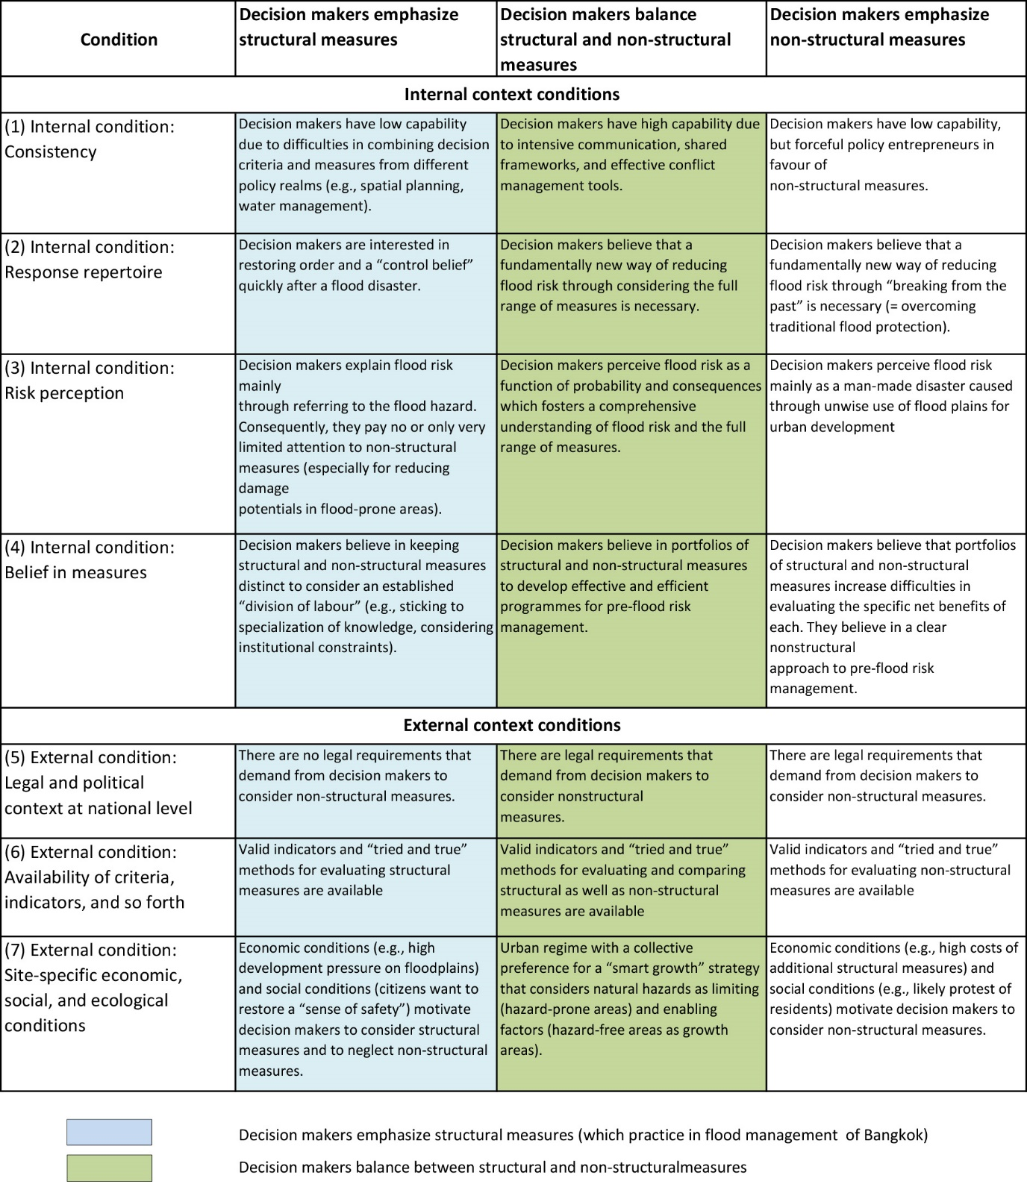

Table 5 : Context conditions influencing the choice of Structural measures and Non-Structural measures – a set of hypotheses
PART 2: Assessing non-structural measure
2.2 Assessing the potential for removing or at least alleviating these causes for adaptive actions with a focus on non-structural aspects
The potential scope of flood risk reduction options by far exceeds the traditional flood protection approaches. A common systematization could facilitate communication.
2. New approaches allow for evaluating and comparing the effectiveness and efficiency of a number of NSM with SM using risk as a common currency.
3. ‘Balancing SM and NSM’ in Decision making is not just a matter of evaluation capabilities.
4. Other important context factors are (i) a broad responsibility of Decision making, / (ii) unlearning on the size of a solution, / (iii) multi-level networks, / (iv) new funding mechanisms and / (v) decentralization in the public sector.
5. Challenges arise from further measures and evaluation criteria (e.g. sustainability, robustness).

Slide 11
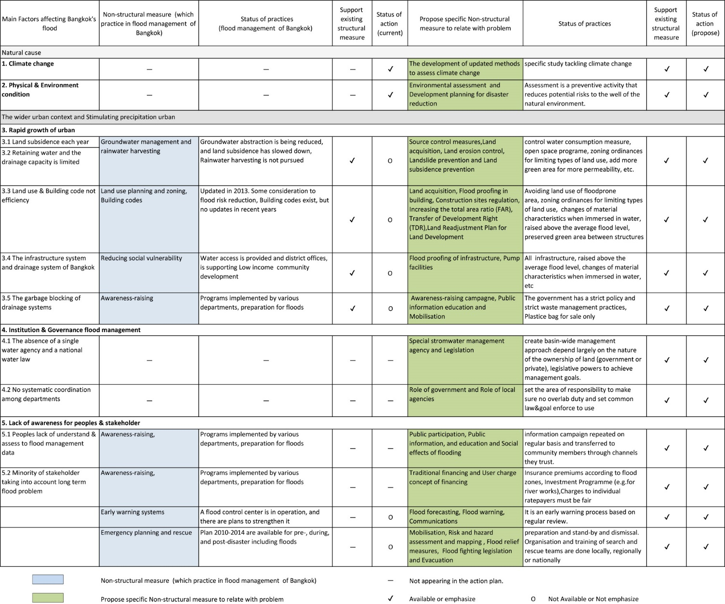

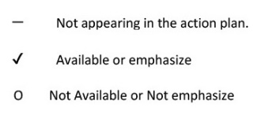
Table.7 : Analysis of The use of Non-structural measures which practice flood management in Bangkok and The propose specific Non-structural measure which suitable with flood problem in Bangkok
PART 2: Assessing non-structural measure
2.2.3. Analyze/assess the potential to find solutions. The focus is on the use of non-structural measures Comply with Structural elements are available in Bangkok.

Slide 12
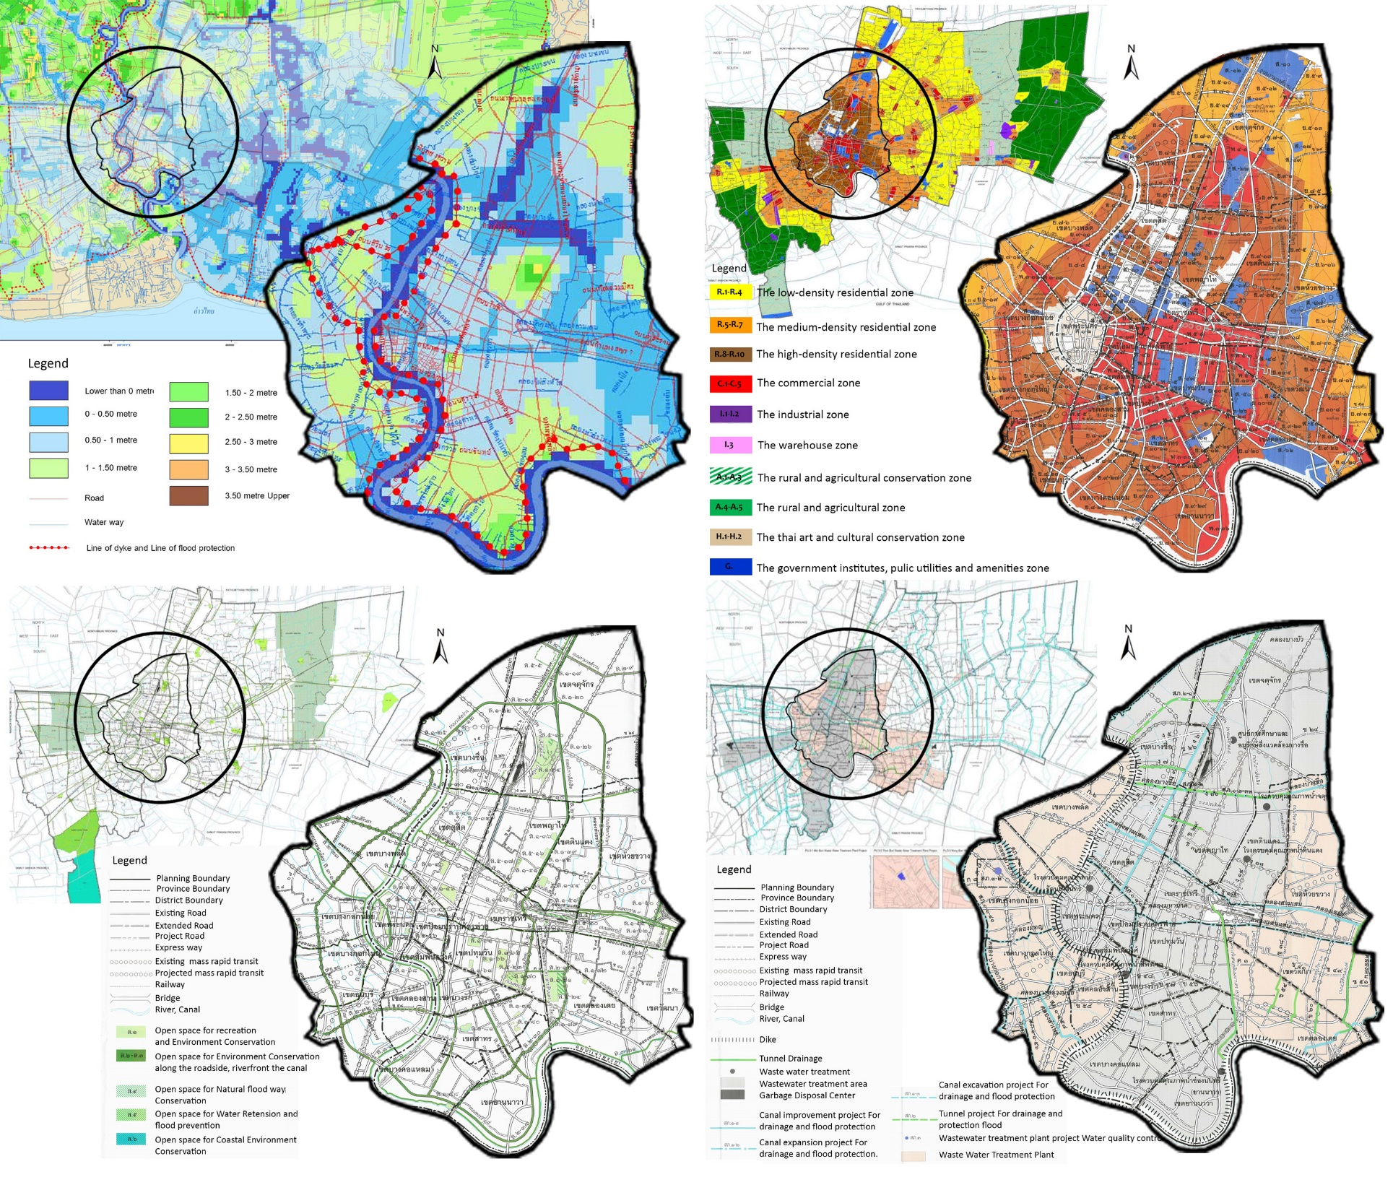
PART 3: Propose which non-structural measures improvements should be achieved to enforce an efficient flood prevention policy in BMA.
3.1 The first scenario: Develop Zoning and Building code in risk area zones
3.2 The second scenario: Defined catchment and drainage and add more permeability surface
3.3 The third scenario: Propose develop some of nonstructural measures
BMA need to announce official of flood risk assessment plan in Bangkok area for public and all stakeholders. Can be centralized from the same information source. For example, The one page project management (OPPM) principal concept by simplifying all information to a visual report that can help the stakeholder to consider relevant tasks in the water management and flood situations. the whole picture of the system, the consequent impacts as well as the planned activities for coping with the flood over the area. To propose appropriate modifications to develop Zoning and Building code in risk area or defined catchment area and drainage etc. This is an important finding since local and regional stakeholders have more control over the distribution of land use Conclusion The social vulnerability maps can be a useful tool for decision-makers to decide on which areas to focus when designing technical measures from the social perspective (reducing flood risks)

Slide 13
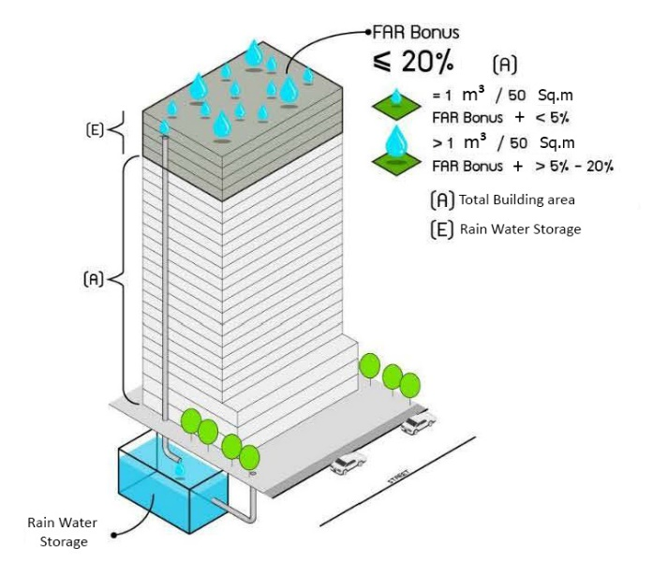
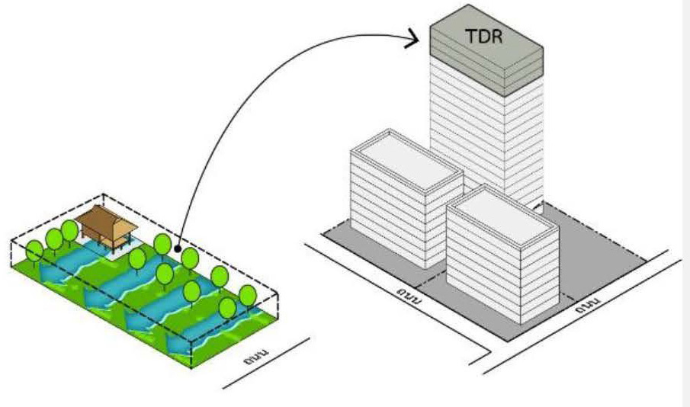
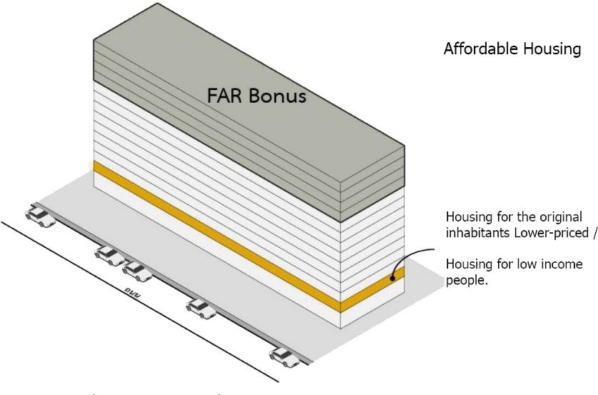
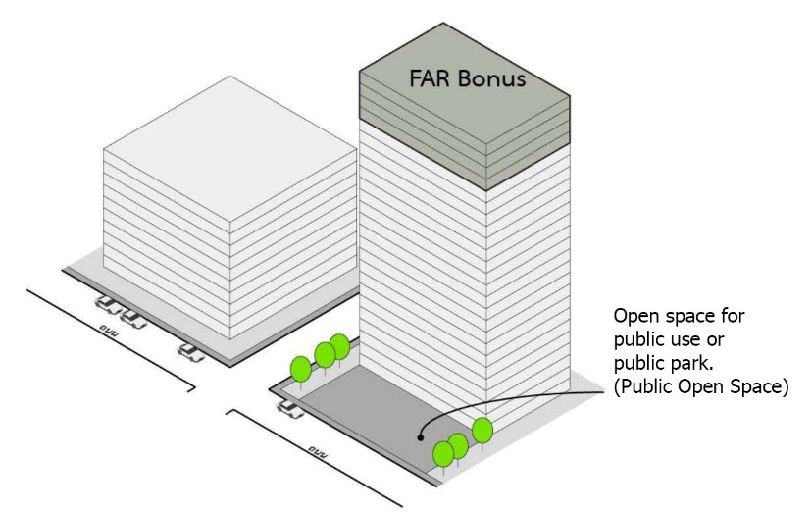
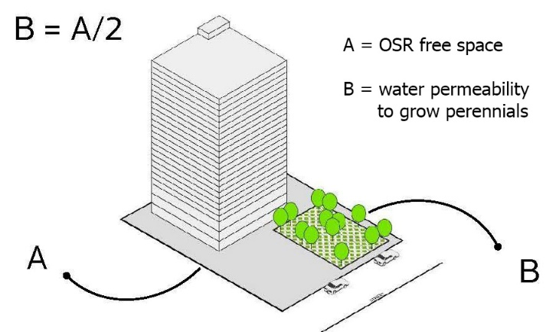
PART 3: Propose which non-structural measures improvements should be achieved to enforce an efficient flood prevention policy in BMA.
3.1 The first scenario: Develop Zoning and Building code in risk area zones
3.2 The second scenario: Defined catchment and drainage and add more permeability surface
3.3 The third scenario: Propose develop some of nonstructural measures
Bulk Control :
Increasing the total area ratio (FAR)
Provide energy-saving buildings and provide water supply
Provide space for the collection of rainwater
in the building or plot of land of the project area.
Provide or develop housing for low income
or existing residents within the project area
Land Use Requirements of Integrated Town Planning, A minimum of 50 % of vacant space is required to be planted per acre. (Open space ratio = OSR)
Provide space for public benefit or park

Slide 14
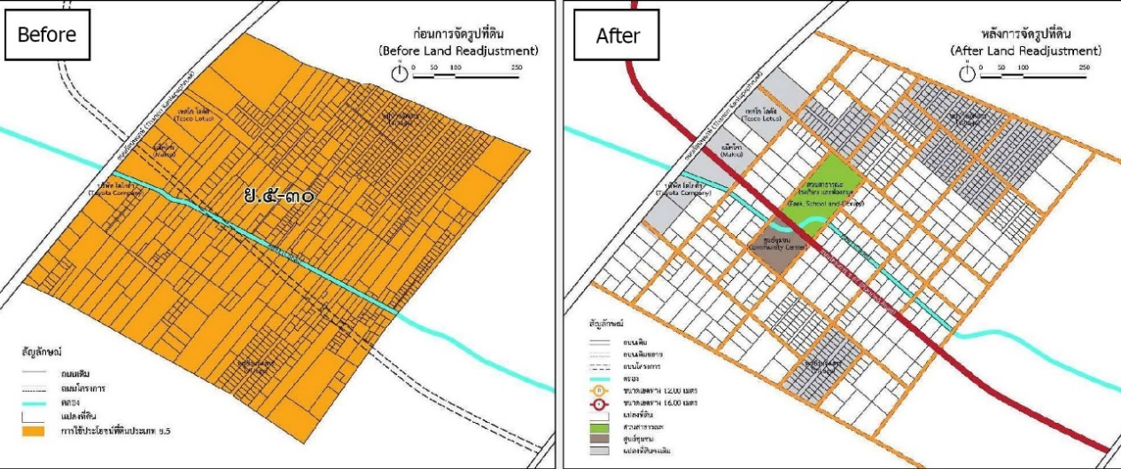
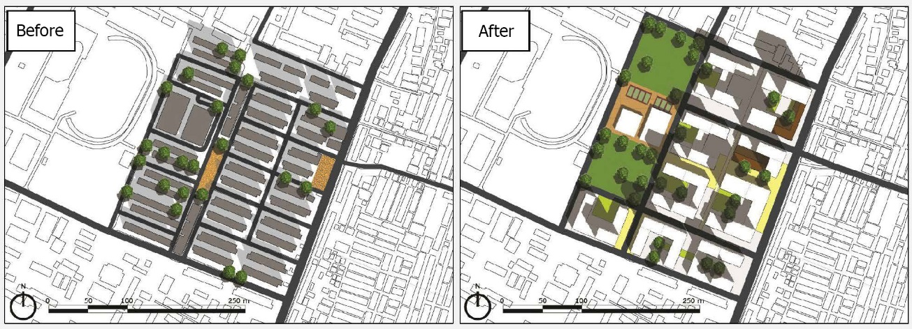
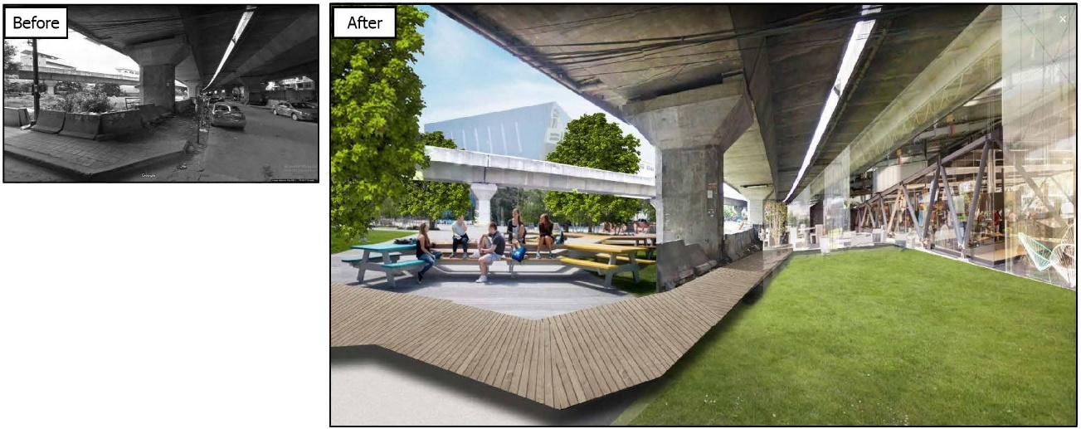
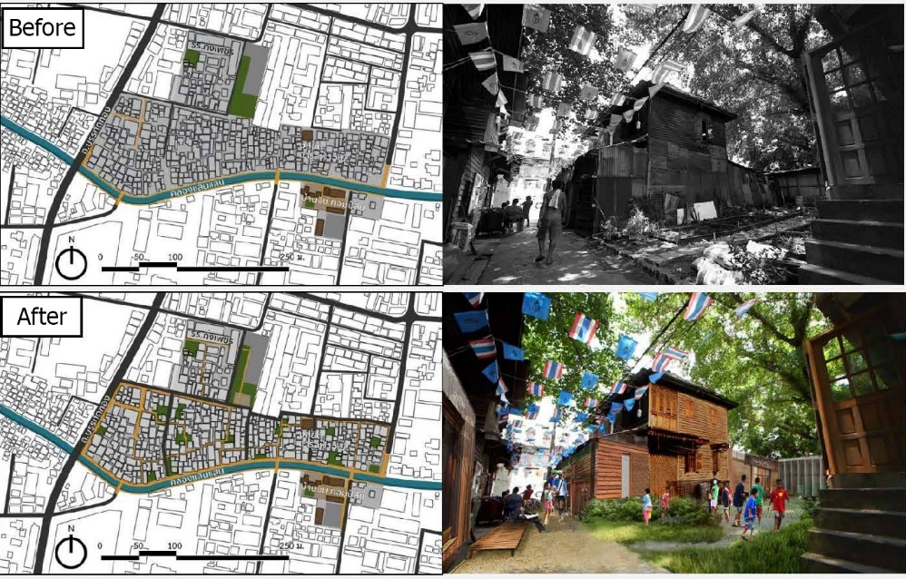
PART 3: Propose which non-structural measures improvements should be achieved to enforce an efficient flood prevention policy in BMA.
3.1 The first scenario: Develop Zoning and Building code in risk area zones
3.2 The second scenario: Defined catchment and drainage and add more permeability surface
3.3 The third scenario: Propose develop some of nonstructural measures
Land Use Control / Activities Control :
Land Readjustment Plan for Land Development
Placement and Development of Housing Redevelopment Project
Improvement of the area under the Expressway
Placement and implementation of Community Development Project
Land Readjustment Plan for Land Development
Placement and Development of Housing Redevelopment Project
Improvement of the area under the Expressway
Placement and implementation of Community Development Project
Source: BMA's Plan for Improvement - (Revise.4th, study status) http://plan4bangkok.com/index.html

Slide 15
PART 3: Propose which non-structural measures improvements should be achieved to enforce an efficient flood prevention policy in BMA.
3.3 The third scenario: Propose develop some of nonstructural measures
Develop public awareness and public participation
It is important to make sure these factors are taken into account when working with the community.
1. Raise awareness about flood risk and motivate the community.
2. Strengthen relevant community institutions.
3. Check the integration.
4. Realistic Planning Encourage participation in sustainability,
Propose mitigation measures
Although flood insurance is in the early stages of Bangkok. It may be an non-structural measure for advanced disaster protection policies, if the objectives, risks, and incentives are set.
6 ways of insurance may lead to a reduction in physical risk Flood:
1. Provide assistance in identifying areas at risk.
2. Disaster Modeling
3. Economic incentives to prevent construction in the watershed.
4. Cost estimates for flood management plans.
5. Promote quick recovery techniques after floods.
6. Promotion of temporary preventive solutions.
3.1 Develop Zoning and Building code in risk area zones
Official of flood risk assessment plan in Bangkok area, By BMA
The one page project management (OPPM) principal concept
3.2 Defined catchment and drainage and add more permeability surface
Bulk Control :
Increasing the total area ratio (FAR)
Land Use Control / Activities Control :
3.3 Propose develop some of nonstructural measures
Develop public awareness and public participation
Propose mitigation measures :
Flood insurance
Summary : PART 3 Propose which non-structural measures improvements should be achieved to enforce an efficient flood prevention policy in BMA.
The flood insurance schemes which Compendium of Disaster Risk Transfer Initiatives in Bangkok inner city such as Property Catastrophe Risk Insurance Pool, Sovereign Disaster Risk Financing & Agricultural insurance (index-based), and Business Interruption Insurance.

Slide 16
V. SUMMARY AND CONCLUSION
It is important to acknowledge that totally protecting urban areas from floods is impossible even with massive structural measures, and that implementation of non-structural measures will have a great potential to reduce damage and losses with the same level of floods. From Study and Analysis of The use of Non-structural measures flood management in Bangkok, are inefficient and do not support the existing structural measure in Bangkok, Found as result The non-structural measures has major vulnerabilities as regard mention.
To cope with future flood The modern flood mitigation is increasingly non-structural. Well- established, an alternative solution. Traditional non-structural measures such as demarcation, building codes, flood monitoring, early detection and warning, emergency planning, flood protection, etc., appear to be an indispensable addition to the engineering structure. Advancement of computer sciences and communications provides an opportunity for further broadening of the context of non-structural flood mitigation. Such as flood management virtual database and flood management decision support system. This work is a way to make the flood management process more transparent and effective in reducing the damage caused by economic, environmental and social floods in the future.
Although, Thailand still far from sustainable and contemporary flood management system development. But Bangkok is a potential city. To be a prototype model, It can start by adjusting paradigm shift in addressing complex flood problems such as the inner city in Bangkok. By Based on the idea that an integrated strategy requires the use of both structural and Non-structural measures and good metrics for "getting the balance right" and the need to understand that every flood risk scenario is different: there is no flood management blueprint. It will be a good starting point. To change whole water management system of The country.

Slide 17
V. SUMMARY AND CONCLUSION
Ivan A. (2001), IHP-V Technical Documents in Hydrology : Guidelines on Non-structural measures in urban flood management, 22p.–73p. http://unesdoc.unesco.org/images/0012/001240/124004e.pdf
Abhas K., Robin B., Jessica L. (2012), Cities and Flooding A Guide to Integrated Urban Flood Risk Management for the 21st Century, 50p.–582p. Washington, USA, World Bank., https://openknowledge.worldbank.org/handle/10986/2241
Norio S., (2014), Urban Climate : Challenges for adapting Bangkok’s flood management systems to climate change, Volume 9, 90p.–99p. www.elsevier.com/locate/uclim
Liao K., (2012), Ecology and Society : A theory on urban resilience to floods—a basis for alternative planning practices, 48p., http://dx.doi.org/10.5751/ES-05231-170448
Taipei Department of Environmental Protection (2012). Total recycling, zero landfill policy introduction, 1p.–4p. http://english.dep.taipei.gov.tw/public/Attachment/27231626521.pdf
Nuanchan S., (2017), International Journal of Disaster Risk Reduction : Flood risk management in Thailand: Shifting from a passive to a progressive paradigm, Volume 25, 92p.–99p. http://dx.doi.org/10.1016/j.ijdrr.2017.08.003
Nuanchan S., Jaya K. (2016) Natural Hazards : Developing a strategic flood risk management framework for Bangkok Thailand, Volume. 84, 934p.-957p., https://link.springer.com/article/10.1007%2Fs11069-016-2467-x
Nawhath T., Sangam S., Indrajit P., (2008) Environment and Urbanization ASIA : Urban Flooding and Climate Change: A Case Study of Bangkok, Thailand, Volume 9 (1), 86p.–97p. http://journals.sagepub.com/doi/abs/10.1177/0975425317748532?journalCode=euaa
Holling C. S. (1996) Engineering resilience versus ecological resilience. Schulze, editor. Engineering within ecological constraints. National Academy Press, 31p.–43p., Washington D.C., USA.
López-Marrero T., and P. Tschakert. (2011) From theory to practice: building more resilient communities in flood-prone areas. Environment & Urbanization, Volume 23(1), 229p.–249p. http://journals.sagepub.com/doi/10.1177/0956247810396055
Walker B., C. S. Holling, S. R. Carpenter, and A. Kinzig, (2004) Resilience, adaptability and transformability in social–ecological systems. Ecology and Society, Volume 9(2), 5p., https://www.ecologyandsociety.org/vol9/iss2/art5/
Berkes F., (2007) Understanding uncertainty and reducing vulnerability: lessons from resilience thinking. Natural Hazards, Volume 41(2), 283p.–295p. https://link.springer.com/article/10.1007%2Fs11069-006-9036-7
Tingsanchali T., (2012), Flood disaster and risk management in developing countries. water & Thailand "Joint Conference on 3G IWRM" 171p.–193p., Bangkok, Thailand., https://www.sciencedirect.com/science/article/pii/S1877705812012647
Petry B., (2002), Flood Defence, Keynote lecture: Cope with floods: Complementarity of structural and non-structural measures, Science Press, 60p.–69p., New York Ltd.,USA, https://fenix.tecnico.ulisboa.pt/downloadFile/3779571681931/keynote%20lecture%20-%20coping%20with%20floods.pdf
N. Jukrkorn, H. Sachdev, O. Panya, (2014), Community-based flood risk management: lessons learned from the 2011 flood in central Thailand, WIT Trans. Environ., 75p.–86p. https://pdfs.semanticscholar.org/7ac6/1c59a8e33ba98a3c4c956a82a59dabbba984.pdf
S. Kittipongvises, T. Mino, (2015), Perception and communication of flood risk: lessons learned about Thailand's flood crisis of 2011, Appl. Environ. Volume. 37 (1), 57p.–70p., http://www.thaiscience.info/journals/Article/APER/10972777.pdf
Hydro and Agro Informatics Institute, (2017), The 2011 mega flood record (in Thai), http://www.thaiwater.net/current/flood54.html
DDPM, Thailand’s national disaster prevention and mitigation plan 2015 (in Thai)., http://www.disaster.go.th/th/dwn-download-7-1/
S. Surminski, D. Oramas-Dorta, Flood insurance schemes and climate adaptation in developing countries,(2014), 154p.–164p., https://doi.org/10.1016/j.ijdrr.2013.10.005
Surajate B., Sutat W., Ole M., (2002), Conference Paper, Modeling of Urban Flooding in Bangkok,1p.-14p., https://www.researchgate.net/publication/268596115
JICA (Japan International Cooperation Agency), (2013), Project for the comprehensive flood management plan for the Chao Phraya River Basin, Bangkok, 1p.–546p., http://open_jicareport.jica.go.jp/617/617/617_122_12127221.html
BMA. 2013. Implementation plan for preventing and solving the problem of floods in Bangkok in 2013 under the responsibility of the Department of Drainage and Sewerage (in Thai). Department of Drainage and Sewerage.
BMA. 2012a. Trust us with Every Facet of Your Life. Bangkok Fire and Rescue Department Annual Report 2011.
BMA. 2012b. Bangkok Fire and Rescue Department (BFRD): Measures and Preparedness for Public Disaster in Bangkok.
BMA. 2010. Bangkok public disaster prevention and mitigation plan 2010–2014 (in Thai).

