Slide 1
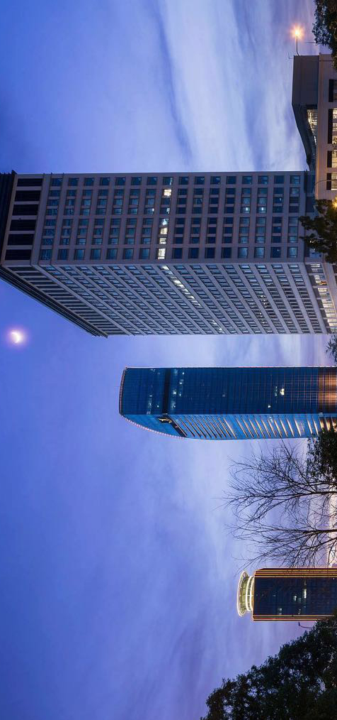
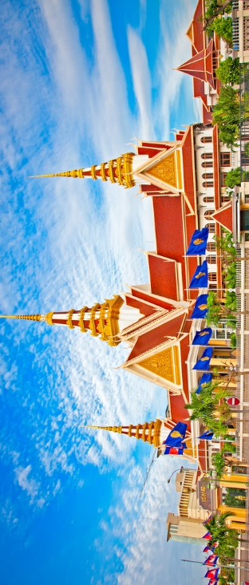
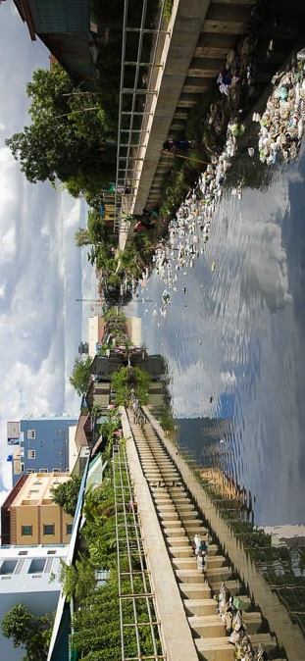
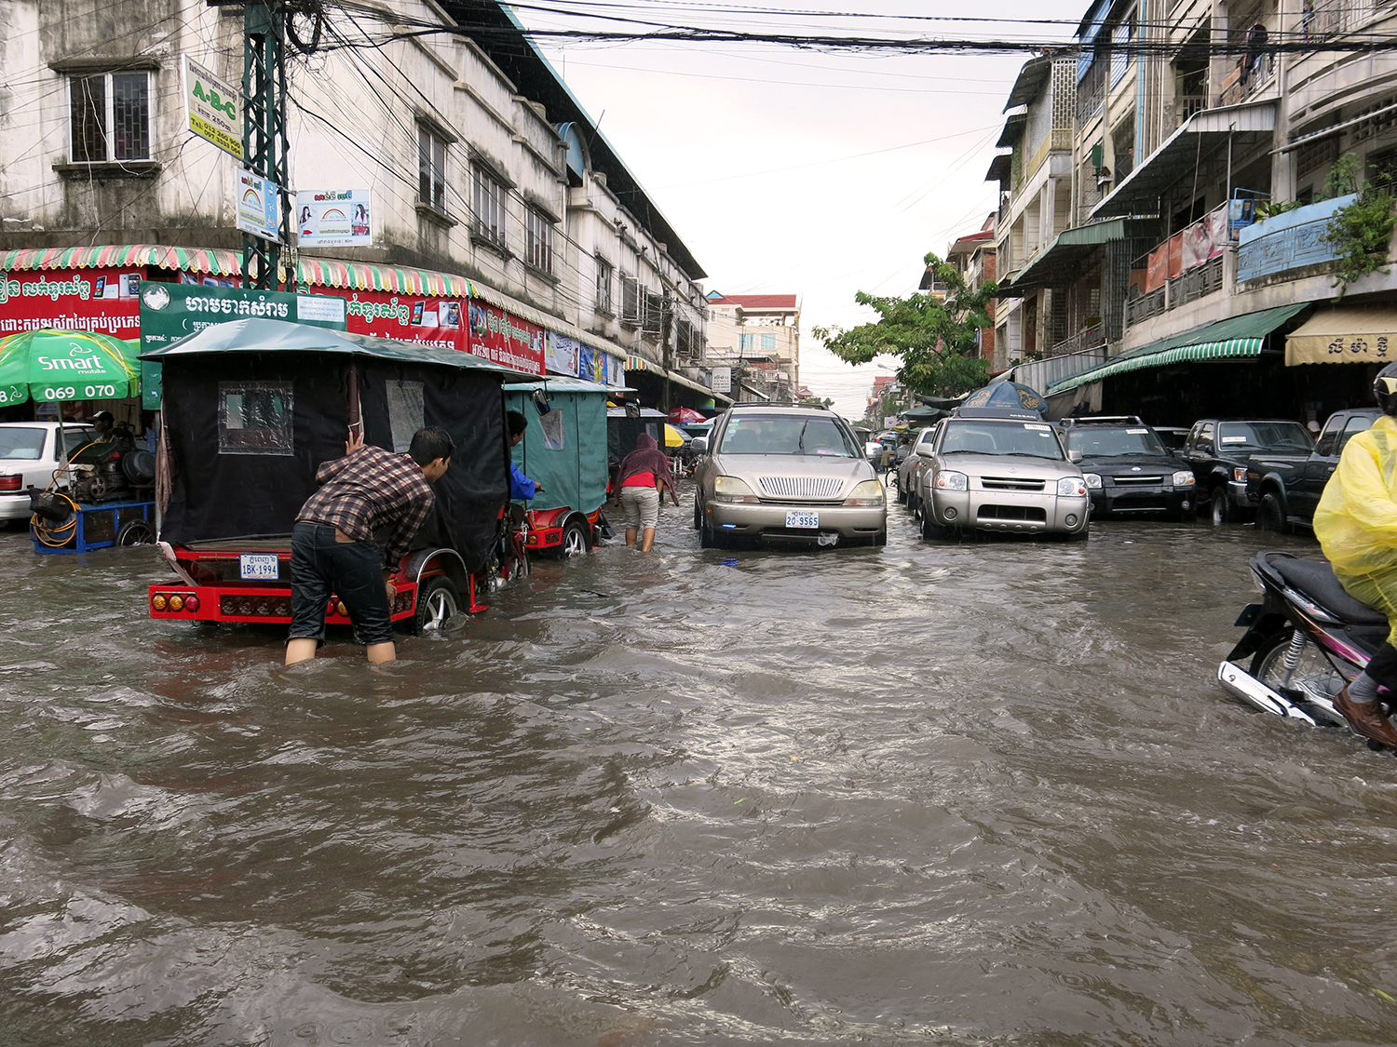



Analysis​ of the impacts of flood and affordable planning strategies in Phnom Penh
Bovisal Sim
Polytech Tours
M2 Planning and Sustainability
21 Chistophe Colomb, Tours
bovisals@gmail.com
Supervisor: Prof. Vincent Rotge

Slide 2
Table of content:
1. Methodology
2. Research questions
3. Research Objectives
4. Introduction
  a. Geography
  b. Bodies of water
5. Flood analysis
  a. History
  b. Impacts
  c. Climate
  d. Flood types
6. Case studies
7. Project
  a. Site
  b. Problem tree
  c. Evacuation
8. Planning strategies
  a. Potential solutions
  b. Maps
9. Conclusions
10. References

Slide 3
Research framework
Introduction
4. Project site
2. Historical flood and weaknesses
5. Planning Strategies
3. Case study
6. Conclusion

Slide 4
1.Methodology
My Research is designed to provide more information into the needs of mixed method approach through method triangulation of quantitative and qualitative method was chosen. As far as I have researched there is no evident of any study on my project site, where situate in central region there are many commercial buildings, condominiums, markets etc. It leaded me to come across with this idea to do this site.
Data plays an important role to know what has happened before. It is a systematically process to illustrate statistical or logical techniques to describe the facts/ history and impacts.
Focus on planning policy here I will describe how does it work/ the way we do. The partnerships for the development I would like to mention the featuring intergovernmental and or public and Private Sectors.
Challenges, understanding these is key to find accurate information and give useful insights and will be vital to determine the most effective responses.
Non- structural measure will be studied to find suitable solutions, The accessibility of open more space for the flow of water.
2.Research questions:
How does flood has negative impacts in daily life and business activities in the city?
Being a future urban planner, in what affordable strategies flood could be tackled?
3.Research objectives:
Identify the impacts of flood in the city and the effects to daily life
Assessing the integration of political problems/ people behavior
Formulating recommendations to find affordable ways to address the issue

Slide 5
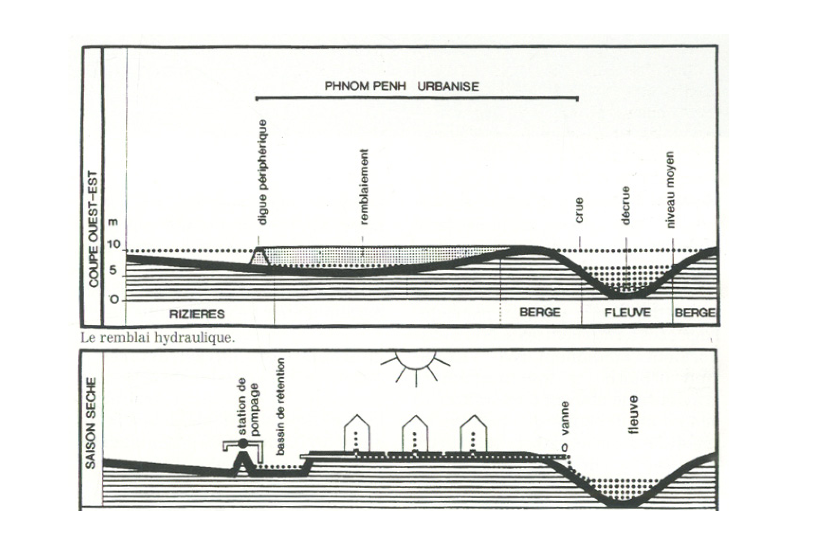
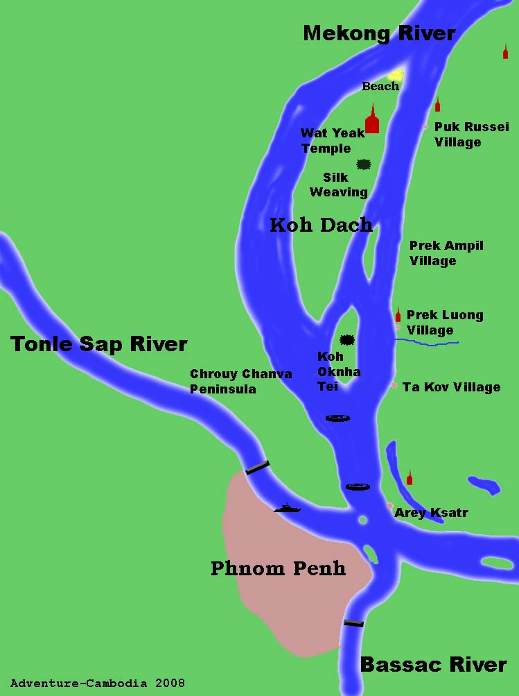
4.Introduction
a. Geography
Phnom Penh is the capital and largest city of Cambodia. It is located in the south-central region of the country, at the confluence of the Tonlé Sap, Mekong, and Bassac rivers. This capital has a tropical wet and dry. Divided into 12 districts, which are under the governance of the Phnom Penh Municipality. Each district also are further subdivided into 76 communes. The urban concentration in the most fertile river valleys and flood plains, flooding is a common occurrence during the rainy season.
Mekong
Figure 1: PP map

Slide 6
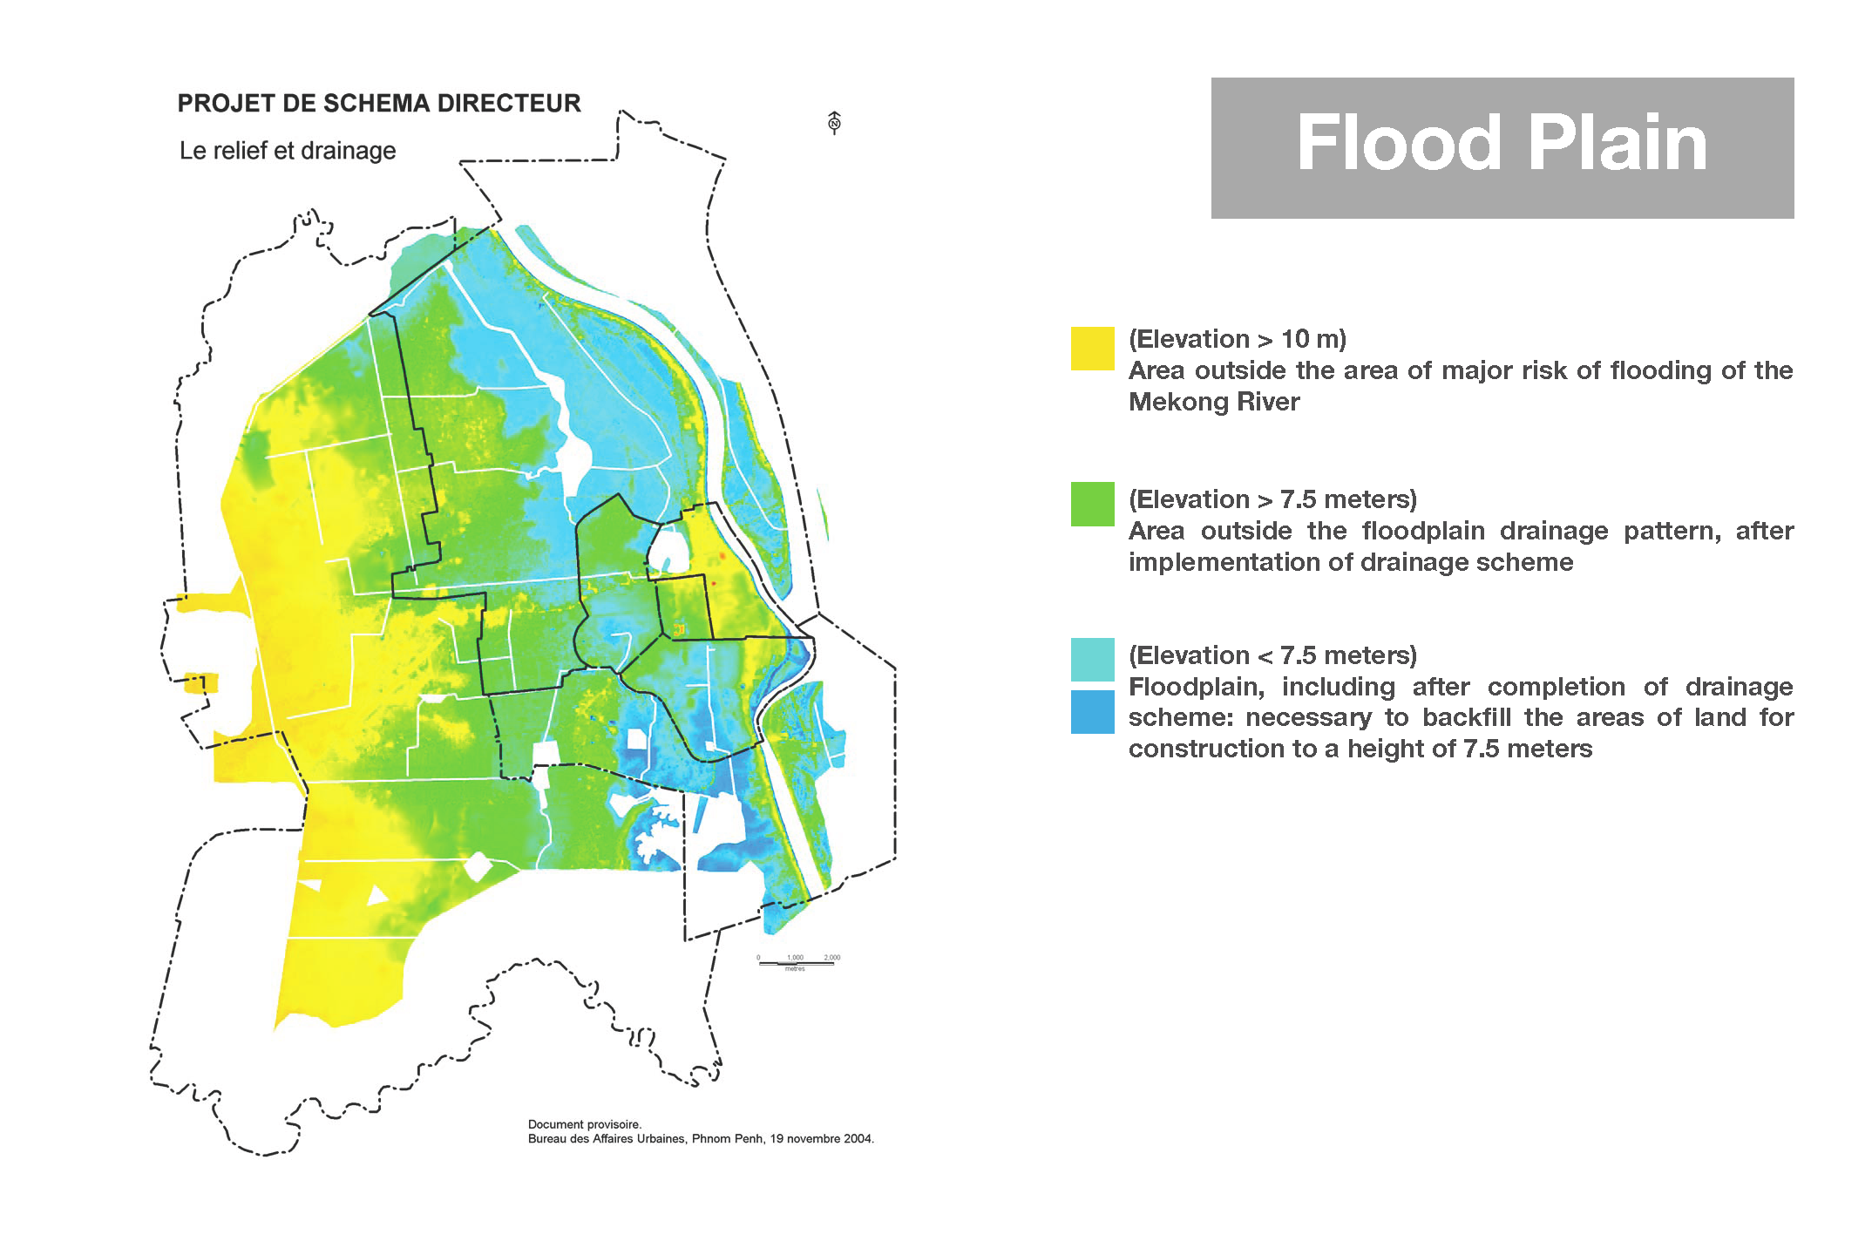
City flood plain
Figure : city elevation

Slide 7
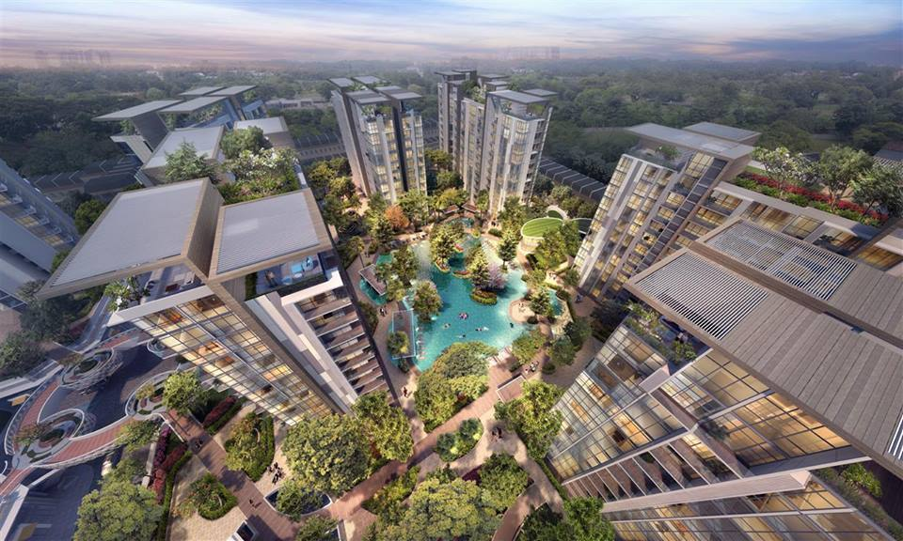
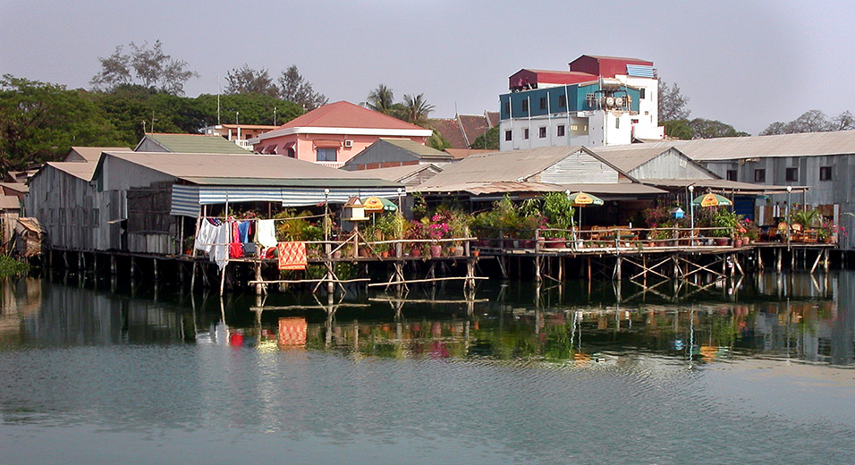
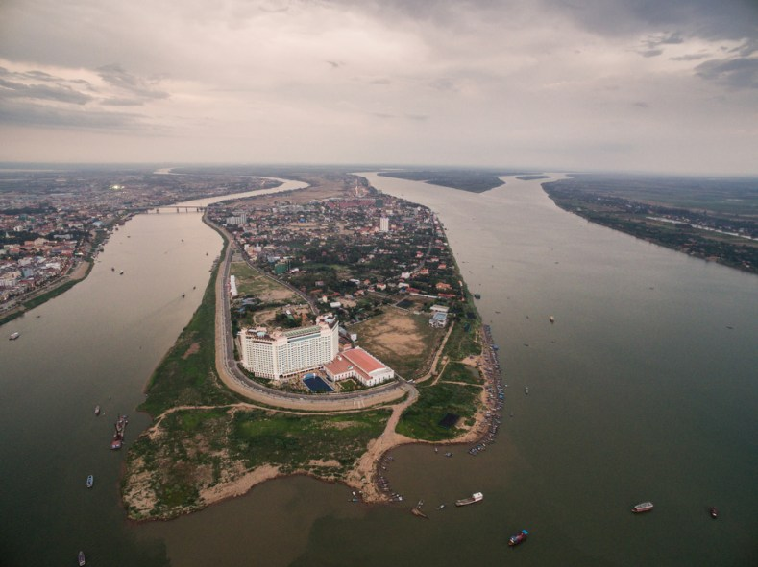
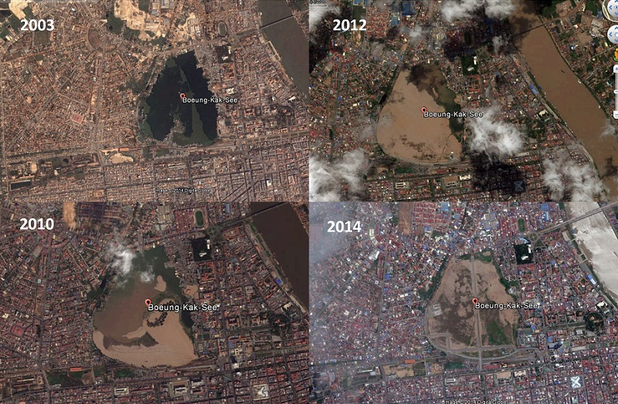
b. Bodies of water
Figure 2: Rivers
The Mekong is the 12th longest river in the world. 60 million people live along the river. Additionally, Tonle Sap Lake is a huge dumbbell-shaped body of water stretching across the northwest of the country. The Lake is the largest fresh water in South East Asia.
Figure 3: Boueng Kak
Kak Lake was a slum in the city center and considered the most important area for backpackers. In 2007 a private investment announced an agreement to transform the lake into a sprawling mixed-use development.
Figure3 : Mekong
Figure4 : Boeng kak

Slide 8
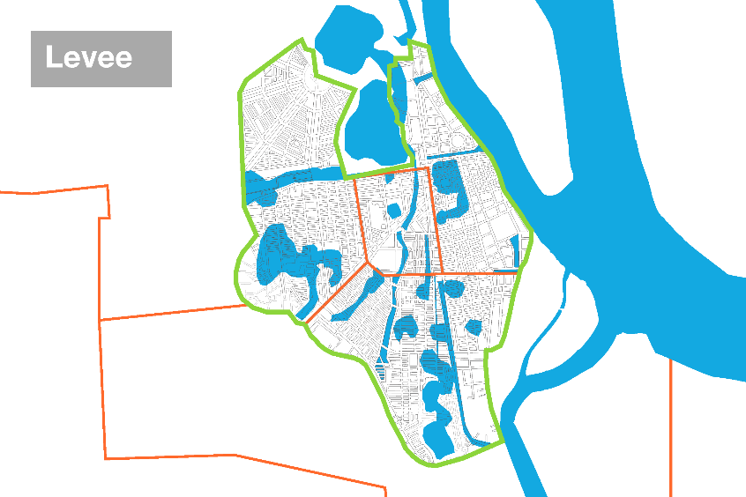
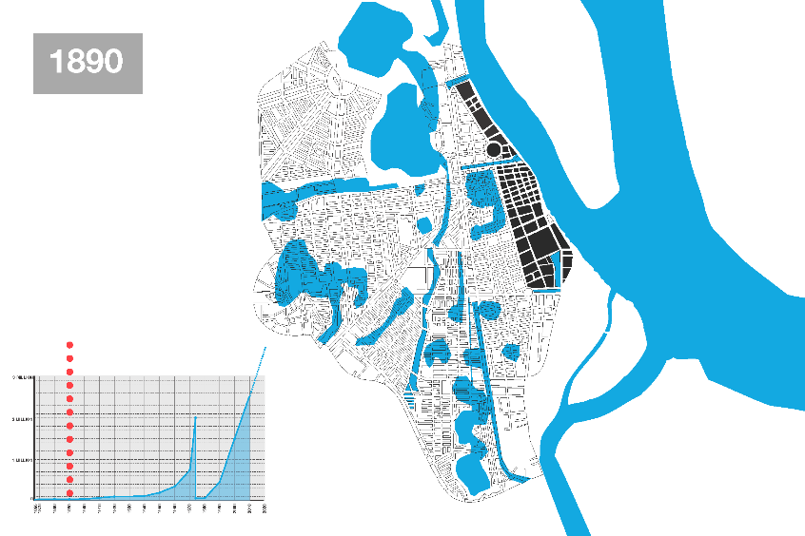
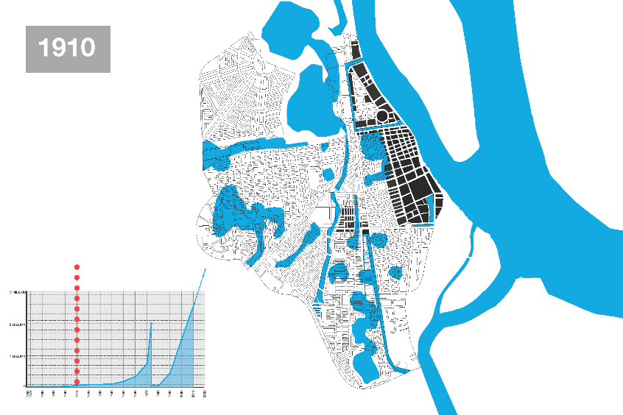
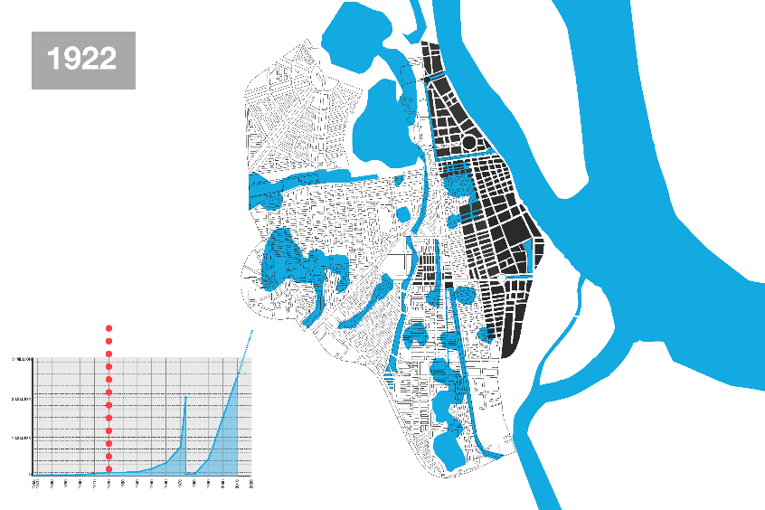
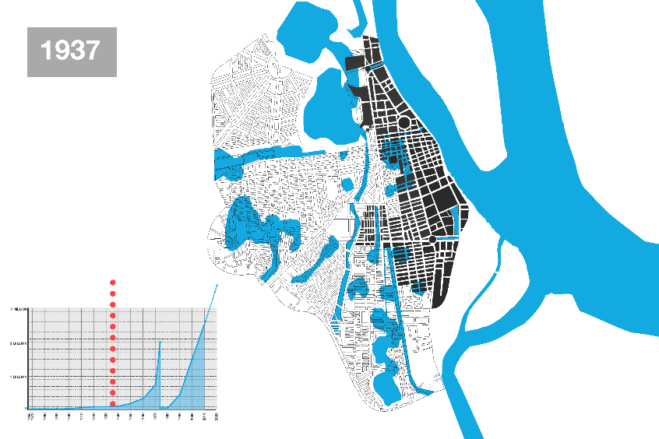
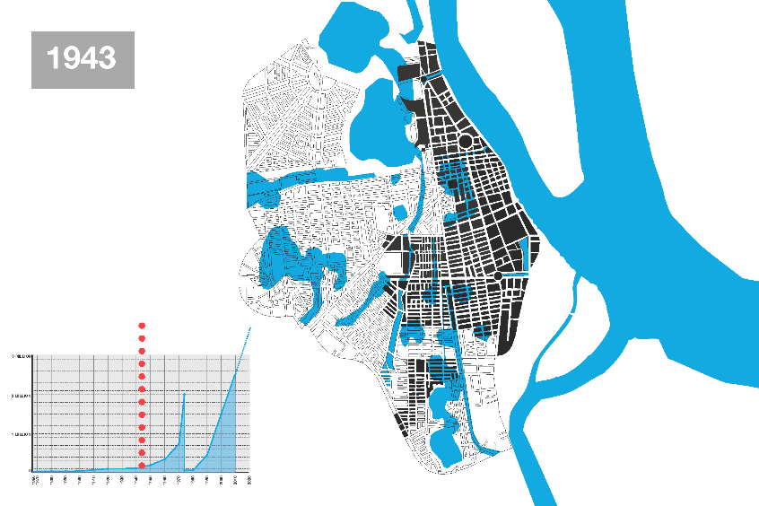
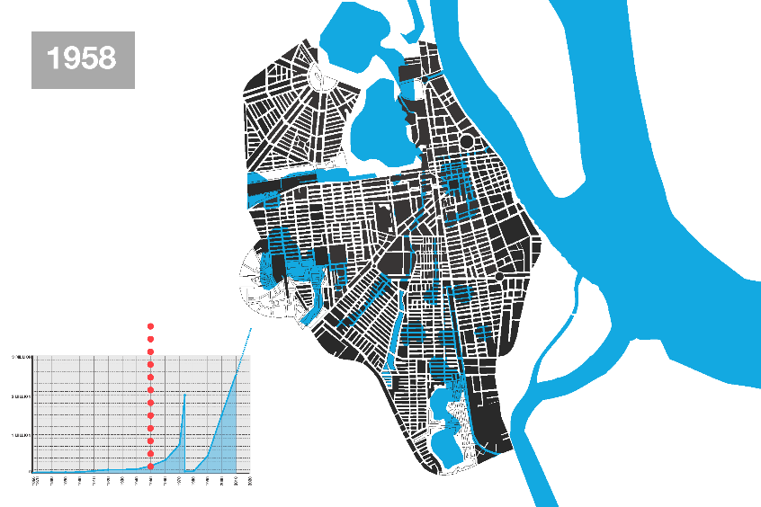
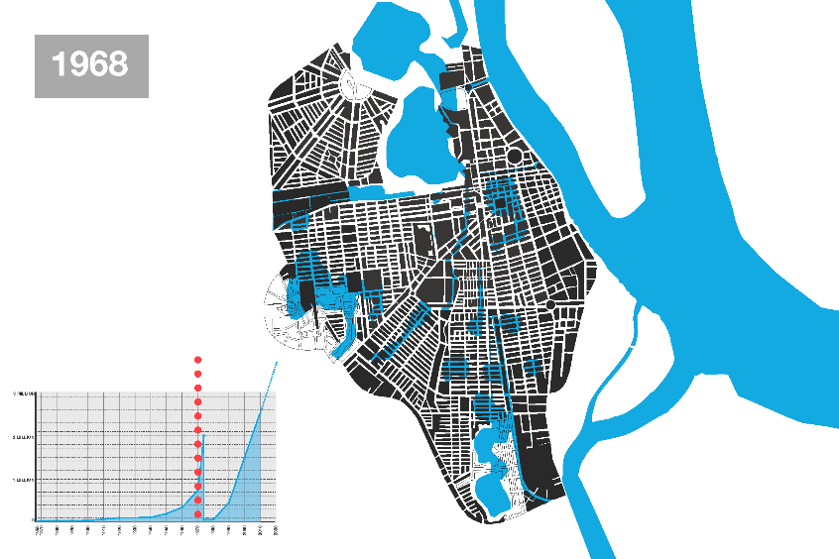
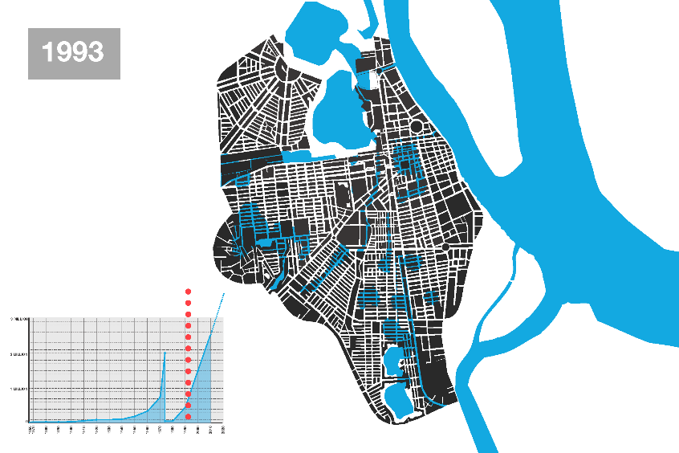
Transformation of the city
Figure 5: city transformation

Slide 9
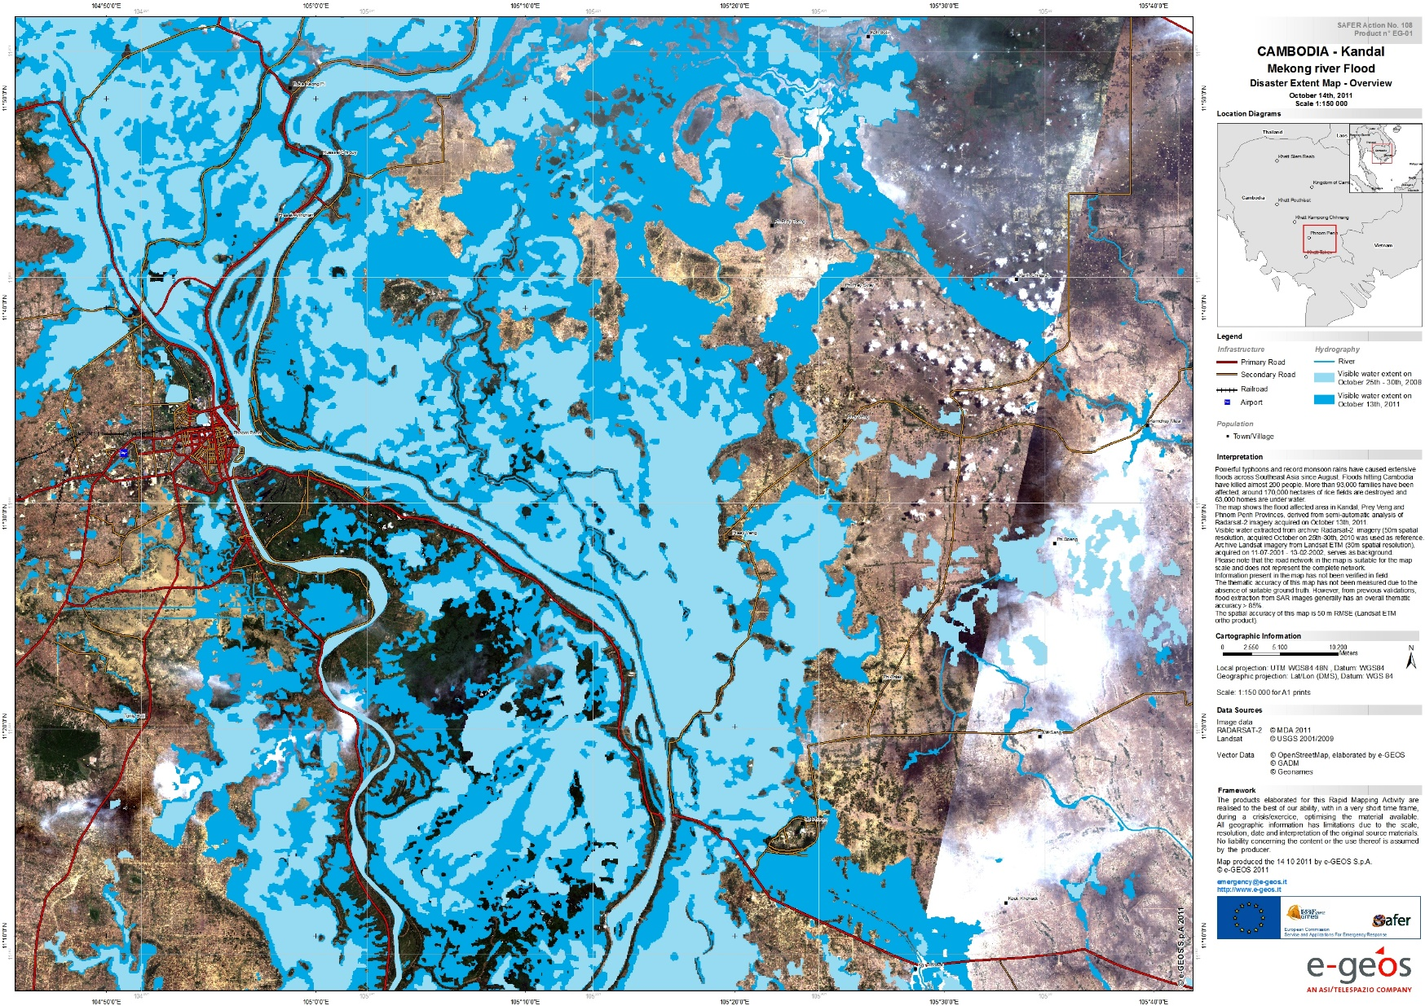
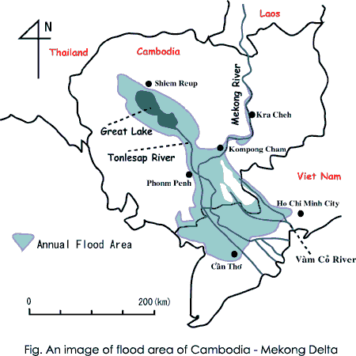
Flood in 2011
According to the Paris Urbanism Agency (APUR), Phnom Penh was less ideal for human settlement. Located on a natural floodplain, the landscape was dotted with rivers, lakes, and marsh (Hale.H 2017).
Figure 6: flood in 2011
Figure 7: country flood prone region

Slide 10
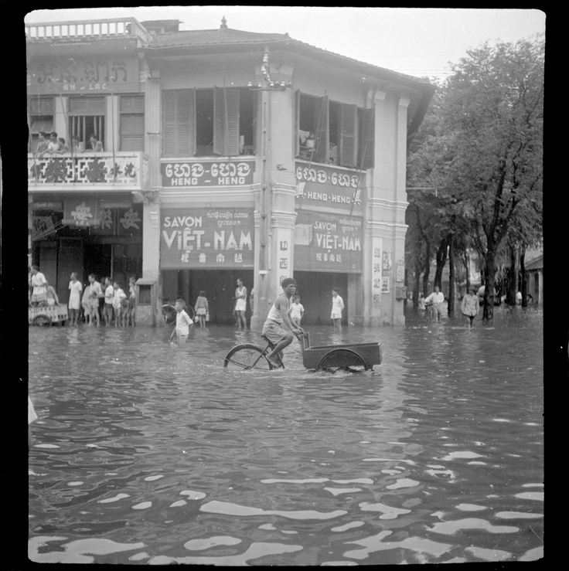
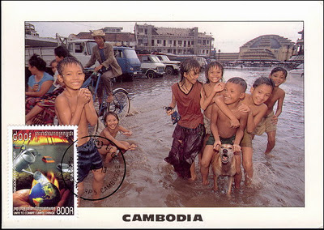
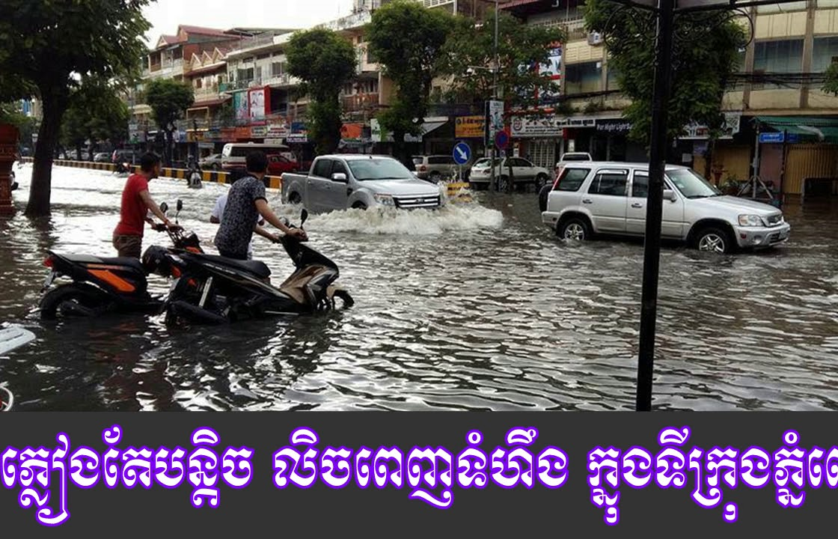
5. Flood analysis, a. Historical floods
Year | killed | victims | Homes damaged | Crop damaged
1996 |  | 1.3 mil | 50,000 | 600,000
1999 | 37 | 527 | 491 | 17,732
2000 | 277 | 2.7 mil
2001 | 62 | 2.1 mil | 429,698
2002 | 29 | 1.44 mil | 296,234 | 40,000
2006 | 18 | 700,000 | 800 | 40,000
2011 | 247 | 1 mil | 46,400
2013 | 152 |  | 418,770 | 300,500
2014 | 45 |  | 11,500
2016 | 3 |  | 9,546
Table 1: flood history
1990s
2017
Unknown
Figure 8: flood
Figure 9: flood 1990s
Figure 10: flood in 2017

Slide 11
b. Economical impacts
The ADB estimated the cost of damage by mass floods in 2011, whole country
Slow economic growth
€ 500 million
241,900 km of national road
142,900 km of streets and pathways
4,470 km of rural road
177 bridges
54 km of canal
1,396 schools
122 reservoirs embankment
6.6% of rice paddy
115 health care centers
Lack of water and power supply

Slide 12
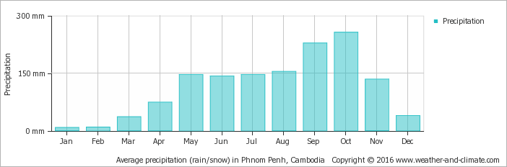
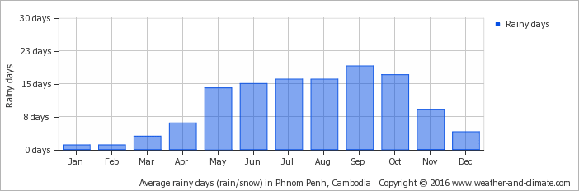
c. Climate
Average monthly precipitation over the year (rainfall), monthly precipitation, rain. Show in inches
Phnom Penh has tropical monsoon climate, the annual average rainfall in 2004 to 2013 is 1,487.2 mm/ year and large variation can be seen in annual rainfall from 1,170.9 mm/year (2006) to 1,938.7 mm/year (2008). The average annual rainfall is 1400 mm in the central low land regions.
Figure: 9 Average precipitation
Average monthly rainy days over the year. This is the number of days each month with rain
Figure: 11 Average monthly rainy days

Slide 13
Disaster scale
Flood 49%
Epidemic 28%
Drought 14%
Storm 9%
d. Flood types
Flash Flood
Flash floods describes as usually taking place after less than six hours of rain. Even without heavy rainfall, flash floods can come rushing in unannounced.
River Flood
A river flood occurs when a river fills with water beyond its capacity. The surplus water overflows the banks and runs into adjoining low-lying lands. The most common reason of river flooding is heavy rainfall.

Slide 14
Flood cause
Meterological Factors | Hydrogical Factors | Human factors
-Rainfall -Cyclonic storms -Temperature | - Soil moisture level - Ground water level before storm -Natrual surface infiltration - Presence of permeable cover - Canal cross section, slope - Presence or absence of over back flow network - High tide | - Land use change - Occupation of flood plain obstruction flows - Inefficient non maintenance of network - Climate change affects magnitude and frequency of precipitations and floods - Lack of flood control measures - Multiple authorities with non-responsibility
Table 2: flood cause
Urbanization impacts over floods
(Sen. D 2018)
Causes | Effects
Natural vegetation removal | Higher runoff volumes and peak flows; greater flow velocities; increased soil erosion.
Increasing of imperviousness rates | Higher runoff volumes and peak flows; less surface depressions detention and greater velocities of flow.
Construction of an artificial drainage net | Significant increasing of flow velocities reduction of time to peak.
River banks and flood plain occupation | Population directly exposed to periodic inundation at natural flooded areas; amplification of the extension of the inundated areas, as there is less space to over bank flows and storage.
Solid waste and wastewater disposal on drainage net | Water quality degradation; diseases; drainage net obstruction; channel sedimentation
Table 3: flood cause and effects

Slide 15
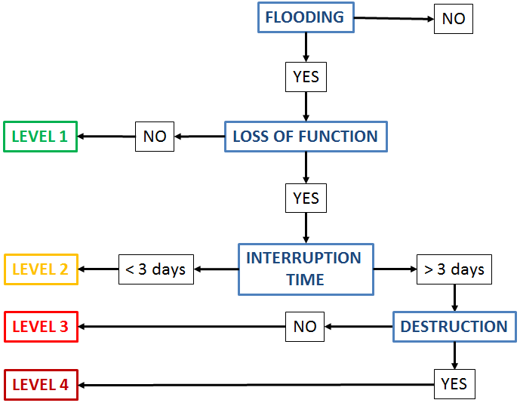
The rating system for flood-related damage
damage severity correspond to the flooding of an element without the loss of its function. F.g, a road is flooded but cars can still drive on it
loss of the element’s function for fewer than 3 days. F.g, a road is flooded and cars cannot drive on it for a day
indicates an interruption time of the flooded element function longer than 3 days. F.g, a road is flooded and cars cannot drive on it for a week
destruction of the element by the flood. F.g, a road is destroyed by a flood
Figure: 12 Flood level

Slide 16
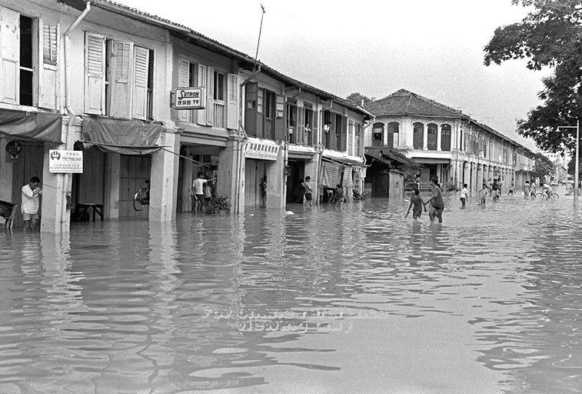
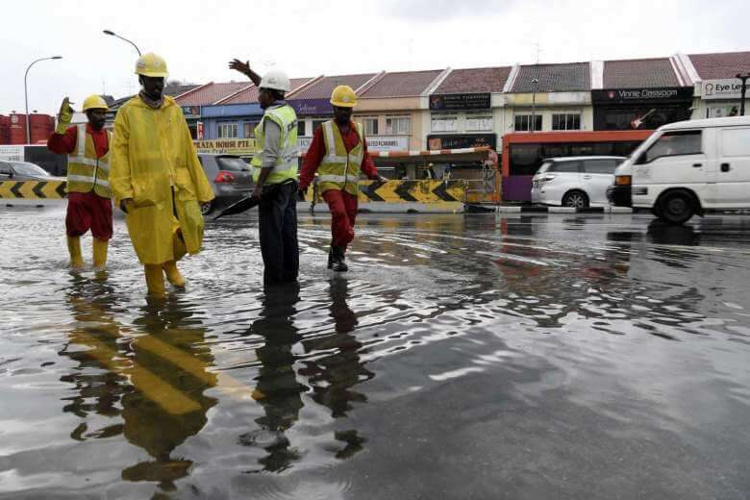
6. Case study
1969 Flood
2017 flash flood
Figure 13: flood in Sg 1969
Figure 14: flood in Sg 2017
At a population density of 7,540 people per square kilometer, the country is 100% urbanized. Floods are a common occurrence in Singapore. Most floods in Singapore are flash floods that subside within a few hours. Over the years, PUB takes every flood incident seriously and assesses the cause of any flood. PUB engages building owners on appropriate flood protection measures to protect their developments from floods.

Slide 17
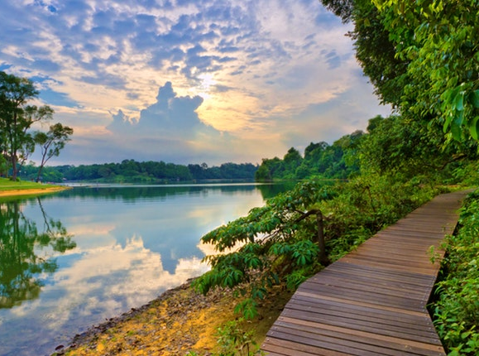
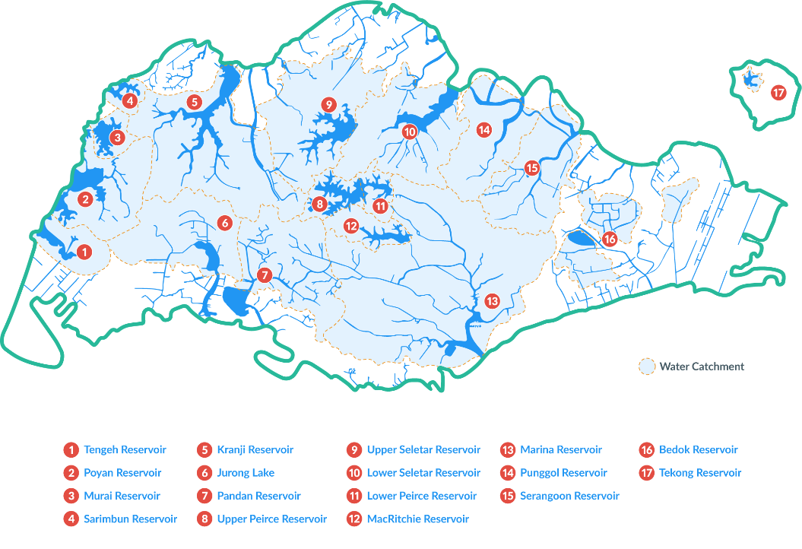
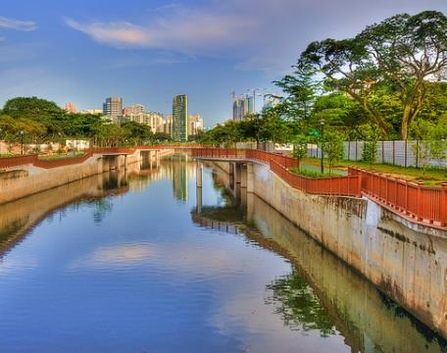
Reservoir and Canal
Singapore does not have any significant, accessible natural aquifers, which are layers of underground rock that are able to hold water. Two-thirds of Singapore's land is used as water catchment. There are 17 reservoirs currently, many of which have adjoining parks with lot of activities.
The Stamford Diversion Canal is a new diversion canal to prevent flash floods. It will channel water to the Singapore River, the project will alleviate flooding along a major road during heavy rain.
Figure 15: reservoirs
Figure 16: number of water bodies
Figure 17: a canal

Slide 18
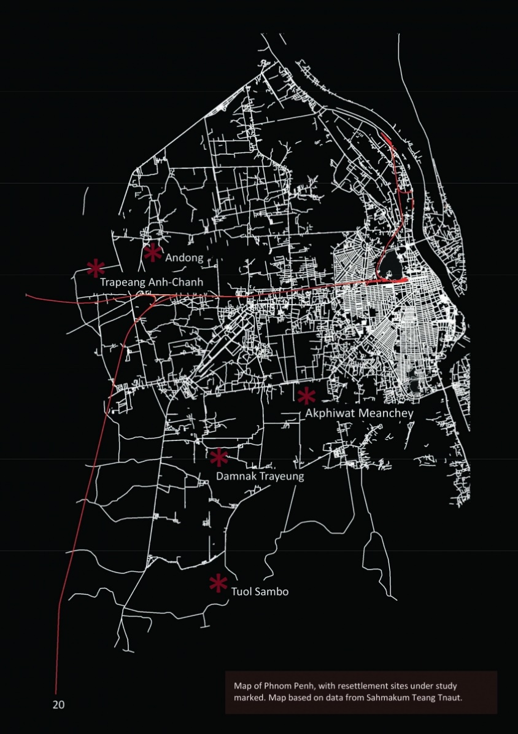
7. Project, a.site
11 Km2
Embassies
+200,000 people
local residents
Condominiums
Entertainment
Figure 18: city annalysis

Slide 19
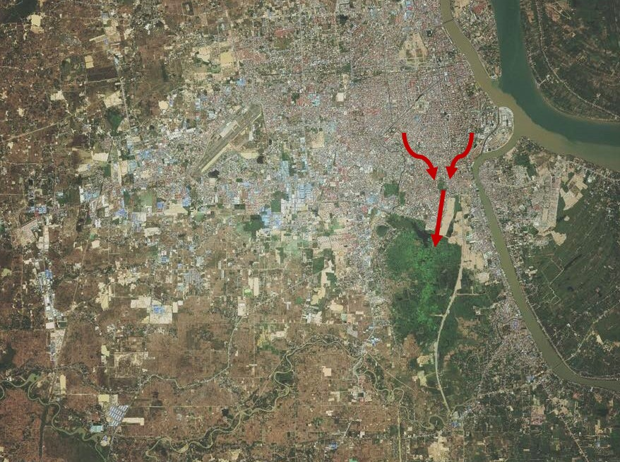
Tumpun lake is a big reservoir with 2,572-hectare in total area. 8,154 cubic meters of waste water and 2,335 cubic meters of urine and 234 tons of feces, are made come to here every single day. It is effectively reducing pollutant loads in Phnom Penh’s wastewater before it reaches the Bassac River.

Slide 20
b. Problem tree
Political problem
Lack of experts
Government
Land-use planning
Small drainage pipe
Weak government
Lack of experts
Financial problem
Poorly maintained
Rivers
Problem tree
Geography
Lakes filled
Flat land
Climate change
Lack of cooperation
Social awareness
Settle on the lake
Garbage

Slide 21
c. Evacuation plan
Weather/Flood Information and Early warning processing
Department of Meteorology/Hydrology
Cabinet Minister of Ministry of Water Resources and Meteorology
Local authority
National committee for disaster management
Ministry of Defend/Interior
Red Cross
Media/ Newspaper

Slide 22


Cities comparison
Urban greenery
47% of total area
0.1% of total area
Sanitation
Widespread coverage of effluent collection and treatment
Lack of sewage system and treatment plants; those that exist fail to collect the planned amount of sewage
Urban drainage
Quantitative aspects are controlled; management of water quality
Unresolved quantitative impacts; unidentified impacts due to water quality
River flooding
Non-structural control measures such as flood insurance and zoning
Heavy losses owing to lack of control policy

Slide 23
8. Planning strategies
Affordable planning strategies
Strengthen Government
Social awareness
Natural Waterway
- Good government
- Legislation and enforcement
- Construction law
- Warning system
- Rainwater harvesting
- Elevate buildings
- Education
- Permeable surface
- Urban greenery
- Vegetation roof
- Wetland and reservoir
- Open space

Slide 24
Planning strategies
Most cities all around the world are 60% to 90% impermeable. It is useful to have urban landscape it is a natural permeable surface with vegetation areas such as parks, gardens, remnant natural corridors. Only 0.66 square kilometers of Phnom Penh are officially public parks, representing only about 0.1%. According to a research by (Commission for Architecture and the Built Environment Uk Based),
- Increasing the green space cover in urban areas by 10 % reduces surface run-off by almost 5 %
- Increasing tree cover in urban areas by 10 % reduces surface water run-off by almost 6 %
- Adding green roofs to all the buildings in town centres can reduce surface water run-off by almost 20 %.

Slide 25
Planning strategies
Good governance
Achieving good governance will require the active participation and commitment of all segments of the society, enhanced information sharing, accountability, transparency, equality, inclusiveness, the rule of law and anti-corruption. In order to gain trust among the people, anti-corruption is highly recommended so that people will respect the rule of law.
Land use
-Development in high flood risk district. -Control beyond the limitation of administrative authority. -Guide on layout streets, infrastructure, lots, shapes and drainage installation.
Legislation and enforcement
-Prior review, designation of flood risk districts, evacuation of disaster affect. Etc. -Requirement of integrated regulations and institution. -Develop categorical manuals or guidelines like the flood prevention standards for each district or building code.
Legislation and enforcement
Characterize as the taking part in an action, people with the authorities and private sectors in choosing projects and activities, setting needs and doing the undertakings as accomplices. It turns into a need to guarantee that cooperation by the commitment of their thoughts, premiums, work and time.

Slide 26



Wetlands conservation and Education
Few important clues to learn from Singapore are: lake/reservoirs conservation. 47% represent green space, 66 m2/person and people spend 5 minute to get to the nearest park. In comparison to Phnom Penh there are 70 parks or open, green spaces, represent only 0.1% of the city total area.
Waterways and culverts are trapped by garbage and debris, and water finds its way into the streets and into people's homes. Hence, education is important, to let people know how serious of flood is, and the cause by trapping the waterway.
Figure 19: reservoir
Figure 20: tree
Figure 21: dust bin

Slide 27
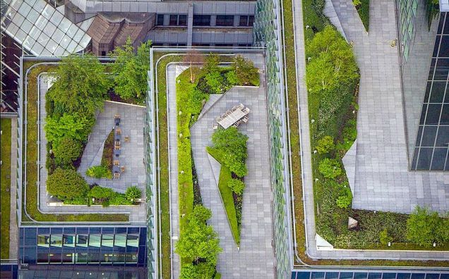
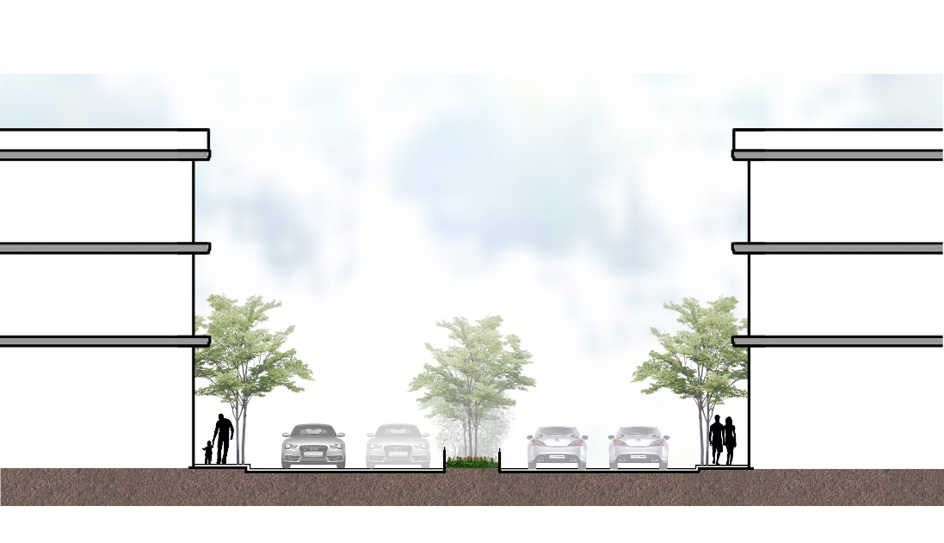
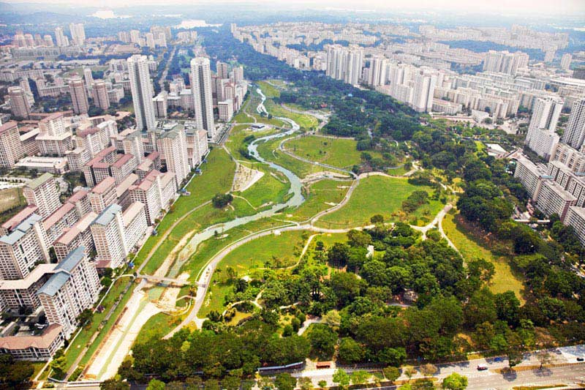
Vegetation roof
Mid street garden
Wetland and reservoir
Reduce runoff, green roofs will intercept between 15% and 90% of runoff. Also there are many more benefits for instance: rainwater control, air quality, energy savings.
It drains rainwater from each side of the street. Hence it could reduce during runoff from sewer.
The creation of more wetlands which can act as sponges, and provide a temporary storage for floodwaters. Soaking up moisture and wooded areas can slow down waters when rivers overflow.
Figure 22 rooftop vegetation
Figure 23 mid street garden
Figure 24 urban wetland

Slide 28
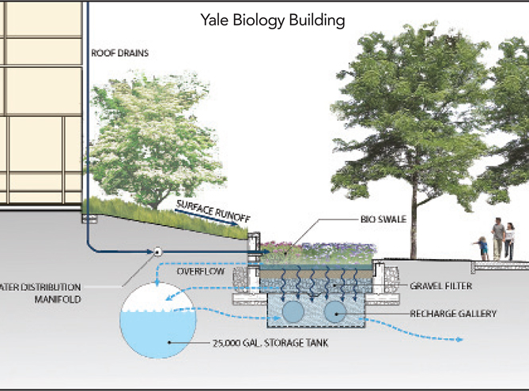
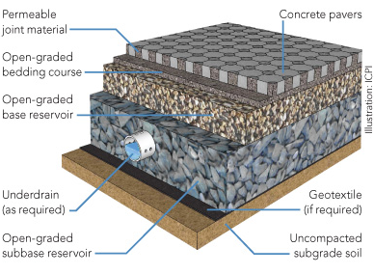
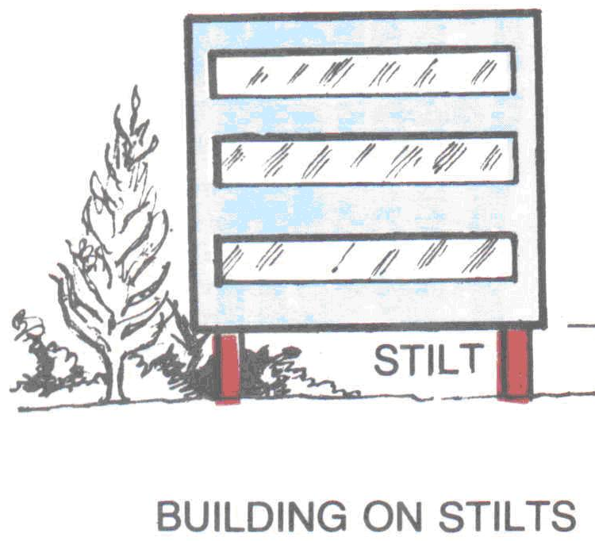
Rainwater harvesting
Permeable surface
Elevate building
Use of rainwater within the vicinity of rainfall is known as rainwater harvesting. Every house in rural area, people harvest rainwater and use it as normal. It is different to the city because tap water is accessible 24/7 .
Permeable allows water to drain through the wearing surface to the underlying ground with the ability to act as a reservoir during periods of high downfall. It could not only help to tackle flash flooding but may also help to reduce the heating of tarmac in hot weather.
Elevate the ground floor beyond the floor line. Install pilotis or pier and innovate the inner floor or building by filling land.
Figure 25 rain water harvesting
Figure 26 section of permeable pavement and road
Figure 27 elevate building

Slide 29
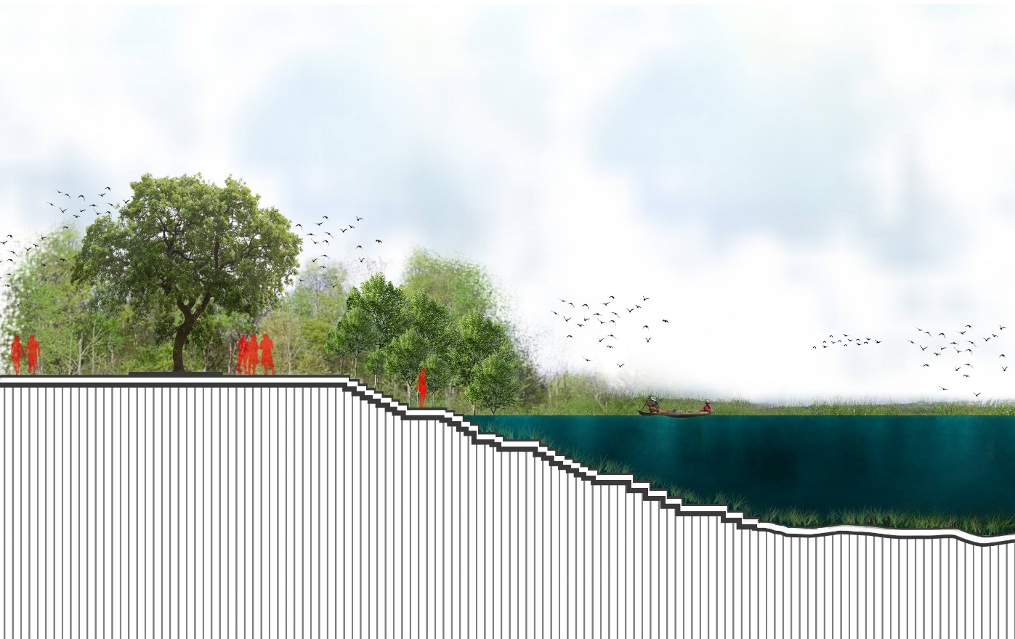
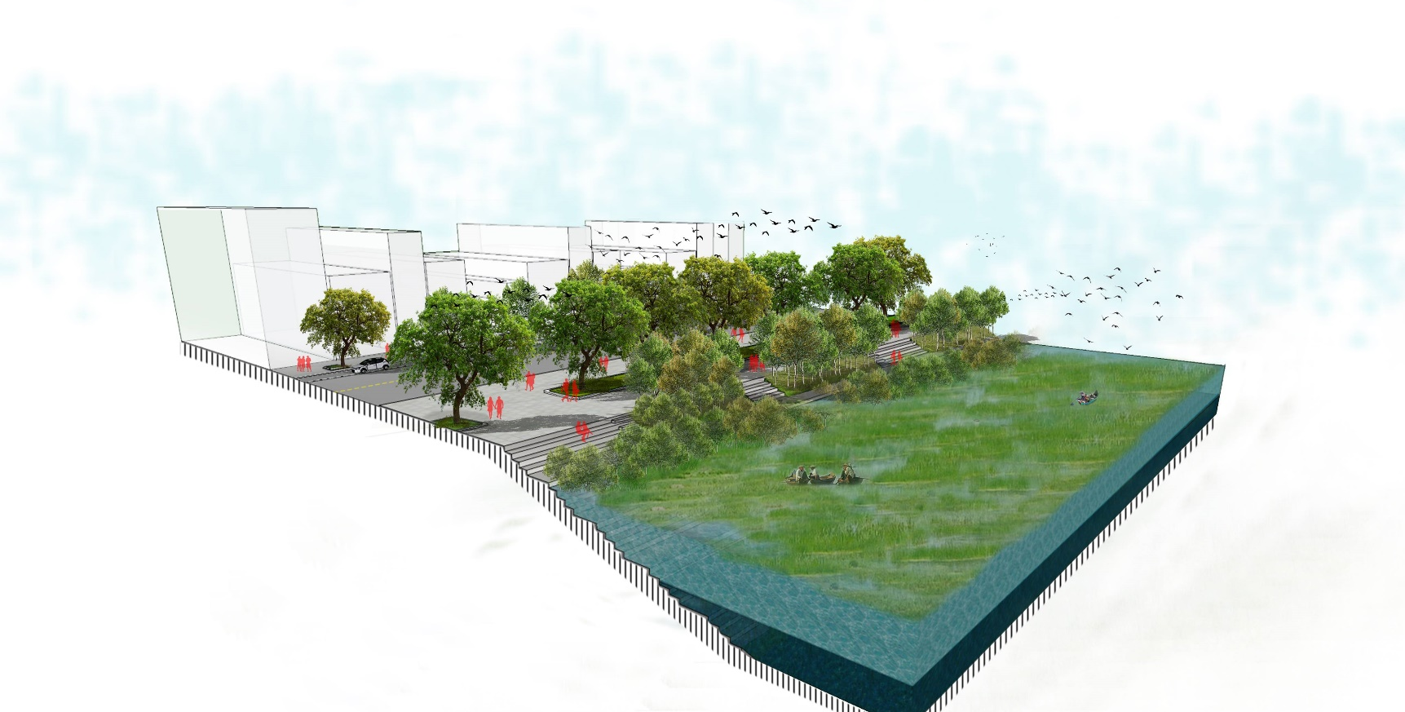
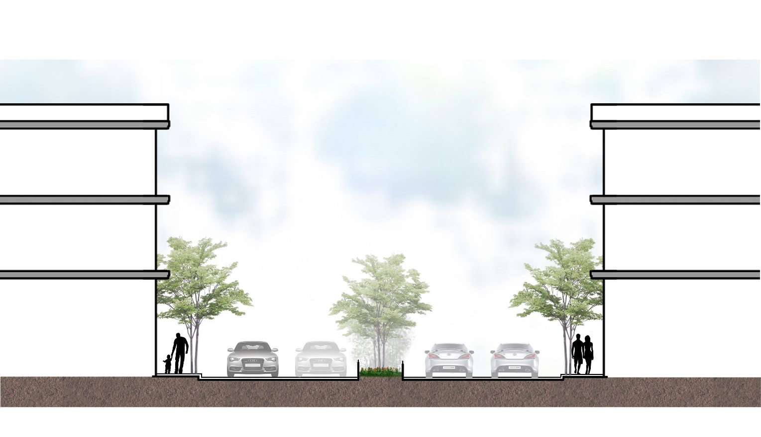
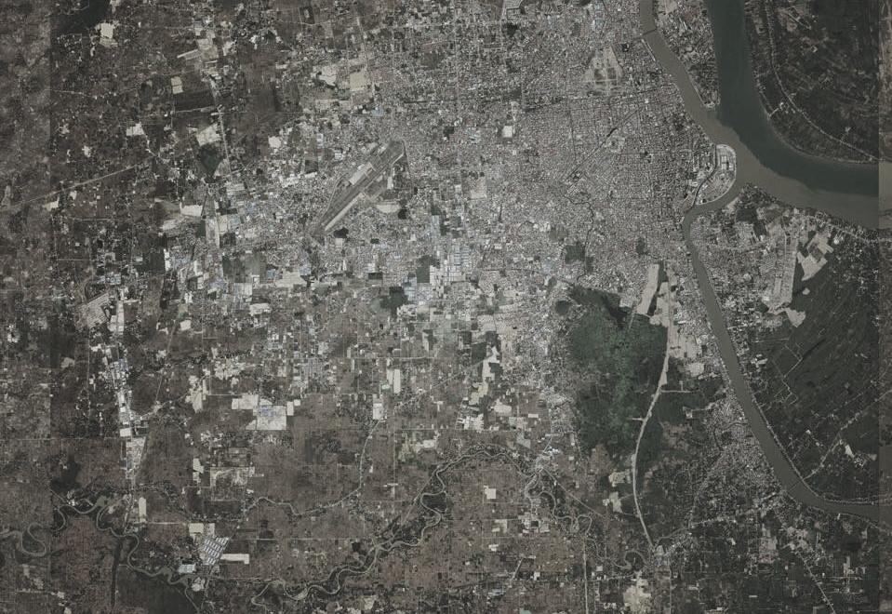
Wetland
Urban greenery
Mid street space

Slide 30
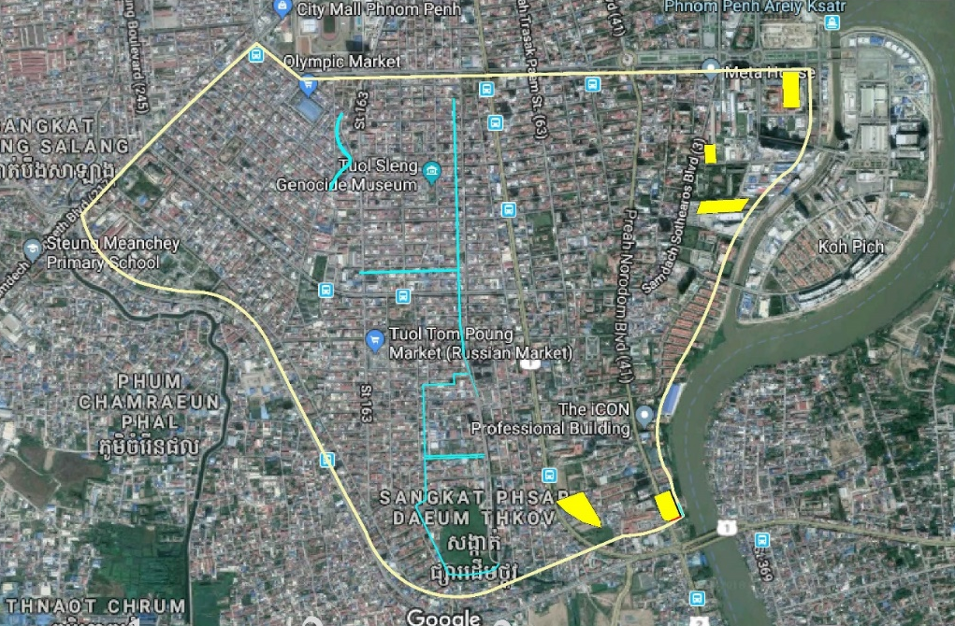
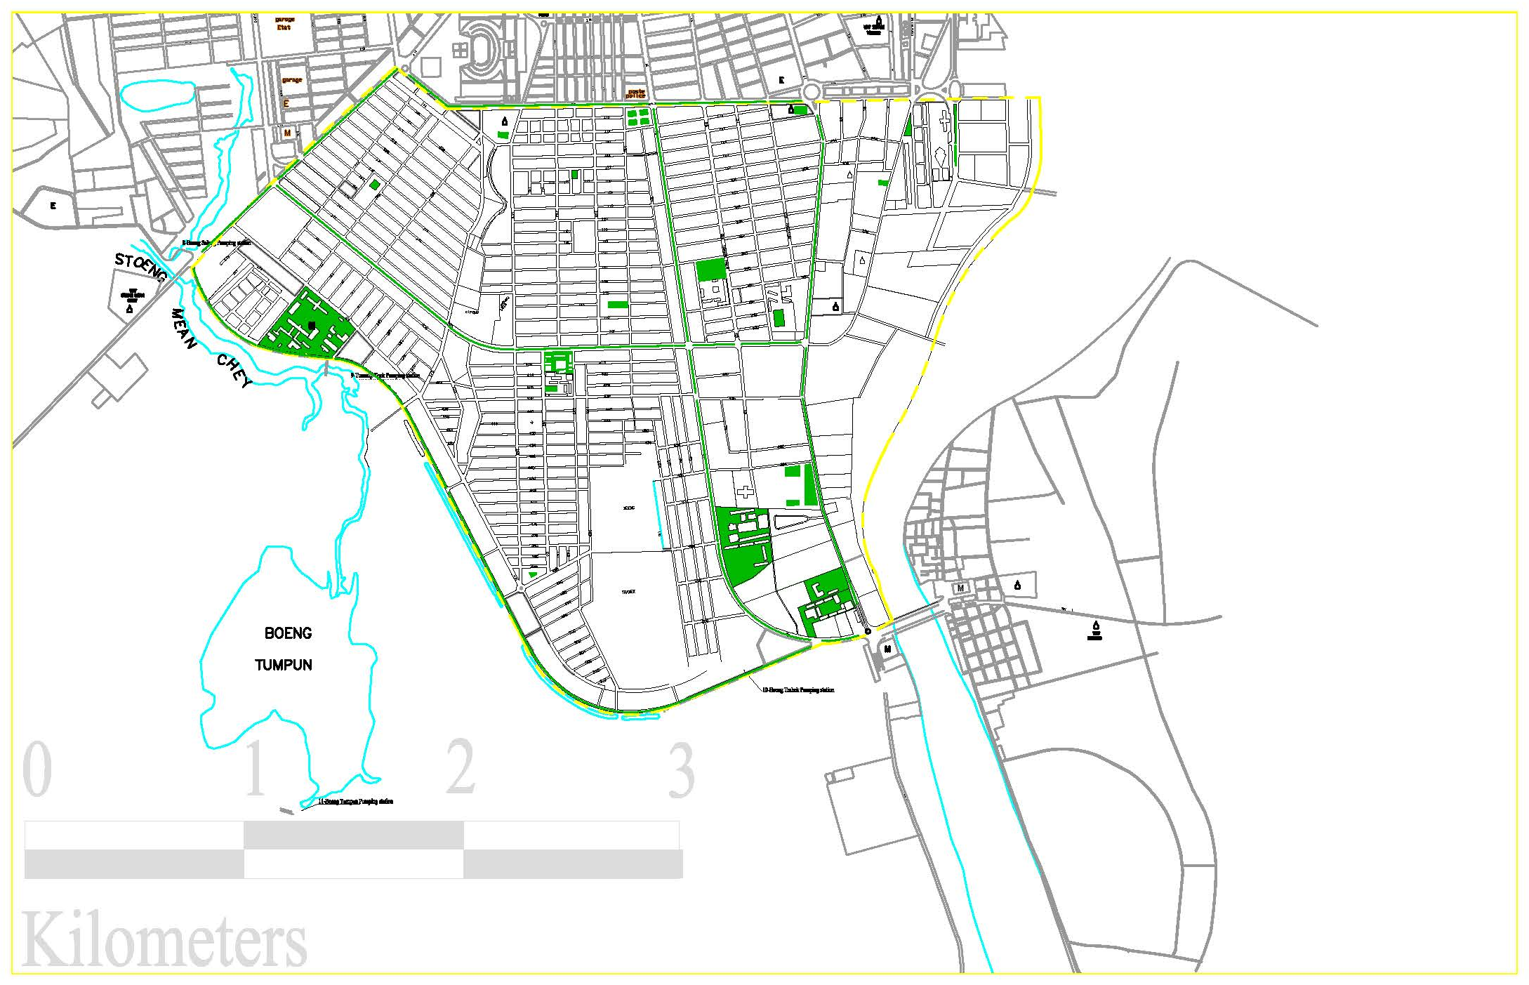
Built up area map and propose green space
Yellow parts are unbuilt zones, this total area is about 97% built
An increase of 0.5km2 of green spaces, it is 5 times bigger the whole city parks and garden combine.
Figure 28 built up area map
Figure 29 propose green space map

Slide 31
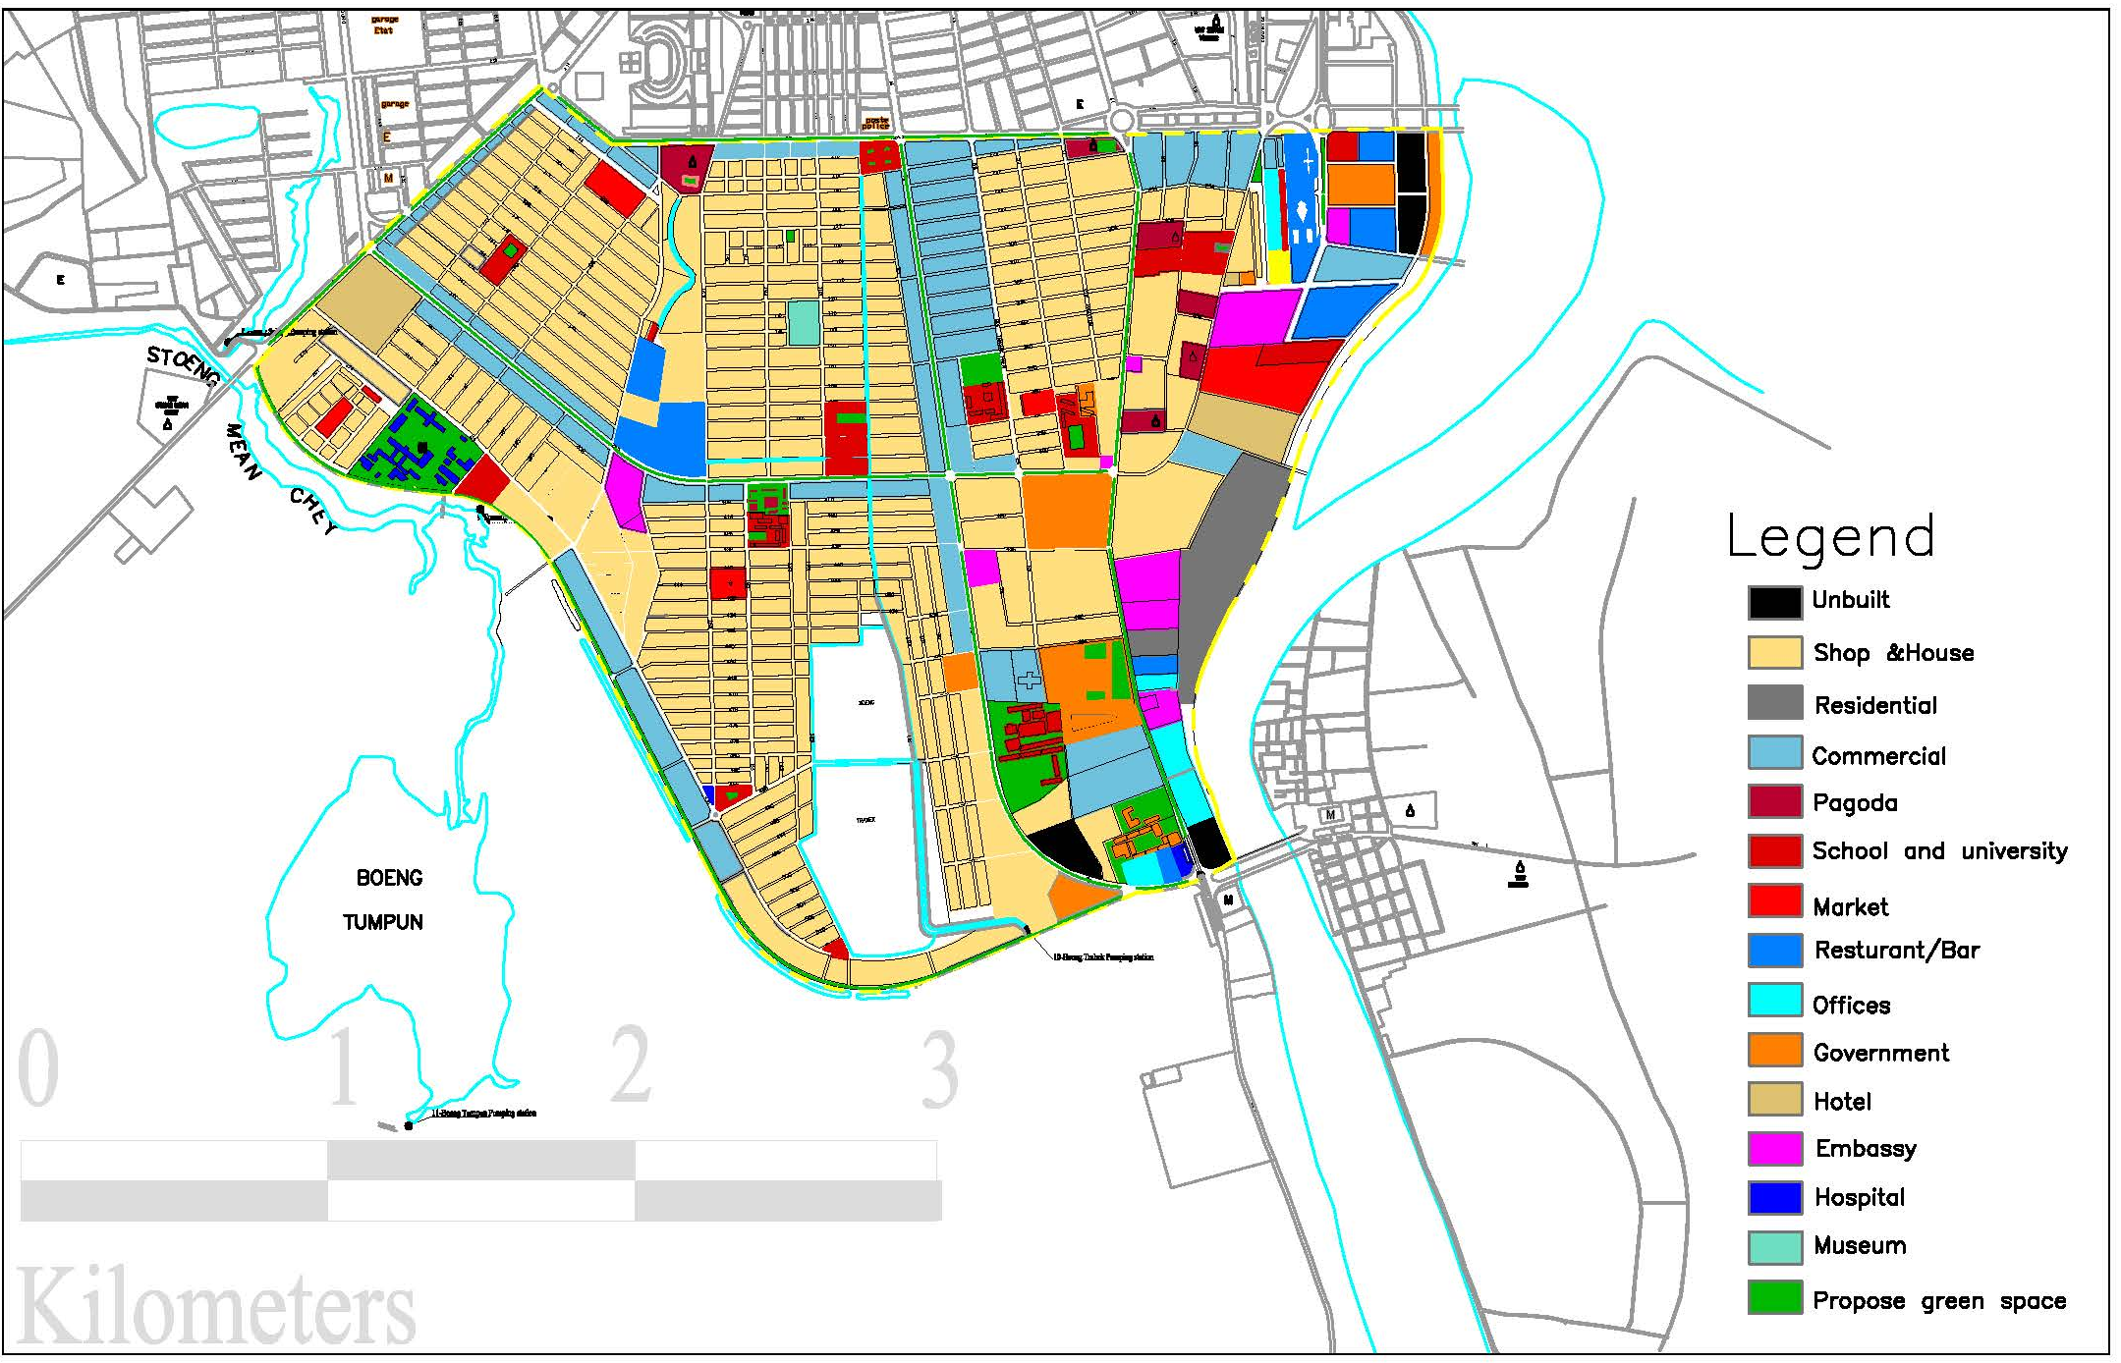
Propose green space
Figure 30 propose green space map 2

Slide 32
9. Conclusion
Phnom Penh is at a high risk of flood is based on its geography, situated by many rivers, it is a flat also with many lakes surrounding. The lack of comprehensive, strategic planning is a very big issue, and this is why the city keep filling its lakes, which destroyed the flow of water as it uses to be, also a lack of green space which plays an importance role for the water to absorb. After going into deep to study this issue, I could assume, flood is very important to study about, it is a hot issue happening all over the world, due to the effect of climate change as a result it is even harder to estimate when will it be happened and how long it lasts. Not only a least developing country such as Cambodia, but even developed countries still working on to mitigate this issue.

Slide 33
10. References:
http://www.adventure-cambodia.com/daytrips.html
https://cityofwater.files.wordpress.com/2012/06/mappingphnompenh_small_locked.pdf
https://www.realestate.com.kh/news/location-profile-chroy-changvar/
https://ejatlas.org/conflict/boeung-kak-lake-evictions-phnom-penh
https://cityofwater.files.wordpress.com/2012/06/mappingphnompenh_small_locked.pdf
http://portal.mrcmekong.org/flood
https://www.pinterest.com/youthorn/la-culture-et-civilisation-du-cambodge/?lp=true
www.weather-and-climate.com
https://www.researchgate.net/figure/Data-structure-diagram-organising-the-connections-between-the-DAMAGE-BASIN-and EVENT_fig3_323524861?_sg=9rpLJ55Vr6efBNAuPzPIB7qh39F4m8IXgEjwUjpOT3cXwH0IePy_rEG2x0qp7VjF3sW2FwEq10A44Je0YCsVVg
https://blogtoexpress.blogspot.com/2011/10/flood-as-natural-disaster.html
https://www.straitstimes.com/singapore/environment/flooding-in-9-areas-due-to-unusually-heavy-rainfall-what-to-do-during-a-flash
https://www.lonelyplanet.com/singapore/attractions/macritchie-reservoir/a/poi-sig/365313/357350
https://www.lonelyplanet.com/singapore/attractions/macritchie-reservoir/a/poi-sig/365313/357350
https://www.pub.gov.sg/watersupply/fournationaltaps/localcatchmentwater
https://www.flickr.com/photos/26774111@N00/5198844409
https://albertawilderness.ca/issues/wildlands/areas-of-concern/pakowki-lake/
https://icon-icons.com/es/icono/arbol-follaje-naturaleza/53329
http://www.redsea-divingsafari.com/eco-efforts/environmental-policy
https://architecturemagz.com/43-green-roof-building-ideas-and-why-it-is-good-for-our-planet/
https://www.treehugger.com/urban-design/bishan-park-kallang-river-restoration-singapore.html
https://ddot.dc.gov/GreenAlleys
http://www.odpem.org.jm/DisastersDoHappen/TypesofHazardsDisasters/Floods/ProtectYourselfFromFloods/HowtoFloodProofYourHome/tabid/292/Default.aspx

