Slide 1


URBAN ISSUES ON THE LAYOUT OF THE NEW LIGHT RAIL SYSTEMS
ANALYSIS IN THE EUROPEAN SPACE
Presented by
João TEIXEIRA
THESYS SUPERVISOR
THIBAULT Serge,
Professor at the University François Rabelais in Tours, France
THESYS CO-SUPERVISOR
PINHO Paulo,
Professor at the University of Porto, Portugal

Slide 2
URBAN ISSUES ON THE LAYOUT OF THE NEW LIGHT RAIL SYSTEMS
ANALYSIS IN THE EUROPEAN SPACE
RESEARCH QUESTION
What kind of relationships exists between the tram and the concept of urbanity?
HYPOTHESIS
A complexity of relationships

Slide 3
EUROPEAN SPACE
“These tall houses packed together on others, these winding streets, these unlikely places, but also this promiscuity of different social groups in the evening of an heavily hierarchical society. This unexpected encounters between professions, yet strictly separated by a corporate logic such are fundamental and enduring features of the European city. “ Max Webber

Slide 4
URBANITY
“The city is a theater of social action, and everything else – art, politics, education, commerce – only serves to make the social drama…more richly significant, as a stage-set, well-designed, intensifies and underlines the gestures of the actors and the action of the play.” Lewis Mumford

Slide 5
DIMENSIONS OF URBANITY
TIME
SPACE
PEOPLE

Slide 6
PROTOCOL
HOW TO MEASURE URBANITY?
HOW CAN THE PAST BE EVALUATED?

Slide 7
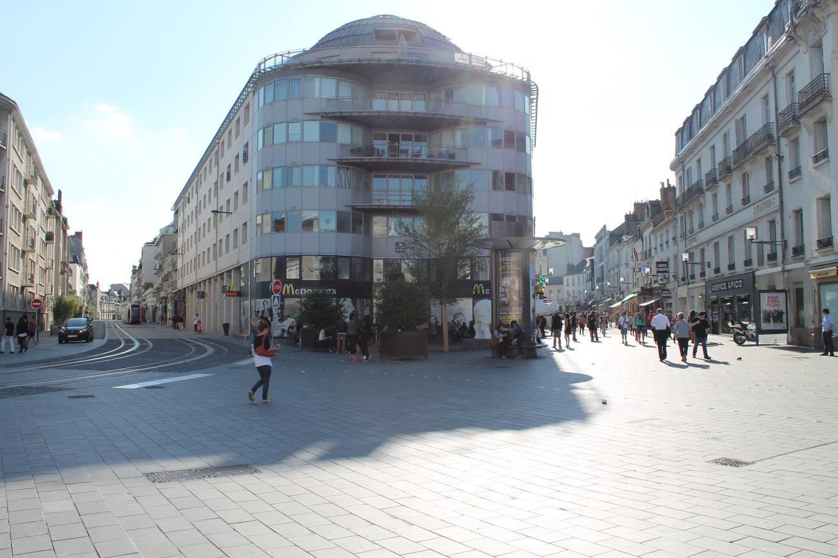
CASE STUDY
TOURS – SET 1
RUE CHARLLES GILES – RUE DE BORDEAUX

Slide 8
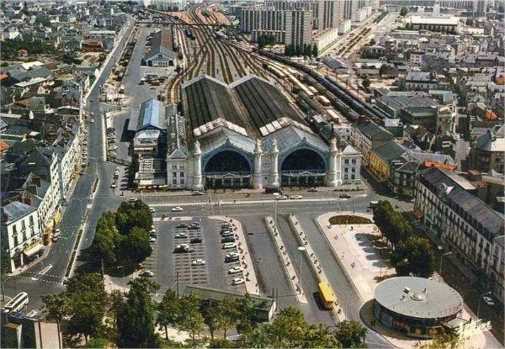
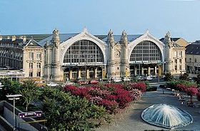
CASE STUDY
TOURS – SET I
GARE DE TOURS

Slide 9
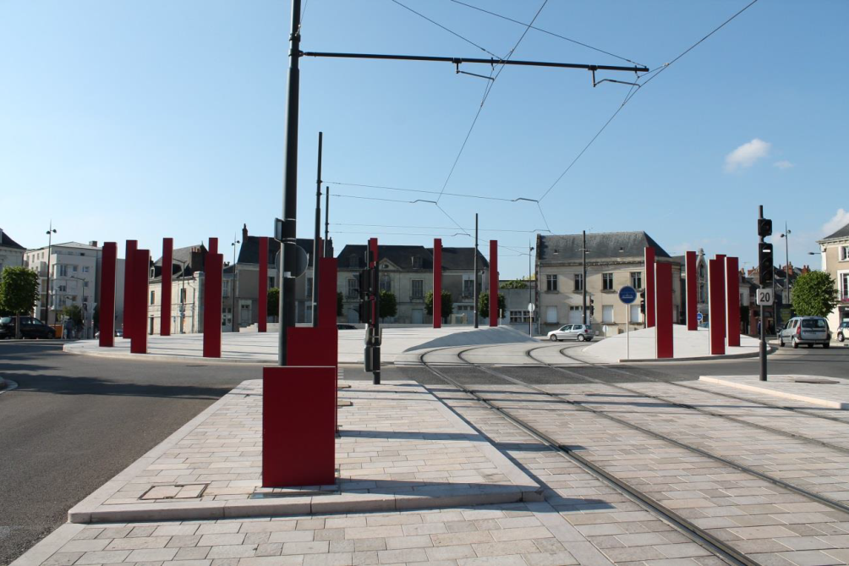
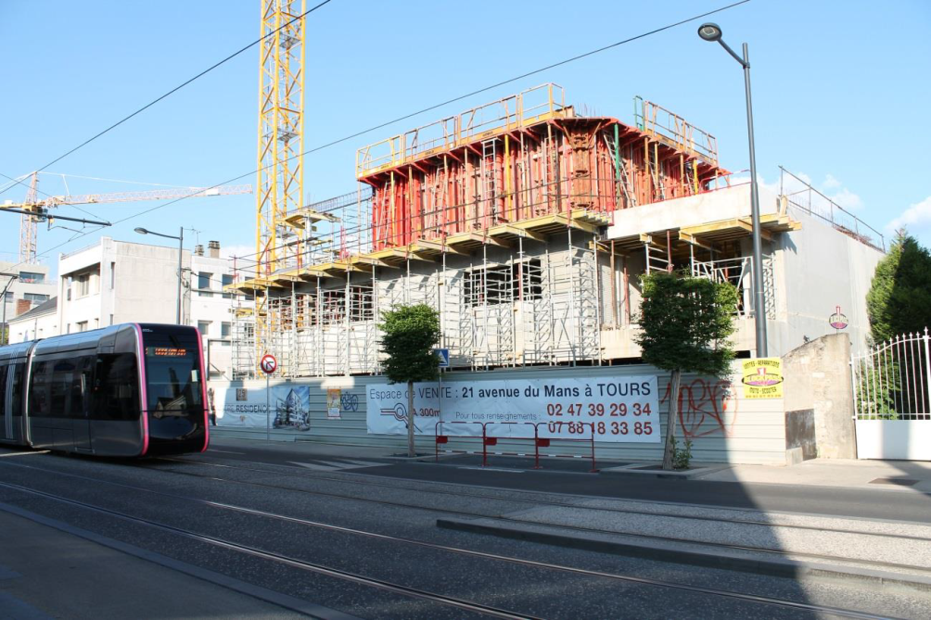
CASE STUDY
TOURS – SET II
NORTH PART OF THE CITY

Slide 10
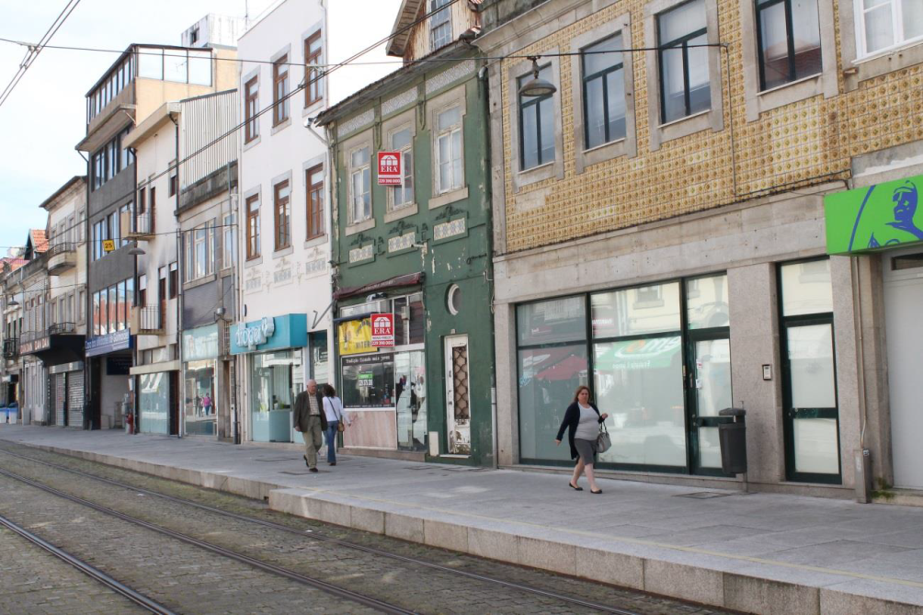
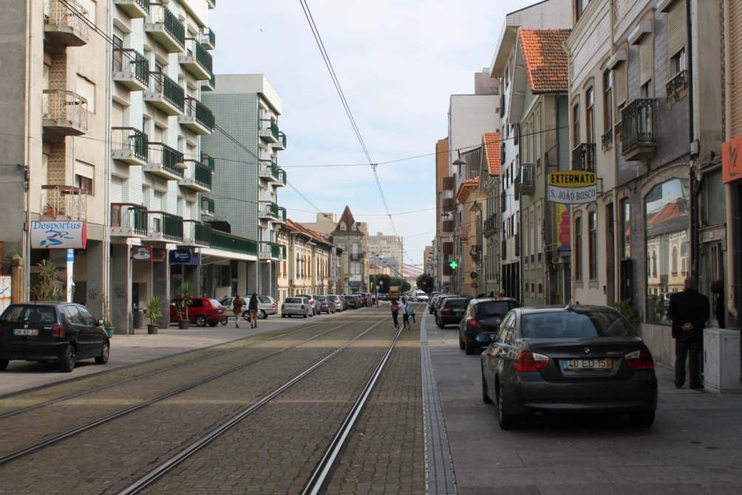
CASE STUDY
PORTO – SET I
MATOSINHOS – RUA BRITO CAPELO

Slide 11
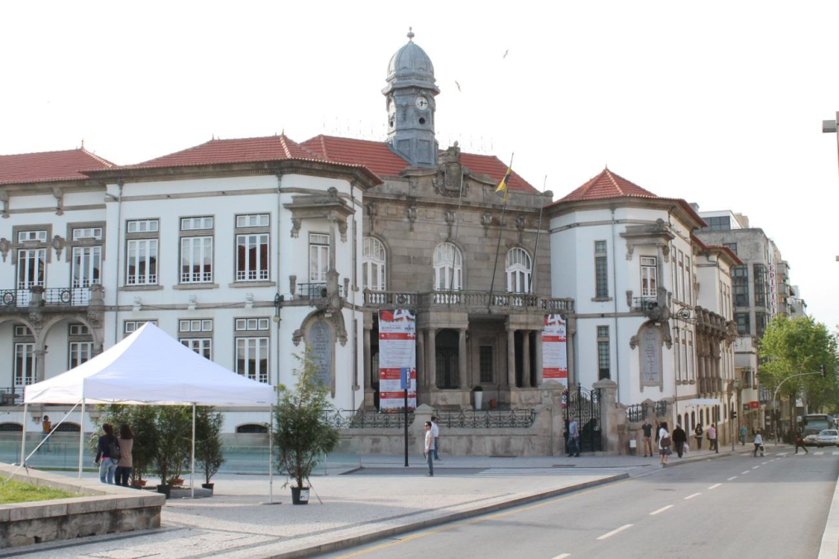
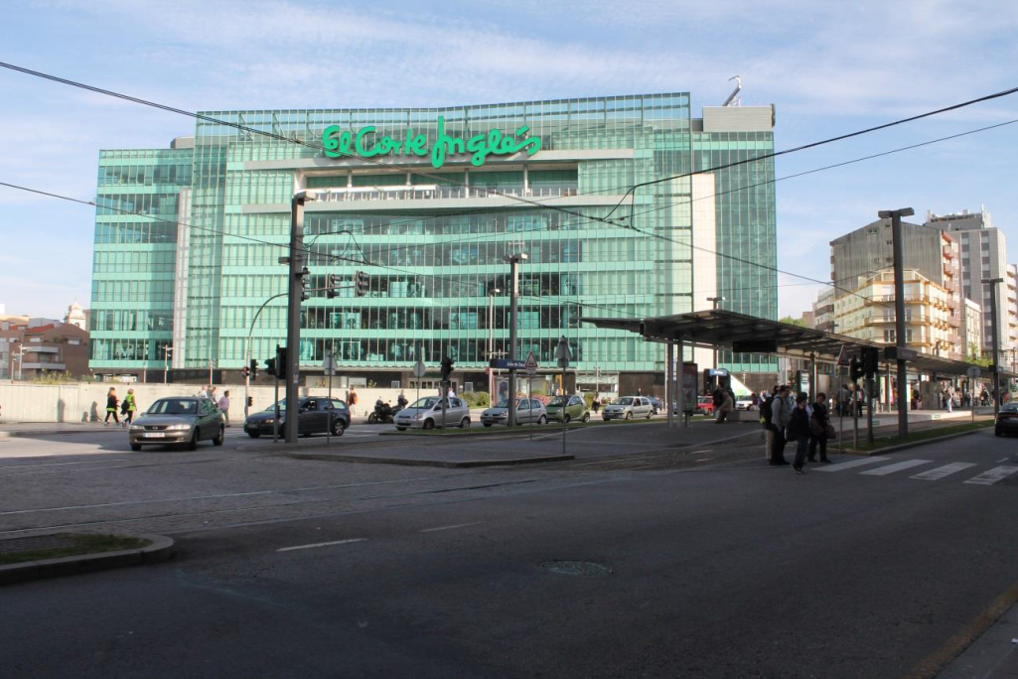
CASE STUDY
PORTO – SET II
VILA NOVA DE GAIA – AVENIDA DA REPÚBLICA

Slide 12
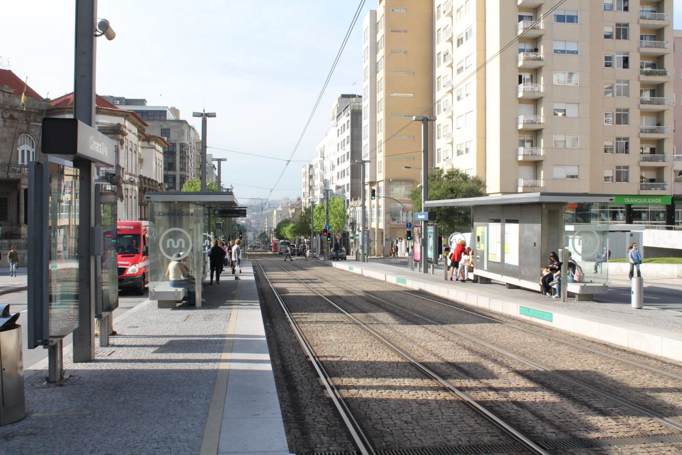
CASE STUDY
PORTO – SET II
VILA NOVA DE GAIA – AVENIDA DA REPÚBLICA

Slide 13
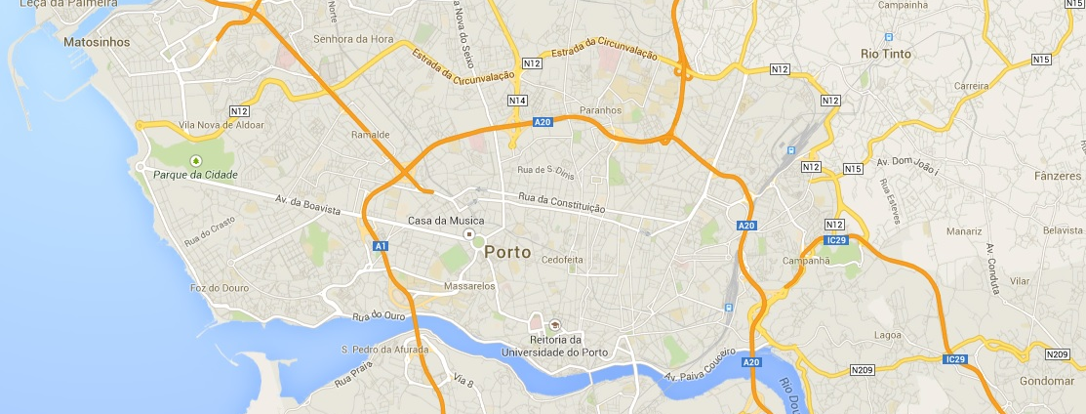
CASE STUDY
PORTO – SET III
PORTO - ASPRELA

Slide 14
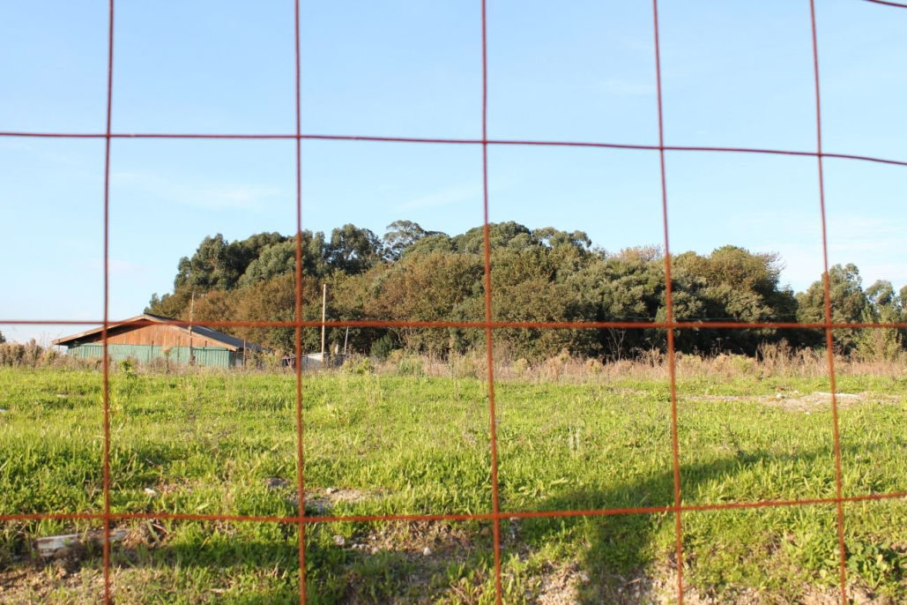
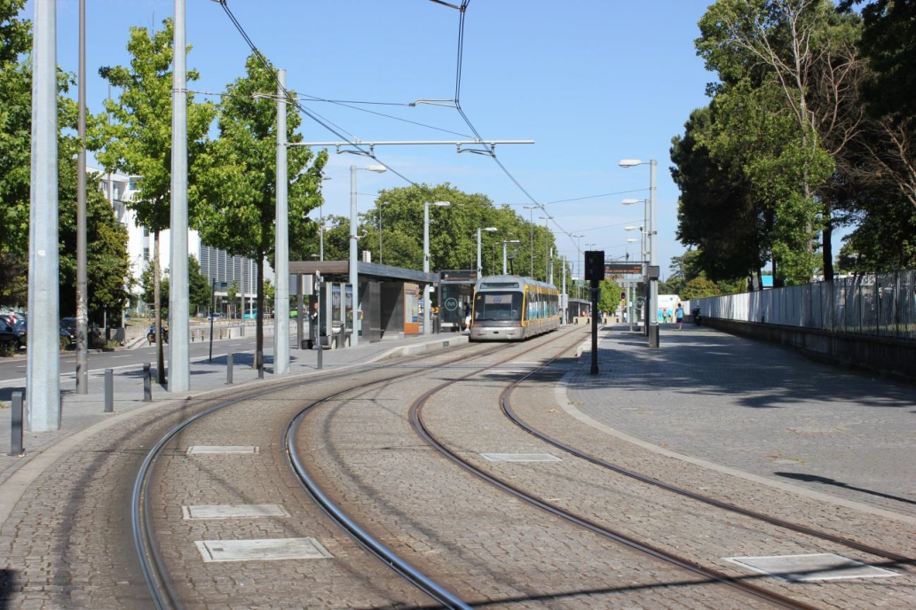
CASE STUDY
PORTO – SET III
PORTO - ASPRELA

Slide 15
URBAN ISSUES ON THE LAYOUT OF THE NEW LIGHT RAIL SYSTEMS
ANALYSIS IN THE EUROPEAN SPACE
CONCLUSIONS

Slide 16
URBAN ISSUES ON THE LAYOUT OF THE NEW LIGHT RAIL SYSTEMS
ANALYSIS IN THE EUROPEAN SPACE
QUESTIONS & ANSWERS
THANK YOU FOR YOUR ATTENTION
João Eduardo da Silva Teixeira
Tours - 2014

