Slide 1
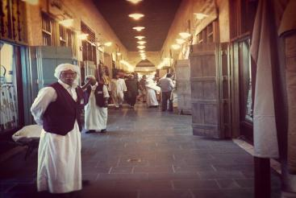


Social Sustainability and the Heritage-led Project
M2RI
International Master in Regional and Urban Planning
Master Dissertation
Prepared by: Diaa Noufal
Supervisor: Dr. Laura Verdelli
Souq Waqif – Doha as a Case Study

Slide 2
Contents
Introduction
Theoretical Background
The Case of Doha City
Souq Waqif
The Survey
Results and Recommendations

Slide 3
Introduction
The Research Background
The Case of Doha City
Souq Waqif
The Research Question

Slide 4
Theoretical Background
Definitions
Built Heritage
Conservation
Cities in the Middle East
Characteristics and Evolution
Historical Districts
In Search for an approach
Value
SIA
Regeneration
Planning
Sustainability
SLCA
Evaluation & Monitoring
Social Sustainability Indicators
Tourist Approach

Slide 5
Definitions
Feilden (2003) definition of an historical building
UNESCO (1972) has segregated the “Cultural Heritage” into three groups:
  Monuments
  Group of Buildings
  Sites
Notes:
Feilden (2003) an historic building is one that gives us a sense of wonder and makes us want to know more about the people and culture that produced it. It has architectural, aesthetic, historic, documentary, archaeological, economic, social and even political and spiritual or symbolic values; but the first impact is always emotional, for it is a symbol of our cultural identity and continuity—a part of our heritage.
(UNESCO 1972):
monuments: architectural works, works of monumental sculpture and painting, elements or structures of an archaeological nature, inscriptions, cave dwellings and combinations of features, which are of outstanding universal value from the point of view of history, art or science;
groups of buildings: groups of separate or connected buildings which, because of their architecture, their homogeneity or their place in the landscape, are of outstanding universal value from the point of view of history, art or science;
sites: works of man or the combined works of nature and man, and areas including archaeological sites which are of outstanding universal value from the historical, aesthetic, ethnological or anthropological point of view.

Slide 6
Definitions
Conservation: safeguarding(Nara Document 1993)
Regeneration: comprehensive resolution for urban problems (Roberts & Sykes 2000)
Rehabilitation: complete upgrading (Wilson 1980)
Degradation: Reasons are either economic, social, psychological, political or natural (UNESCO 2004b); English Heritage
Usages Notes
Notes:
Conservation as defined by ‘The Nara Document on Authenticity’ represents all efforts designed to understand cultural heritage, know its history and meaning, ensure its material safeguard and, as required, its presentation, restoration and enhancement.
Regeneration: “a comprehensive and integrated vision and action which leads to the resolution of urban problems and which seeks to bring about a lasting improvement in the economic, physical, social and environmental conditions of an area that has been subject to change”
According to Wilson (1980) “Rehabilitation” means the complete upgrading of a built structure. It may include “restoration” when this involves restoring the original intent and design of the building, “recycling” when an existing structure is adapted for a new purpose and most “heritage” activities It may also include “renovation” if routine or minor maintenance and repair work are not included, and “retrofitting” if the buildings systems are brought up to higher standards of energy consumption efficiency, security, and fire protection. The term “repair” should not be used because it covers too broad a range of activities, nor should the terms “modernization” and “redevelopment” because projects involving them may also include significant amounts of new building. These concepts apply to both residential and non-residential buildings.
Wilson AH (1980) The Rehabilitation of Buildings: Report on the Second Canadian Building Congress. National Research Council of Canada
Degradation: Reasons are either economic, social, psychological, political or natural (UNESCO 2004b)
In the previous sections of this chapter we highlighted some of the terminology as per observations of available resources. For the purpose of this research we will assume that all three types of developments illustrated above are producing similar social effects and thus relevant social indicators from literature will be accrued later through expert discussions for the case study in hand (Souq Waqif).

Slide 7
Middle East Cities
Rich in Urban Heritage
Specific economic and political environment
Rapid urban change affects the historical nuclei
The New – Old binary / Westernizing
No culture of planning – dictatorial, normative.
Notes:
The heritage in the Middle Eastern cities (particularly the Arab World) is rich and diverse due to the long process of evolution it took through thousands of years by numerous civilizations.
the Arab World not only shares a common history because of the ebb and flow of civilizations within its geographical range, but also because of its geopolitical position and the recent history from Ottoman dominance to colonial encounters, and to post-colonial adjustments and transformations in a changing world
(Hassan et al 2008) “Sadly, many of the development projects, especially those related to tourism, project and represent the past in Arab countries in Western terms, especially in the way the past is hardly connected with the present and the cultures of living communities.”
Shechter and Yacobi (2005) argue that different urban spaces have represented binary oppositions: the ‘‘old city’’ stood for ‘‘tradition’’ and ‘‘local’’ life, the new public buildings, commercial centers, and residential neighborhoods created an urban iconography of the imported “modern”.

Slide 8
Social Sustainability
Sustainability and the built heritage (Rodwell 2007), (UNESCO 2005)
Social sustainability is often treated as the poor cousin in evaluating the success or failure of urban renewal projects. (Colantonio 2011)
It is necessary to develop greater linkage between the social and environmental pillars. (Murphy 2012)
Socially Sustainable Development: compatible with harmonious evolution of civil society, fostering an environment conducive to the compatible cohabitation of culturally and socially diverse groups while at the same time encouraging social integration, with improvements in the quality of life for all segments of the population. (Polster & Stern 2000)
Notes:
Rodwell (2007), argues that neither architectural conservation nor townscape is founded upon a preoccupation with sustainability. However, both have the potential to make a significant contribution to it. An historic building or district can be a tangible symbol of a community's interest in honoring its heritage, valuing its character and sense of place, getting the most out of prior investments in infrastructure and development, and encouraging growth in already developed areas.
The protection and conservation of the natural and cultural heritage are a significant contribution to sustainable development. (UNESCO 2005)
(Polese and Stren 2000) Development (and/or growth) that is compatible with harmonious evolution of civil society, fostering an environment conducive to the compatible cohabitation of culturally and socially diverse groups while at the same time encouraging social integration, with improvements in the quality of life for all segments of the population

Slide 9
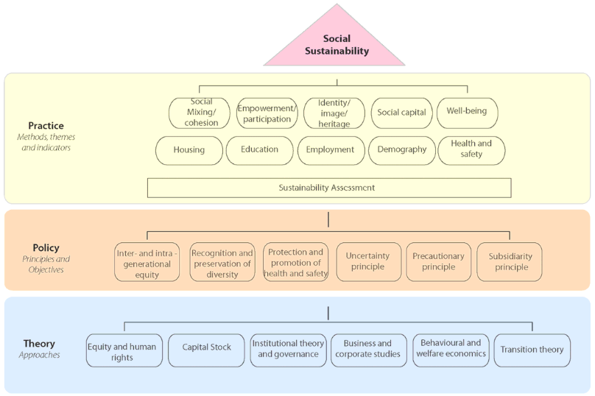
Social Sustainability Assessment Framework (Colantonio & Dixon 2009)
Notes:
Colantonio and Dixon (2009): the following 10 social sustainability dimensions and policy areas:
Demographic change (ageing, migration and mobility);
Education and skills;
Employment;
Health and safety;
Housing and environmental health;
Identity, sense of place and culture;
Participation, empowerment and access;
Social capital;
Social mixing and cohesion; and,
Well-being, happiness and quality of life.

Slide 10
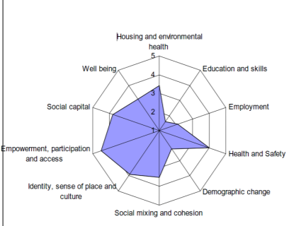
Social Sustainability Themes
Demographic change (ageing, migration and mobility);
Education and skills;
Employment;
Health and safety;
Housing and environmental health;
Identity, sense of place and culture;
Participation, empowerment and access;
Social capital;
Social mixing and cohesion; and,
Well-being, happiness and quality of life.
Notes:
Colantonio and Dixon (2009): the following 10 social sustainability dimensions and policy areas:
Demographic change (ageing, migration and mobility);
Education and skills;
Employment;
Health and safety;
Housing and environmental health;
Identity, sense of place and culture;
Participation, empowerment and access;
Social capital;
Social mixing and cohesion; and,
Well-being, happiness and quality of life.

Slide 11
Social Indicators for Heritage-Led Projects (Yung et al. 2011)
Provide physical evidence of the past
Provide symbolic meanings from symbols, spirit, emotions and past events
Enhance sense of place
Enrich collective memory
Enhance cultural identity that brings a sense of pride
Satisfaction of current use which can enhance the heritage value of the place
Promote local culture and uniqueness
Enhance self-esteem to improve social well-being
Passage of interaction
Educate present and future generations
Maintenance of the physical condition
Enhance city livability
Illustrate that economic and scientific development took place in the district
Facilitate social inclusion
Enhance cultural diversity
Enhance community interaction and social cohesion
Inform professionals about the occupants’ perception
Accessibility of use
Developing skills in heritage restoration and related activities
Provide public involvement opportunity in decision making
Provide partnership opportunity to develop the project
Notes:
For the purpose of this research, we will try to mimic the same approach developed by Yung et al. (2010) aiming to come up with relevant indicators. Though we believe they fit into our case study, it is found that these indicators are not well comprehended by space users, especially with language barrier existed for many of them.
Therefore, we based our indicators on the long list of indicators developed by Colantonio and Dixon (2009) based on the long list. (Please refer to the Appendix 7.3).

Slide 12
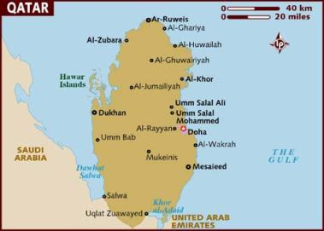
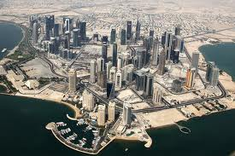
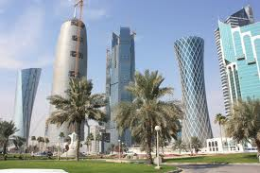
Doha City

Slide 13
Souq Waqif

Slide 14
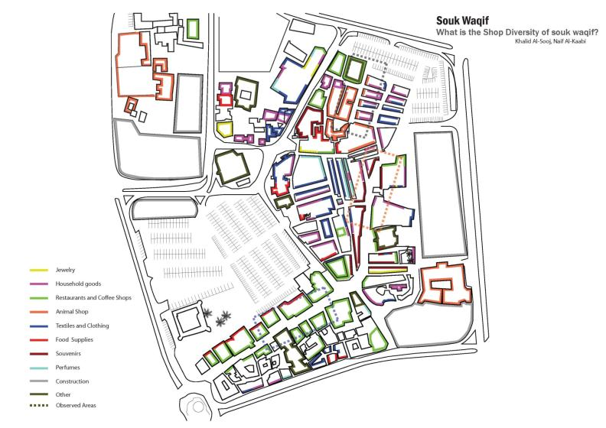
Souq Waqif

Slide 15
The Survey
First Stage (Proofing)
First Interviews with Experts
Mini / Test Survey (10 persons)
Second Stage (Conducting)
Improved Survey
Guided Questionnaire with Experts
Analysis
Analysing Descriptieve Answers
Analysing Preferences
Summarising Results
Online Questionnaire
Notes:
The following points summarize a number of difficulties that obstructed our research:
the novelty of the topic;
the special case of Doha society and Souq Waqif;
the lack of data on topics related to social effects of the project;
the time constrain;
lack of resources; and
unwillingness to share information by stakeholders
test survey had the following objectives:
To test the level of respondent comprehension;
To test the relevance and validity of the questions to the context of Souq Waqif;
To test the best flow of questions;
To test the wording and translation (English / Arabic); and
To register notes on suggestions regarding the raised points

Slide 16
The Survey
General Questions
Open Ended for Visitors / Workers / Tenants
27 Likert-scaled statements

Slide 17
Results
Age Histogram

Slide 18
Results
Social Experience Indicators – by Type of Users

Slide 19
Results
Social Experience Indicators – by Local / non Local

Slide 20
Results
Sense of pride and sense of place by different types of users

Slide 21
Results
# | Code | Question | Result (in descending order)
1 | 5.04 | SW is a suitable representation of cultural heritage of Qatar | 4.52
2 | 5.01 | Souq Waqif is safe area for children and pedestrian friendly | 4.36
3 | 5.21 | SW contributes to the night life in the community | 4.35
4 | 5.05 | SW has helped Qatar presenting its authentic image | 4.25
5 | 5.25 | You are generally satisfied with the social effect of Souq Waqif | 4.18
6 | 5.10 | SW is clean with minimum noise, air and visual pollution. | 4.16
7 | 5.17 | SW is suitable for all income groups | 4.12
8 | 5.02 | SW is a place for suitable social interaction | 4.11
9 | 5.03 | SW respects the cultural diversity of visitors | 4.08
10 | 5.07 | Developing SW has helped creating new jobs | 3.97
11 | 5.20 | SW contributes to community sense of pride | 3.95
12 | 5.22 | SW provides suitable space for community events and celebrations | 3.93
13 | 5.23 | SW is passing the history knowledge to the next generation. | 3.92

Slide 22
Results
# | Code | Question | Result (in descending order)
14 | 5.16 | SW is a place for family entertainment | 3.85
15 | 5.06 | SW is a place that enhances cultural creativity and promotes inter-cultural understanding | 3.84
16 | 5.11 | SW encourages walking / cycling and low car dependency. | 3.82
17 | 5.19 | SW contributes to community sense of place and identity | 3.79
18 | 5.08 | SW is easily accessed from different parts of the city | 3.77
19 | 5.18 | SW contributes to women participation in the society | 3.68
20 | 5.27 | Souq Waqif buildings, design and layout fits well with the surrounding nighbourhoods | 3.68
21 | 5.09 | SW is located close to different services and amenities (healthcare, educational, entertainment, shopping, leisure, etc.) | 3.59
22 | 5.15 | SW is equipped for people with special mobility requirements / handicapped | 3.55
23 | 5.13 | SW provides street furniture and public art. | 3.53
24 | 5.14 | You can raise your concerns and complaints about SW easily. | 3.29
25 | 5.24 | Signs on history of SW are provided | 3.26
26 | 5.26 | You can tell which are the original buildings of the souq and those that are newly built | 3.00
27 | 5.12 | SW provides greenery and green space. | 2.39

Slide 23
Results
Planning for sustainability
Expected Social Impacts
Contra-Gentrification
A Top-Down approach
Authentic vs. Revitalized
The Souq as a Generator for Creative Activities
Negative Impacts of Souq Waqif
Extended Effect of Souq Waqif

Slide 24
Interpretation of the Results
Though not planned, Souq Waqif has achieved some level of socially sustainable development indicators.
Souq Waqif has contributed to the Social sustainability of the community and it is expected to continue to do so.
Souq Waqif has helped creating a ‘historical theme’ of the inner-city of Doha.
Social demand of such developments in the city is yet under-saturated.
Nevertheless, Souq Waqif fails to address some social problems such as participation and cohesion.

Slide 25
Recommendations
Planning for social sustainability
Recommendations for the Management
Avoiding decay
  Preserving the space activities
  Enhancing social cohesion
  Connecting with surrounding projects
  Upgrading quality of space and service
  Preserving the competitive edge
  Refine management approaches

Slide 26
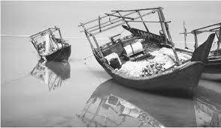
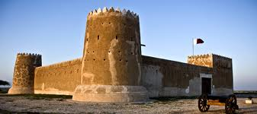
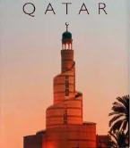
Thank You

