Slide 1




cd
FEASIBILITY STUDY FOR USING FROM SOLAR ENERGY IN PUBLIC TRANSPORTATION ALONG WITH THE URBAN SUSTAINABILITY
(CASE STYDY: TEHRAN)
ba
Presented by:
Soroush ARJOMANDZADEH
THESIS SUPERVISOR:
Maizia MINDJID
Master in Planning and Sustainability: Urban & Regional Planning
UNIVERSITY FRANÇOIS RABELAIS OF TOURS
POLYTECHNIC SCHOOL - PLANNING DEPARTMENT

Slide 2
PREFACE
PROBLEM DEFINITION
RESEARCH QUESTION
RESEARCH AIMS
LITERATURE RESEARCH
METHODOLOGY
HYPOTHESES
CONCLUSION

Slide 3
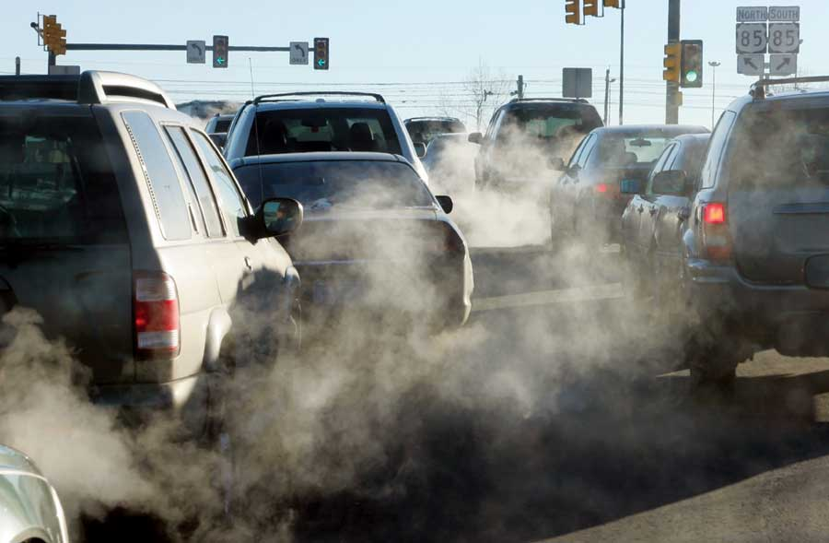
PREFACE
PROBLEM DEFINITION
RESEARCH QUESTION
RESEARCH AIMS
LITERATURE RESEARCH
METHODOLOGY
HYPOTHESES
CONCLUSION
Irregular energy consumption in most countries, world's attention to energy consumption improvement as well as environmental preservation have caused many countries to conduct research and studies for energy consumption improvement and replacement of oil products. This issue is developing and on the other hand, transportation –especially in populous cities – is known as the most urban challenge subject in last decades.

Slide 4
PREFACE
PROBLEM DEFINITION
RESEARCH QUESTION
RESEARCH AIMS
LITERATURE RESEARCH
METHODOLOGY
HYPOTHESES
CONCLUSION
The fact is that, public transit is not rendered appropriately and it will turn into a crisis in the near future if no preventive or corrective measure is taken. That is why developed and developing countries have no option other than moving toward a sustainable public transportation management.

Slide 5
PREFACE
PROBLEM DEFINITION
RESEARCH QUESTION
RESEARCH AIMS
LITERATURE RESEARCH
METHODOLOGY
HYPOTHESES
CONCLUSION
The importance and necessity of conducting this kind of study will be defined with emphasis on three subjects that the present study has been conducted in order to answer these three Questions:
1. To what extent, using from renewable energies with emphasis on the Solar Energy in the Urban Transportation Sector can lead to Urban Sustainability?
2. How and what are the potentials of Iran, with emphasis on the use from the Solar Energy for the Urban Applications?
3. Will use from the Solar Energy in the Urban Transportation, help to Sustainability of City of Tehran?

Slide 6
PREFACE
PROBLEM DEFINITION
RESEARCH QUESTION
RESEARCH AIMS
LITERATURE RESEARCH
METHODOLOGY
HYPOTHESES
CONCLUSION
The present study tries to answer this question: If using from the Solar Energy as a Renewable Source of Energy in the urban transportation system, can lead to sustainability of the City?

Slide 7
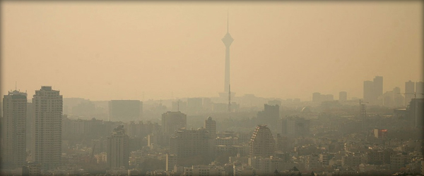
TEHRAN AIR POLLUTION
PREFACE
PROBLEM DEFINITION
RESEARCH QUESTION
RESEARCH AIMS
LITERATURE RESEARCH
METHODOLOGY
HYPOTHESES
CONCLUSION
Air pollution derived from fossil fuels of the automotive in Iran, especially in metropolises or big cities like Tehran is under critic and dangerous conditions. Air pollution in Tehran has reached to a high amount in many cases which resulted in a dangerous status reported by environment official and healthcare managers and they warn seriously for not going out from home.
For instance, during the recent years, elementary and secondary schools were closed for a few days for many times and the whole city organizations were also forced closure in emergency cases.

Slide 8
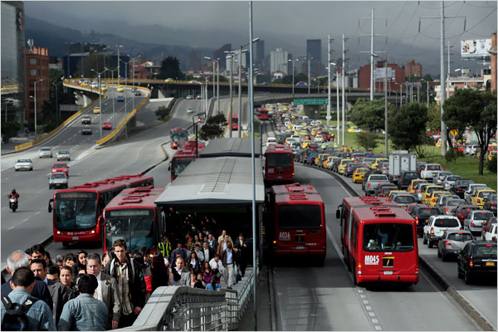
BRT LINES IN TEHRAN
PREFACE
PROBLEM DEFINITION
RESEARCH QUESTION
RESEARCH AIMS
LITERATURE RESEARCH
METHODOLOGY
HYPOTHESES
CONCLUSION
Bus rapid transit system, is the beginning of changing of view and making big revolution in urban traffic and transportation management structure. According to studies, 10 main corridors of city are chosen for making rapid bus system and 6 lines are established, until now there is 164 KM bus special line in Tehran.

Slide 9
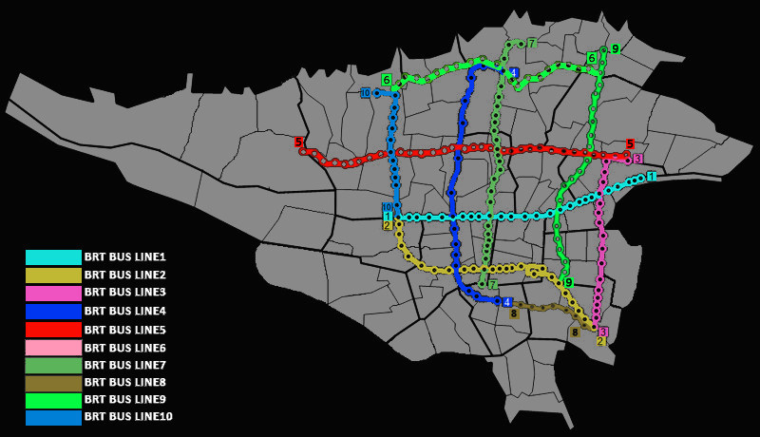
BRT LINES IN TEHRAN
PREFACE
PROBLEM DEFINITION
RESEARCH QUESTION
RESEARCH AIMS
LITERATURE RESEARCH
METHODOLOGY
HYPOTHESES
CONCLUSION
But for safe and easy plying of public vehicles in Tehran, we need to 200KM special line. The putting into operation of these 6 lines of BRT by 1100 buses.

Slide 10
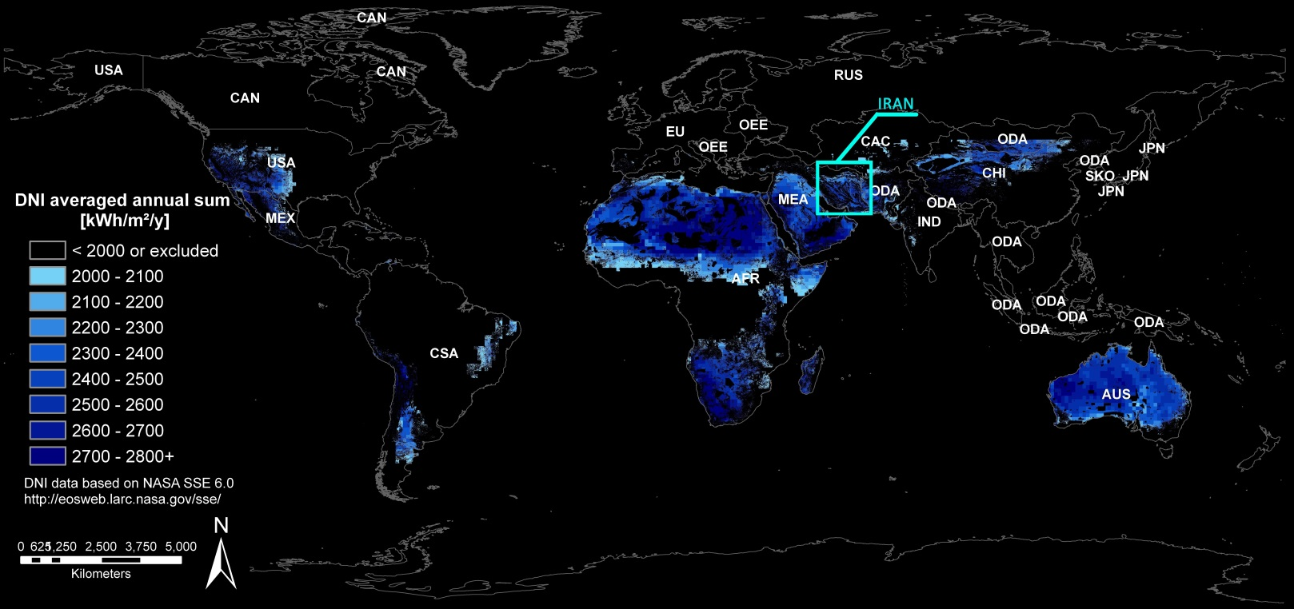
SOLAR ENERGY IN IRAN
PREFACE
PROBLEM DEFINITION
RESEARCH QUESTION
RESEARCH AIMS
LITERATURE RESEARCH
METHODOLOGY
HYPOTHESES
CONCLUSION
Iran with about 300 sunny days per year is of the best countries of the world to produce potential solar energy, which is more than 6 times of European countries. Also, annual solar radiation in central areas of Iran is 7.7 h/day or 2800 h/year. Therefore, regarding this, the average solar radiation is about 5 kwh/days while the sequential cloudy days per year in our country are less than 5 days/year.

Slide 11
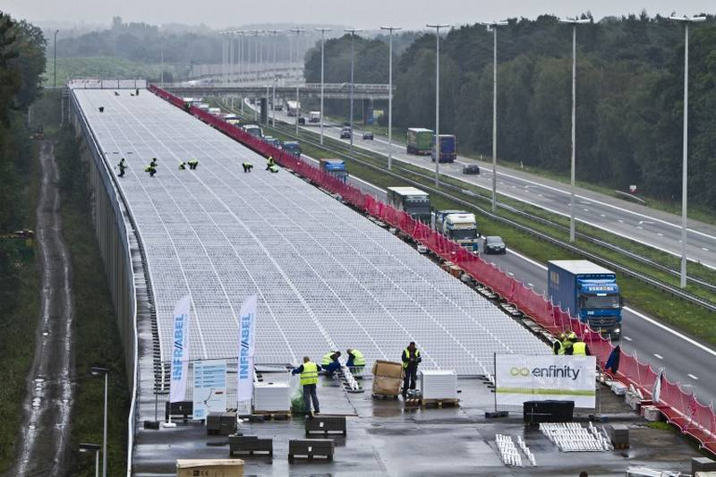
Estimation of Technical Potential to Use Solar Panels in Tehran Public Transportation System
PREFACE
PROBLEM DEFINITION
RESEARCH QUESTION
RESEARCH AIMS
LITERATURE RESEARCH
METHODOLOGY
HYPOTHESES
CONCLUSION
Pointing out the experiences of other countries to apply solar power plants, BRT line of Tehran which is more than 60 KM can be covered by solar panels to generate electricity in the first step to decrease the pollutants from city buses fuels and decrease their noise and acoustic pollutions and a sustained environment and also to help public transportation system of Tehran.
One of the experiences of the case is the green train of Amsterdam-Paris which has recently started to work. On this path, the 3.6 KM tunnel which passes from Antrope in the north of Belgium, has been covered with 16000 solar panels which is 50000 Sq. M area (about 5 football grounds).

Slide 12
PREFACE
PROBLEM DEFINITION
RESEARCH QUESTION
RESEARCH AIMS
LITERATURE RESEARCH
METHODOLOGY
HYPOTHESES
CONCLUSION
The mentioned assumptions could be analysed according to following algorithm. The Toster system Program could be run in Matlab software to calculate the data. Different scenarios will occur as the length of BRT line covered by solar panel or velocity change:

Slide 13
Comprehensive Data
PREFACE
PROBLEM DEFINITION
RESEARCH QUESTION
RESEARCH AIMS
LITERATURE RESEARCH
METHODOLOGY
HYPOTHESES
CONCLUSION
Regarding to all information’s and mentions not in this paper we can use follow supposes:
1. The total length of BRT line bus in Tehran : 164 km
2. Normal width of BRT line bus : 8 m
3. The output power in the year for 1 m^2 solar panel : 140 kwh /year
4. The rate of electricity consumption for an electric bus : 66 kwh /100 km
5.Total number of diesel buses in Tehran : 3547
6. Total number of BRT buses in Tehran : 1100
7. BRT bus speed : between 20 ~ 50 km/h
8. The average of bus speed : 35 km/h
9. The time of moving buses per day : 15 h (6 am ~ 9pm)
10. Average moving distance per day for each bus : 500 km
11. Fuel consumption of buses: 0.3 Liter/ km

Slide 14
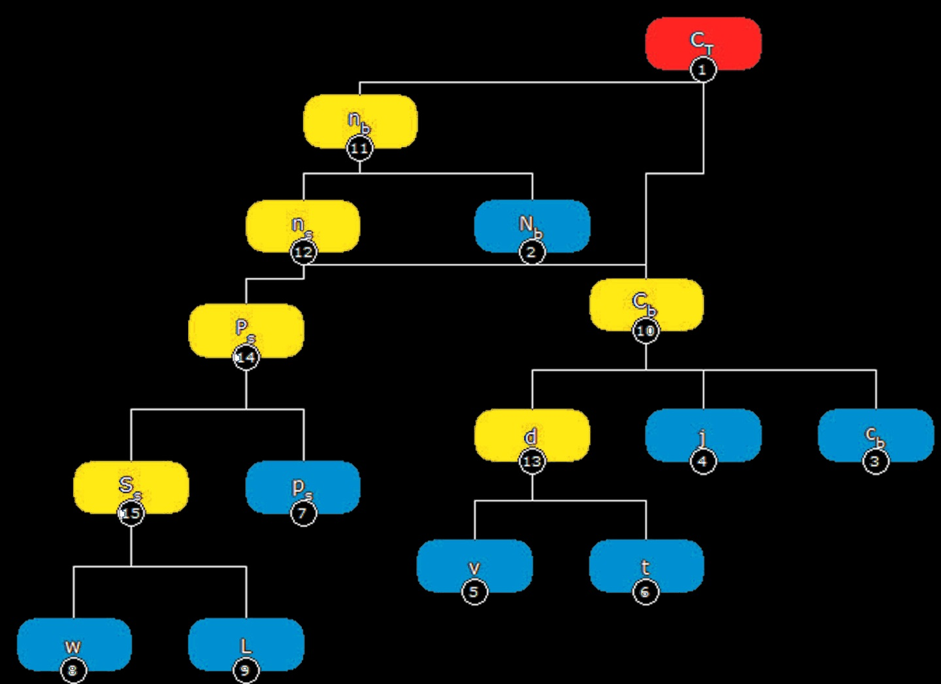
PREFACE
PROBLEM DEFINITION
RESEARCH QUESTION
RESEARCH AIMS
LITERATURE RESEARCH
METHODOLOGY
HYPOTHESES
CONCLUSION

Slide 15
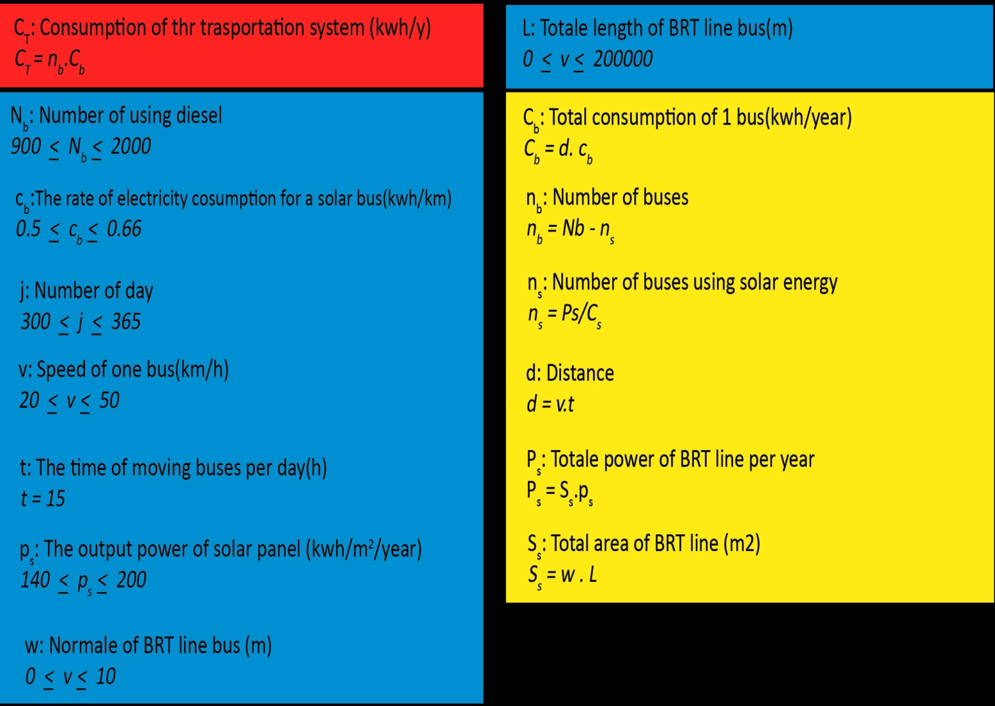
PREFACE
PROBLEM DEFINITION
RESEARCH QUESTION
RESEARCH AIMS
LITERATURE RESEARCH
METHODOLOGY
HYPOTHESES
CONCLUSION

Slide 16
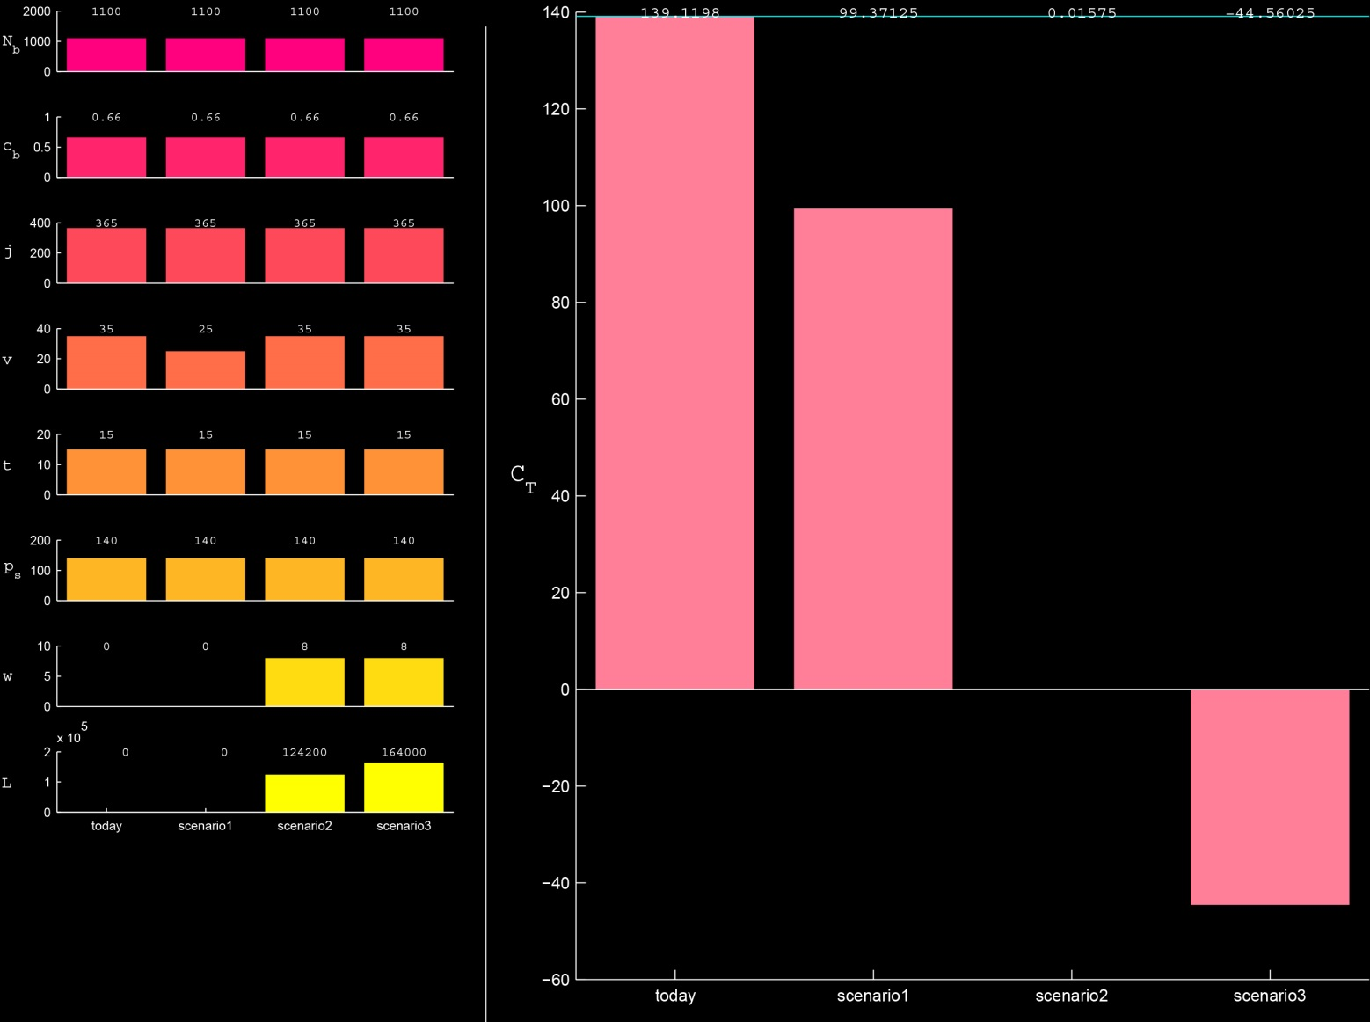
PREFACE
PROBLEM DEFINITION
RESEARCH QUESTION
RESEARCH AIMS
LITERATURE RESEARCH
METHODOLOGY
HYPOTHESES
CONCLUSION
Today:
If all the BRT Buses are electrified, the energy consumption will be 1391198KW per year which is quite high.
Hypotheses 2:
If 124KMof BRT line is covered by solar panels all amount of electric energy needed by Buses will be supplied.
Hypotheses 1:
As velocity rises while all other variants are kept constant, the energy consumption decreases but the transporting activities slow down which causes further problems in transforming passengers.
Hypotheses 3:
According to the diagram If total length of BRT line(164km) is covered with solar panels, all amount of electric energy needed by Buses will be supplied and considerable amount of generated electric power remains.

Slide 17
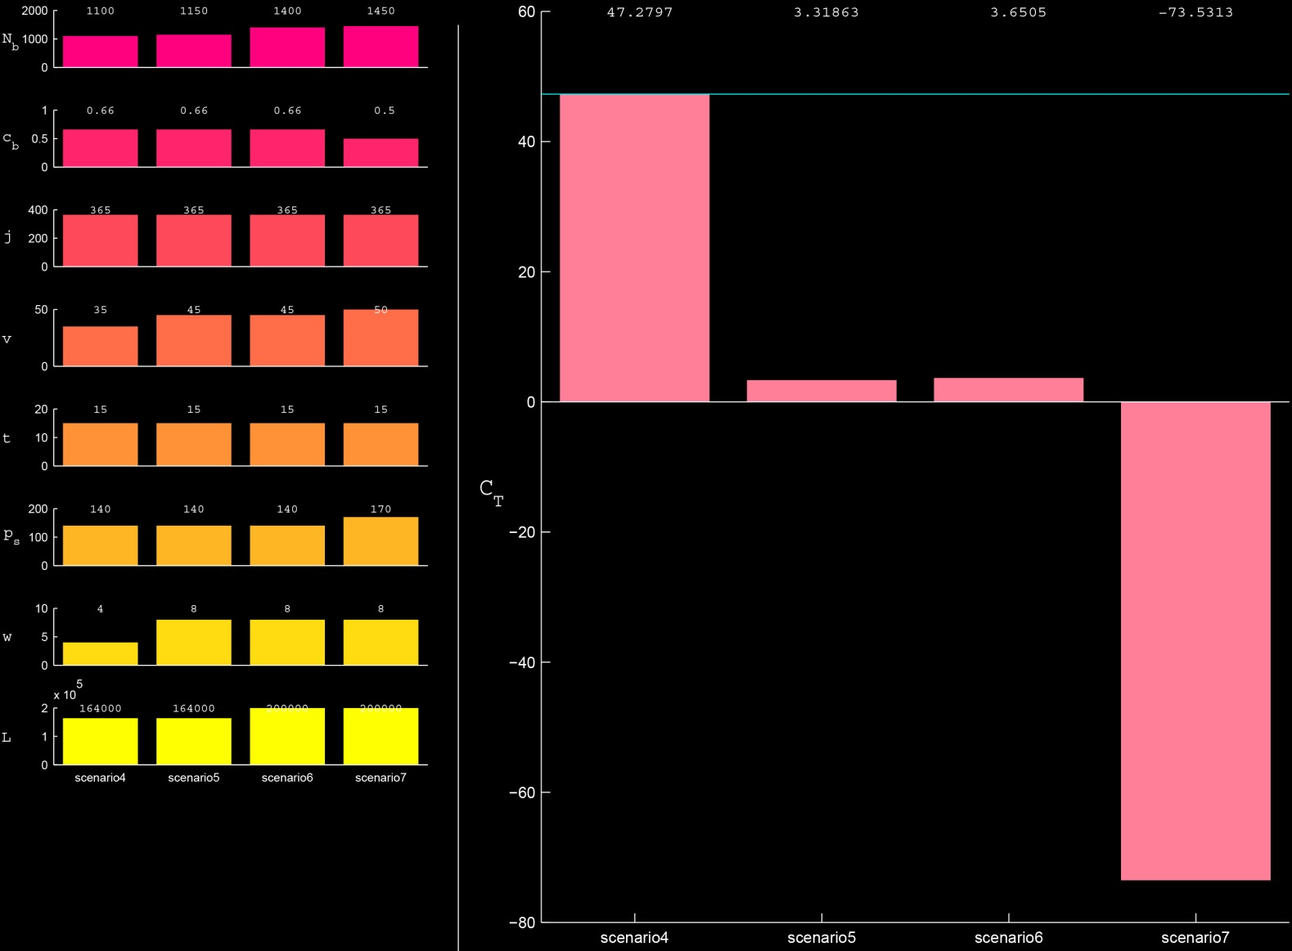
PREFACE
PROBLEM DEFINITION
RESEARCH QUESTION
RESEARCH AIMS
LITERATURE RESEARCH
METHODOLOGY
HYPOTHESES
CONCLUSION
Hypotheses 4:
If half width of BRT line (4m) is covered by solar panels, a considerable amount of electric energy needed by Buses will be supplied.
Hypotheses 6:
As the total bus line's length accomplished to 200km, if the total length is covered by solar panels, 1400 buses can be run with velocity of 45km/hr.
Hypotheses 5:
If total length of BRT line (164km) is covered by solar panels, it is possible to add 50 buses to current number of buses (1150buses) and raise the velocity up to 45 Km/hr.
Hypotheses 7:
If the buses and solar panel will be optimized efficiently in the future it can be possible to have 1450 buses with velocity of 50km/hr and remained significant extra generated electric power.

Slide 18
Estimation of Reduction of Air Pollution by using Solar Panel in Public Transportation in Tehran
PREFACE
PROBLEM DEFINITION
RESEARCH QUESTION
RESEARCH AIMS
LITERATURE RESEARCH
METHODOLOGY
HYPOTHESES
CONCLUSION
Title | Unit | Definition
R= 1- (P _{solar} / P _{diesel}) | [%] | Reduction of chemical pollution in public transportation
P _{diesel} = V _{diesel}. D | gr | diesel pollution variable
V _{diesel} | Gr/km | Substances Pollution Emissions
D | km | Distance
P _{solar} = P _{diesel} (T - ΔT) / P _{diesel} | gr | Pollution variable after adding solar panel
T | - | Total number of diesel Buses
ΔT | - | Number of Electric Buses
NO x | gr | NO x = (NO+NO2+NO3) Nitrogen oxides
CO | gr | Carbon monoxide

Slide 19
Emissions for Diesel bus:
Co = 3.1 gr V Co diesel =3.1 gr/km
Nox = 12.4 gr V Nox diesel = 12.4 gr/km
P= V. D
D = 1 km
The Emission of Carbon Monoxide for each Bus: 500 * 3.1 =1550 gr/day
The Emission of Nitrogen Oxides for each Bus: 500 * 12.4= 6200 gr/day
As a bus travel 500 kilometre, 1.7 ton Co and 6.8 ton Nox emitted to the air.
Reduction of Diesel bus:
R Co = 1 - (P Co solar/ P Co diesel)*100
R Co =1- (2447 * 3.1/ 3547 * 3.1) * 100 = = %31
R Nox = 1 - (P Nox solar/ P Nox diesel)*100
R Nox = 1 - (2447 * 12.4 / 3547 * 12.4) * 100 =%31
PREFACE
PROBLEM DEFINITION
RESEARCH QUESTION
RESEARCH AIMS
LITERATURE RESEARCH
METHODOLOGY
HYPOTHESES
CONCLUSION
P Co diesel = 3.1 gr/km, P Nox diesel = 12.4 gr/km

Slide 20
All mentioned above leads us to the conclusion that using solar panels in BRT lines reduces the annual fuel consumption of 60 million litters. As a result the two air pollutant indexes of Co and Nox will be decreased as 2000ton and 8000 ton respectively. It is a significant step for changing consumption pattern and using recycled energy instead of fossil fuel.
According to what is said, the important un sustainability measures for the environment are energy consumption, Air pollution, and destruction of the natural resources.
Totally, it can be said that sustainability factor for the transportation, includes the reduction of energy consumption, reduction of the environment destruction, increase in the social sustainability for access to the transportation system as well as improvement in the efficiency and performance along with the economic development.
Also with regard to the three defined levels about the sustainable transportation, namely environmental, social and economic levels, the present study emphasizes on the environmental dimension in order to reduce the pollutions resulted from the transportation sector by using from the renewable energies especially the solar energy.
With regard to the special situation of Iran and specially Tehran City in terms of its complexities, the challenges faced by the urban management and transportation sector and also proper use from the radiation of the Sun in this region, the emphasis of the present study is placed on the use from the Solar Energy as a proper pattern of the Renewable Energies in the Sustainable Urban Transportation.
All these can make the dream of having clean air come true and provide people with sustainable metropolises.
PREFACE
PROBLEM DEFINITION
RESEARCH QUESTION
RESEARCH AIMS
LITERATURE RESEARCH
METHODOLOGY
HYPOTHESES
CONCLUSION

Slide 21
THANK YOU FOR YOUR ATTENTION

